Slide 1

Chapter 5
Arrays
Copyright © 2016 Pearson, Inc. All rights reserved.

Slide 2
Learning Objectives
Introduction to Arrays
  Declaring and referencing arrays
  For-loops and arrays
  Arrays in memory
Arrays in Functions
  Arrays as function arguments, return values
Programming with Arrays
  Partially Filled Arrays, searching, sorting
Multidimensional Arrays

Slide 3
Introduction to Arrays
Array definition:
  A collection of data of same type
First "aggregate" data type
  Means "grouping"
  int, float, double, char are simple data types
Used for lists of like items
  Test scores, temperatures, names, etc.
  Avoids declaring multiple simple variables
  Can manipulate "list" as one entity

Slide 4
Declaring Arrays
Declare the array → allocates memory
int score[5];
  Declares array of 5 integers named "score"
  Similar to declaring five variables:
  int score[0], score[1], score[2], score[3], score[4]
Individual parts called many things:
  Indexed or subscripted variables
  "Elements" of the array
  Value in brackets called index or subscript
    Numbered from 0 to size - 1

Slide 5
Accessing Arrays
Access using index/subscript
  cout << score[3];
Note two uses of brackets:
  In declaration, specifies SIZE of array
  Anywhere else, specifies a subscript
Size, subscript need not be literal
  int score[MAX_SCORES];
  score[n+1] = 99;
    If n is 2, identical to: score[3]

Slide 6
Array Usage
Powerful storage mechanism
Can issue command like:
  "Do this to i^{th} indexed variable"
  where i is computed by program
  "Display all elements of array score"
  "Fill elements of array score from user input"
  "Find highest value in array score"
  "Find lowest value in array score"

Slide 7
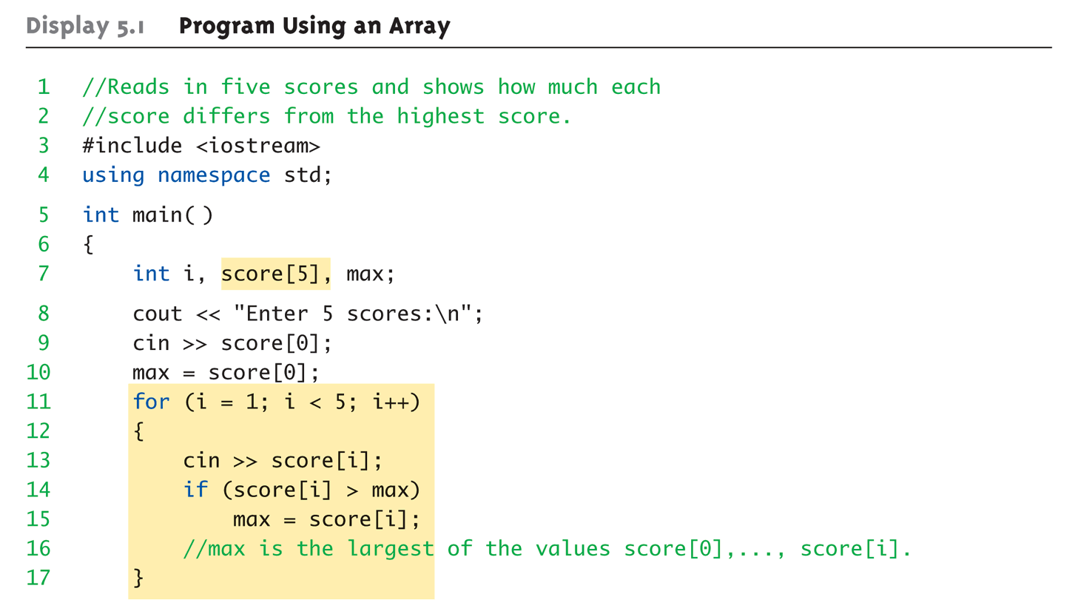
Array Program Example:
Display 5.1 Program Using an Array (1 of 2)

Slide 8
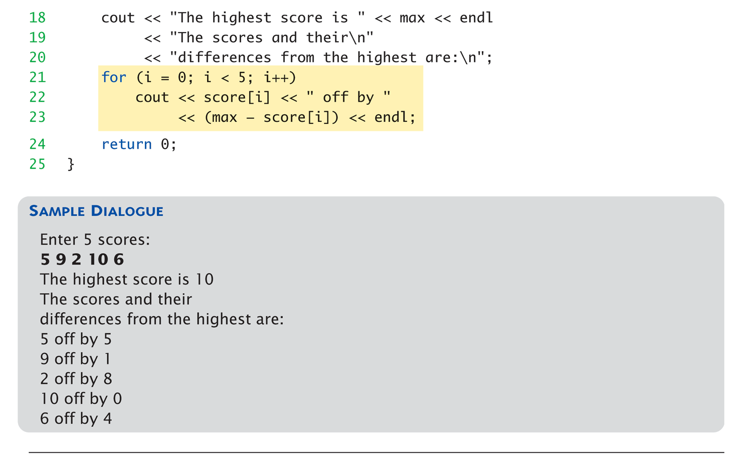
Array Program Example:
Display 5.1 Program Using an Array (2 of 2)

Slide 9
for-loops with Arrays
Natural counting loop
  Naturally works well "counting through" elements
  of an array
Example:
for (idx = 0; idx<5; idx++)
{
cout << score[idx] << "off by "
<< max – score[idx] << endl;
}
  Loop control variable (idx) counts from 0 – 5

Slide 10
Major Array Pitfall
Array indexes always start with zero!
Zero is "first" number to computer
scientists
C++ will "let" you go beyond range
  Unpredictable results
  Compiler will not detect these errors!
Up to programmer to "stay in range"

Slide 11
Major Array Pitfall Example
Indexes range from 0 to (array_size – 1)
  Example:
  double temperature[24]; // 24 is array size
  // Declares array of 24 double values called
  temperature
    They are indexed as:
    temperature[0], temperature[1] … temperature[23]
  Common mistake:
  temperature[24] = 5;
    Index 24 is "out of range"!
    No warning, possibly disastrous results

Slide 12
Defined Constant as Array Size
Always use defined/named constant for
array size
Example:
const int NUMBER_OF_STUDENTS = 5;
int score[NUMBER_OF_STUDENTS];
Improves readability
Improves versatility
Improves maintainability

Slide 13
Uses of Defined Constant
Use everywhere size of array is needed
  In for-loop for traversal:
  for (idx = 0; idx < NUMBER_OF_STUDENTS; idx++)
  {
  // Manipulate array
  }
  In calculations involving size:
  lastIndex = (NUMBER_OF_STUDENTS – 1);
  When passing array to functions (later)
If size changes → requires only ONE change in program!

Slide 14
Ranged-Based For Loop
The C++11 ranged-based for loop makes it easy to iterate over each element in a loop
Format
Example
for (datatype varname : array)
{
// varname is set to each successive
// element in the array
}
int arr[] = {20, 30, 40, 50};
for (int x : arr)
cout << x << " ";
cout << endl;
Output: 20 30 40 50

Slide 15
Arrays in Memory
Recall simple variables:
  Allocated memory in an "address"
Array declarations allocate memory for
entire array
Sequentially-allocated
  Means addresses allocated "back-to-back"
  Allows indexing calculations
    Simple "addition" from array beginning (index 0)

Slide 16
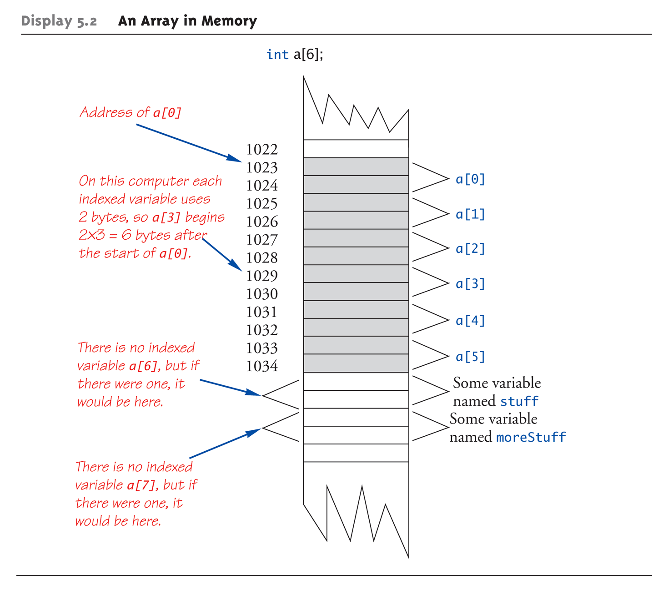
An Array in Memory

Slide 17
Initializing Arrays
As simple variables can be initialized at
declaration:
int price = 0; // 0 is initial value
Arrays can as well:
int children[3] = {2, 12, 1};
  Equivalent to following:
  int children[3];
  children[0] = 2;
  children[1] = 12;
  children[2] = 1;

Slide 18
Auto-Initializing Arrays
If fewer values than size supplied:
  Fills from beginning
  Fills "rest" with zero of array base type
If array-size is left out
  Declares array with size required based on
  number of initialization values
  Example:
  int b[] = {5, 12, 11};
    Allocates array b to size 3

Slide 19
Arrays in Functions
As arguments to functions
  Indexed variables
    An individual "element" of an array can be
    function parameter
  Entire arrays
    All array elements can be passed as
    "one entity"
As return value from function
  Can be done → chapter 10

Slide 20
Indexed Variables as Arguments
Indexed variable handled same as simple
variable of array base type
Given this function declaration:
void myFunction(double par1);
And these declarations:
int i; double n, a[10];
Can make these function calls:
myFunction(i); // i is converted to double
myFunction(a[3]); // a[3] is double
myFunction(n); // n is double

Slide 21
Subtlety of Indexing
Consider:
myFunction(a[i]);
  Value of i is determined first
    It determines which indexed variable is sent
  myFunction(a[i*5]);
  Perfectly legal, from compiler’s view
  Programmer responsible for staying
  "in-bounds" of array

Slide 22
Entire Arrays as Arguments
Formal parameter can be entire array
  Argument then passed in function call
  is array name
  Called "array parameter"
Send size of array as well
  Typically done as second parameter
  Simple int type formal parameter

Slide 23
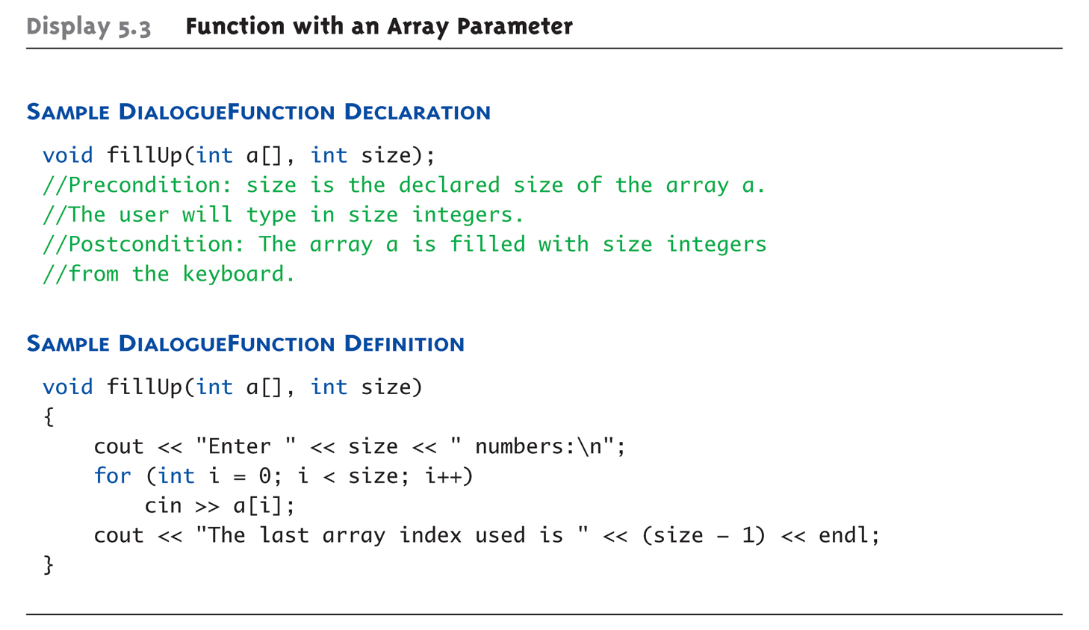
Entire Array as Argument Example:
Display 5.3 Function with an Array Parameter

Slide 24
Entire Array as Argument Example
Given previous example:
In some main() function definition,
consider this calls:
int score[5], numberOfScores = 5;
fillup(score, numberOfScores);
      1st argument is entire array
      2nd argument is integer value
  Note no brackets in array argument!

Slide 25
Array as Argument: How?
What’s really passed?
Think of array as 3 "pieces"
  Address of first indexed variable (arrName[0])
  Array base type
  Size of array
Only 1st piece is passed!
  Just the beginning address of array
  Very similar to "pass-by-reference"

Slide 26
Array Parameters
May seem strange
  No brackets in array argument
  Must send size separately
One nice property:
  Can use SAME function to fill any size array!
  Exemplifies "re-use" properties of functions
  Example:
  int score[5], time[10];
  fillUp(score, 5);
  fillUp(time, 10);

Slide 27
The const Parameter Modifier
Recall: array parameter actually passes
address of 1st element
  Similar to pass-by-reference
Function can then modify array!
  Often desirable, sometimes not!
Protect array contents from modification
  Use "const" modifier before array parameter
    Called "constant array parameter"
    Tells compiler to "not allow" modifications

Slide 28
Functions that Return an Array
Functions cannot return arrays same way simple types are returned
Requires use of a "pointer"
Will be discussed in chapter 10…

Slide 29
Programming with Arrays
Plenty of uses
  Partially-filled arrays
    Must be declared some "max size"
  Sorting
  Searching

Slide 30
Partially-filled Arrays
Difficult to know exact array size needed
Must declare to be largest possible size
  Must then keep "track" of valid data in array
  Additional "tracking" variable needed
    int numberUsed;
    Tracks current number of elements in array

Slide 31
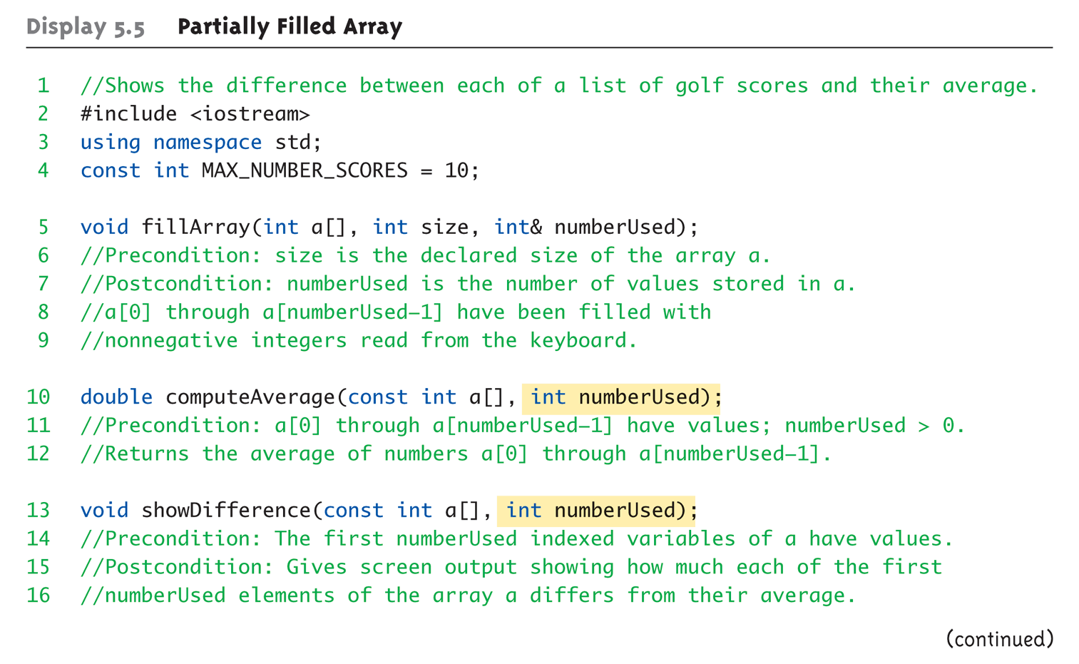
Partially-filled Arrays Example:
Display 5.5 Partially Filled Array (1 of 5)

Slide 32
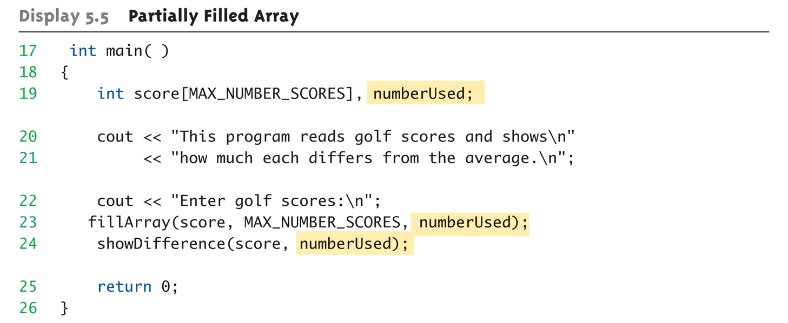
Partially-filled Arrays Example:
Display 5.5 Partially Filled Array (2 of 5)

Slide 33
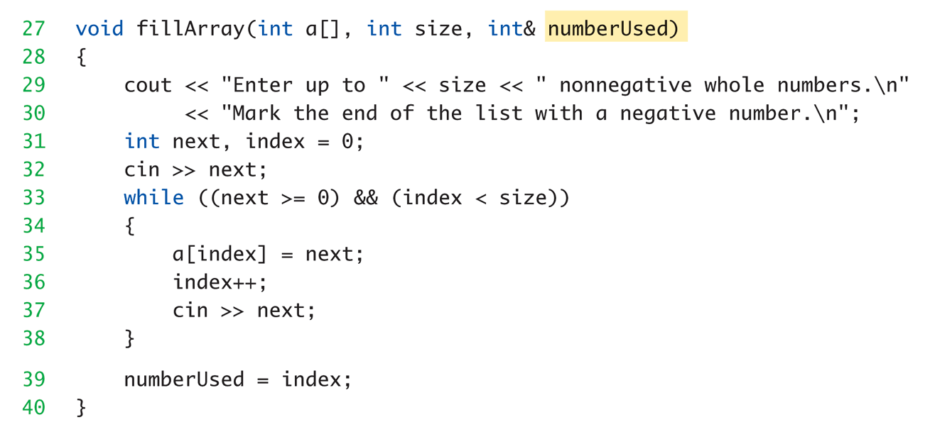
Partially-filled Arrays Example:
Display 5.5 Partially Filled Array (3 of 5)

Slide 34
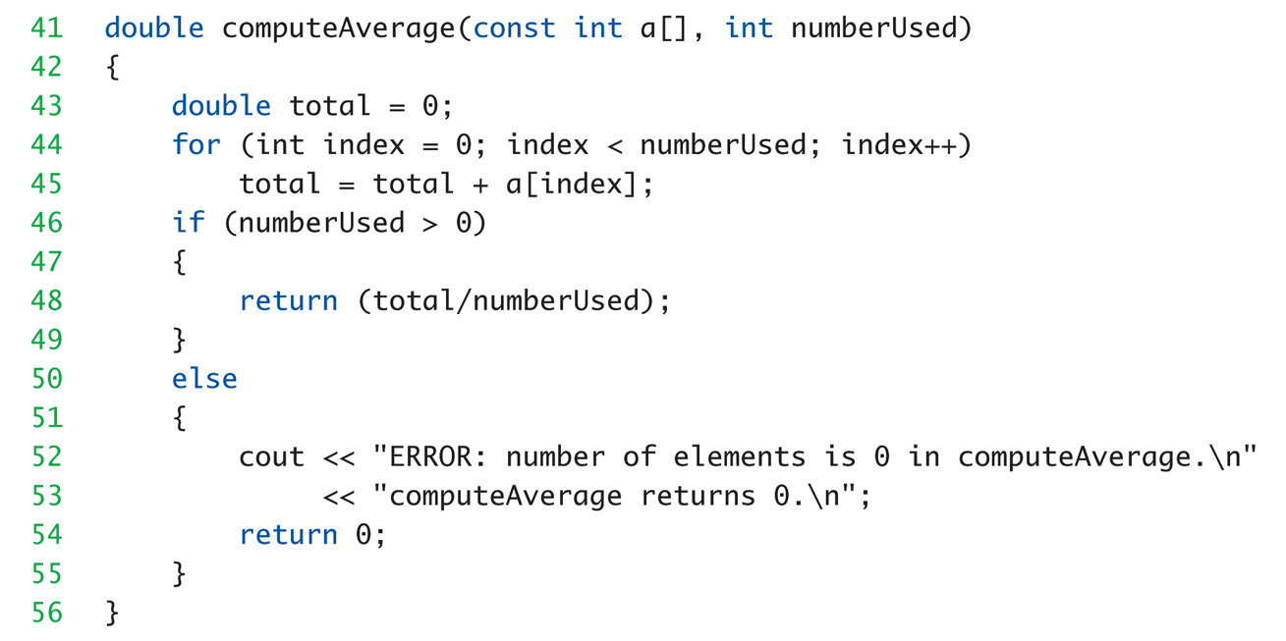
Partially-filled Arrays Example:
Display 5.5 Partially Filled Array (4 of 5)

Slide 35
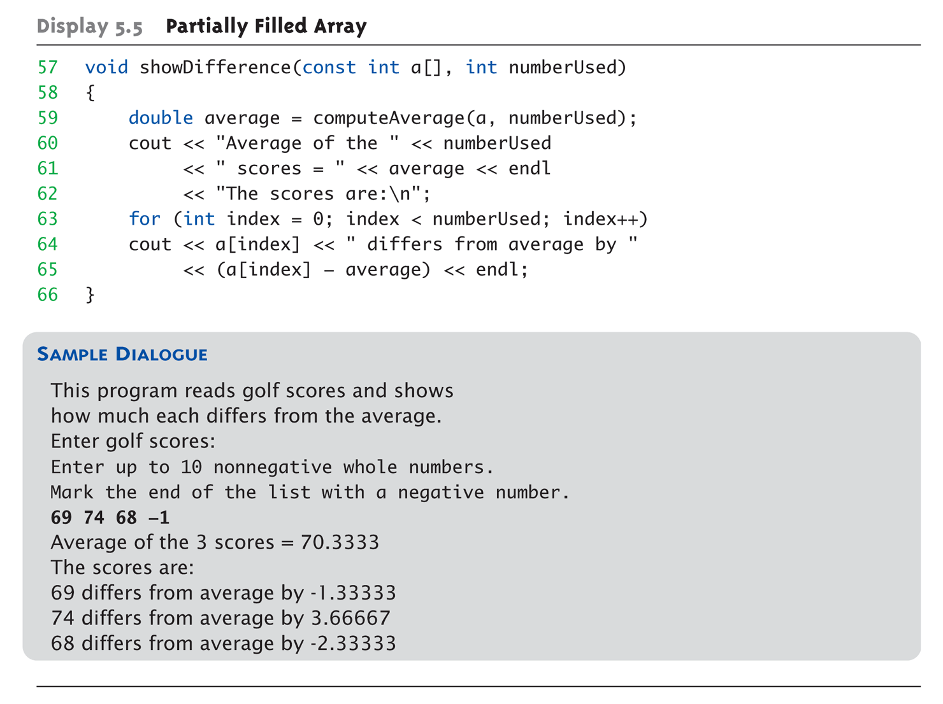
Partially-filled Arrays Example:
Display 5.5 Partially Filled Array (5 of 5)

Slide 36
Global Constants vs. Parameters
Constants typically made "global"
  Declared above main()
Functions then have scope to array
size constant
  No need to send as parameter then?
    Technically yes
  Why should we anyway?
    Function definition might be in separate file
    Function might be used by other programs!

Slide 37
Searching an Array
Very typical use of arrays
Display 5.6 next slide

Slide 38
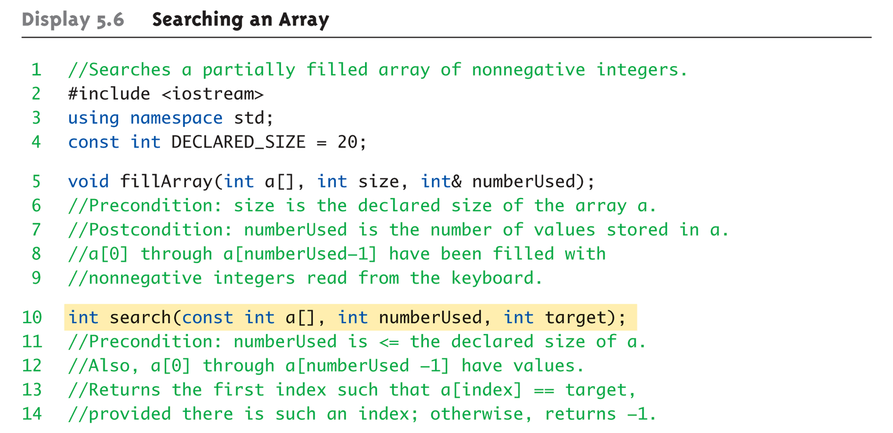
Display 5.6
Searching an Array (1 of 4)

Slide 39
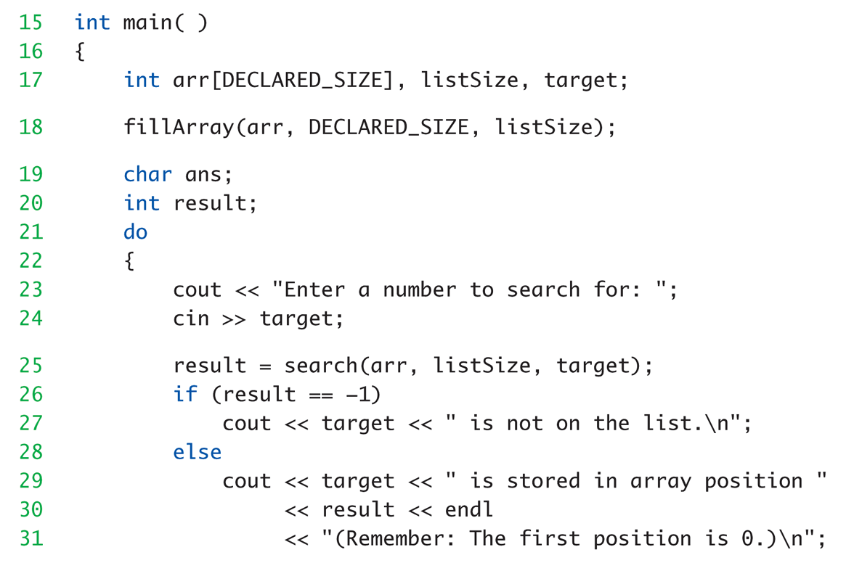
Display 5.6
Searching an Array (2 of 4)

Slide 40
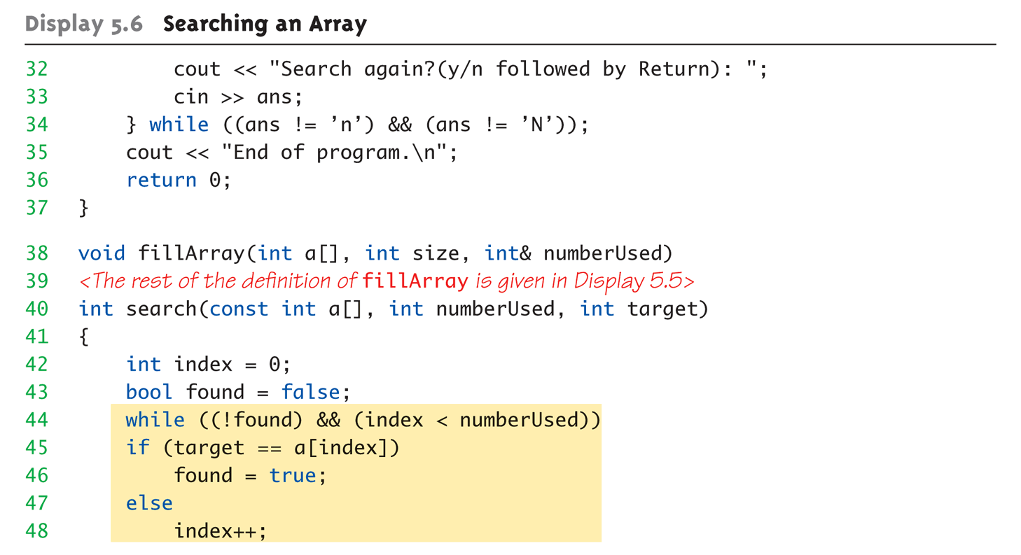
Display 5.6
Searching an Array (3 of 4)

Slide 41
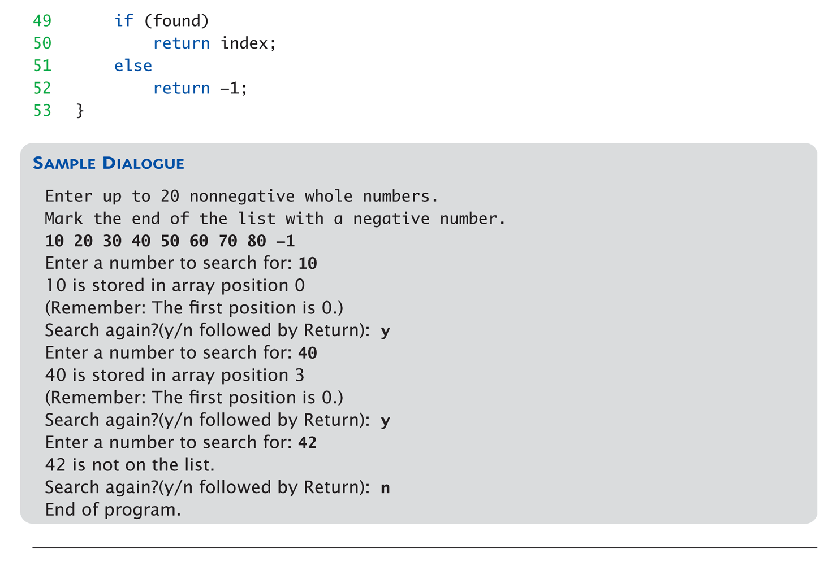
Display 5.6
Searching an Array (4 of 4)

Slide 42
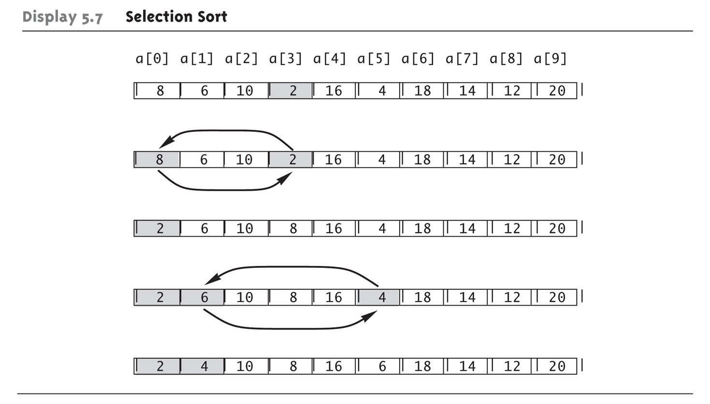
Sorting an Array:
Display 5.7 Selection Short
Selection Sort Algorithm

Slide 43
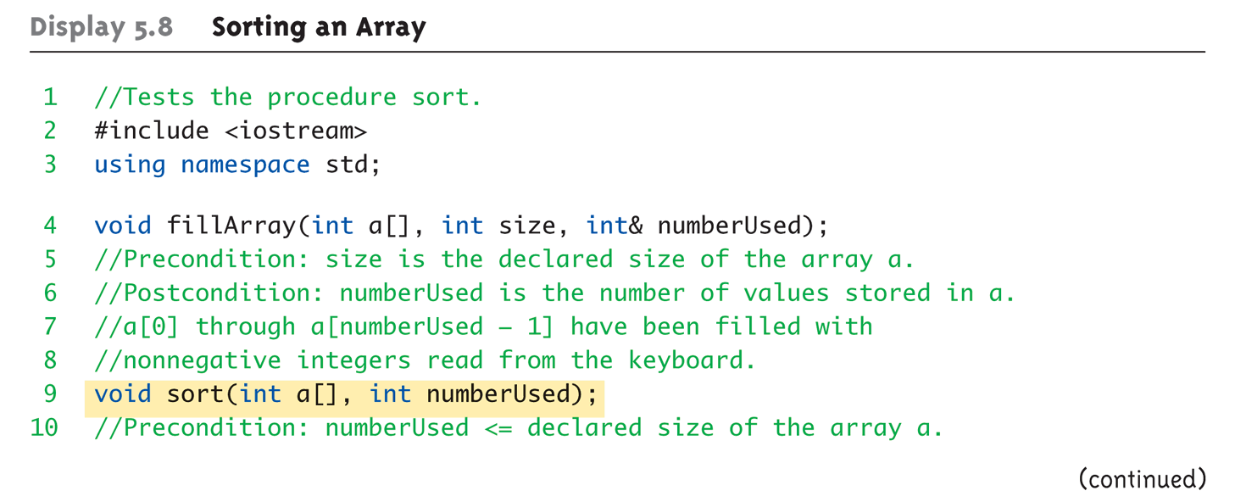
Sorting an Array Example:
Display 5.8 Sorting an Array (1 of 4)

Slide 44
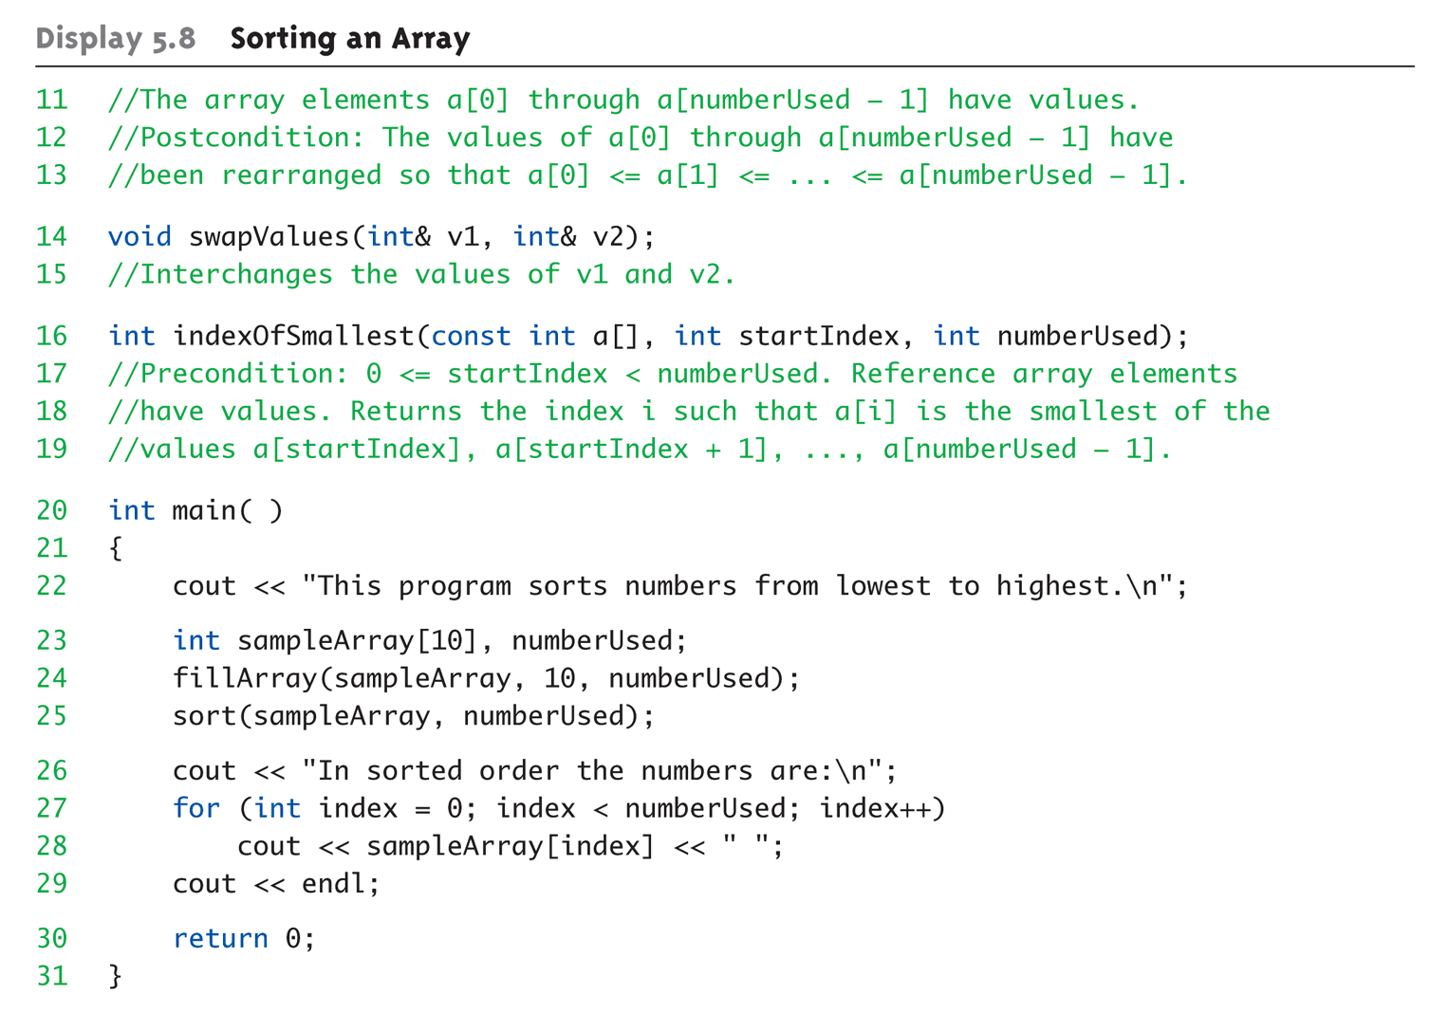
Sorting an Array Example:
Display 5.8 Sorting an Array (2 of 4)

Slide 45
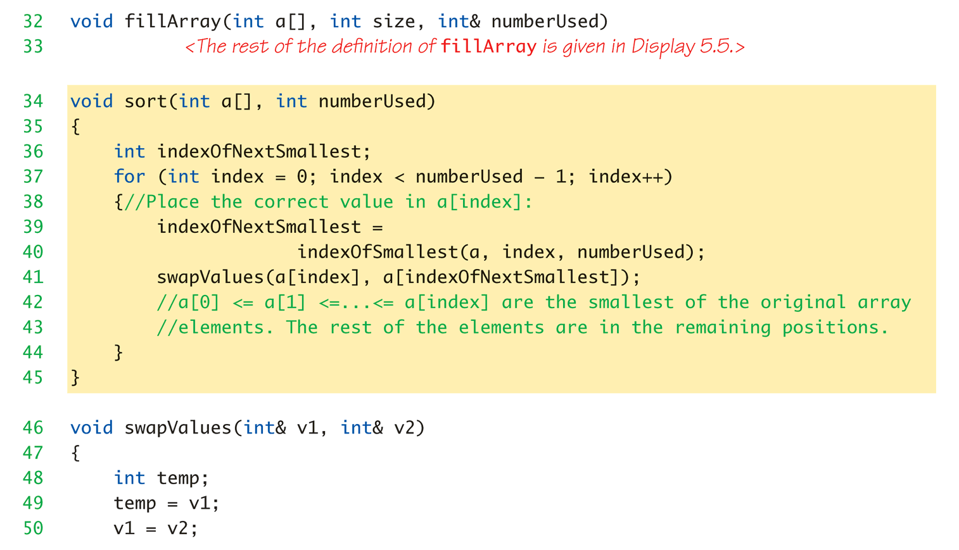
Sorting an Array Example:
Display 5.8 Sorting an Array (3 of 4)

Slide 46
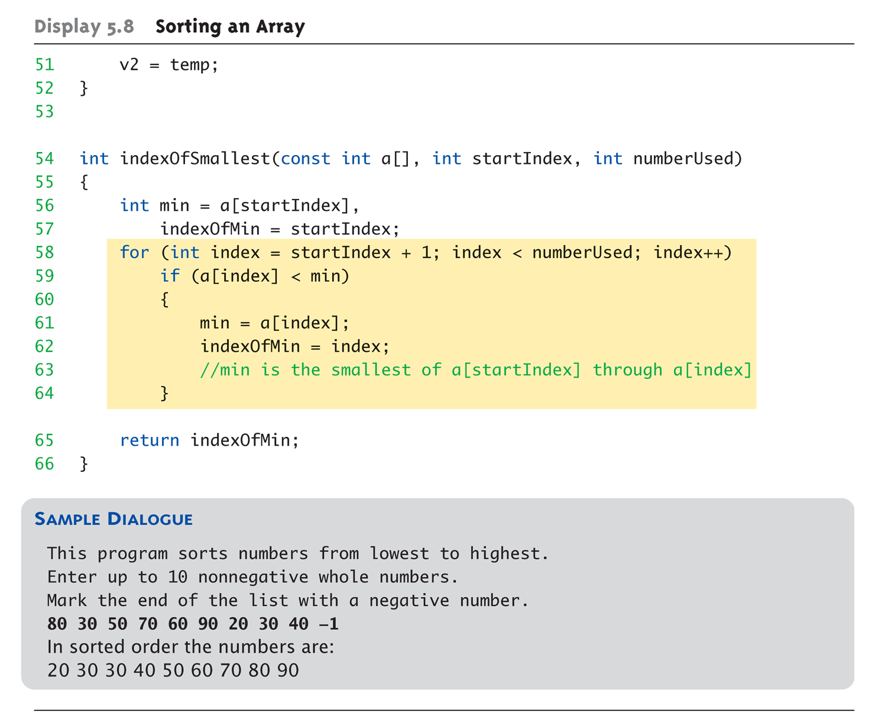
Sorting an Array Example:
Display 5.8 Sorting an Array (4 of 4)

Slide 47
Multidimensional Arrays
Arrays with more than one index
  char page[30][100];
    Two indexes: An "array of arrays"
    Visualize as:
    page[0][0], page[0][1], …, page[0][99]
    page[1][0], page[1][1], …, page[1][99]
    …
    page[29][0], page[29][1], …, page[29][99]
C++ allows any number of indexes
  Typically no more than two

Slide 48
Multidimensional Array Parameters
Similar to one-dimensional array
  1st dimension size not given
    Provided as second parameter
  2nd dimension size IS given
Example:
void DisplayPage(const char p[][100], int sizeDimension1)
{
for (int index1=0; index1<sizeDimension1; index1++)
{
for (int index2=0; index2 < 100; index2++)
cout << p[index1][index2];
cout << endl;
}
}

Slide 49
Summary 1
Array is collection of "same type" data
Indexed variables of array used just like
any other simple variables
for-loop "natural" way to traverse arrays
Programmer responsible for staying
"in bounds" of array
Array parameter is "new" kind
  Similar to call-by-reference

Slide 50
Summary 2
Array elements stored sequentially
  "Contiguous" portion of memory
  Only address of 1st element is passed to functions
Partially-filled arrays → more tracking
Constant array parameters
  Prevent modification of array contents
Multidimensional arrays
  Create "array of arrays"

