Slide 1
Arrays and Classes
Arrays and classes
Declare an array of objects
Manipulate each member of the array as a regular variable
Type the name of the class followed by a variable name and a dimension using square brackets
Example”
class point
{
public:
int x, y;
}
point p[4];

Slide 2
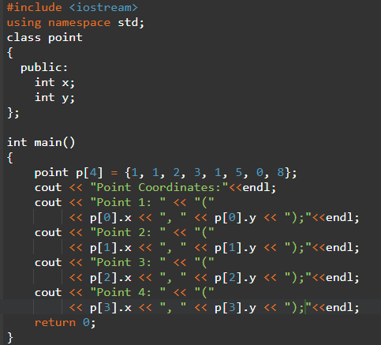
Arrays and Classes
Arrays and class
After declaring a variable of an array of objects, each member of the array has its own value
Access it use the index and dot operator
p[0].x;
P[2].y
Initialize an array of objects

Slide 3
Arrays and Classes
Arrays and classes
Initialize an array of objects
point p[4] = {1, 1, 2, 3, 1, 5, 0, 8};
point p[4] = {{1, 1}, {2, 3}, {1, 5}, {0, 8}};
class point
{
public:
int x, y;
} point p[4]= {1, 1, 2, 3, 1, 5, 0, 8};
class point
{
public:
int x, y;
} point p[4] = {{1, 1}, {2, 3}, {1, 5}, {0, 8}};

Slide 4
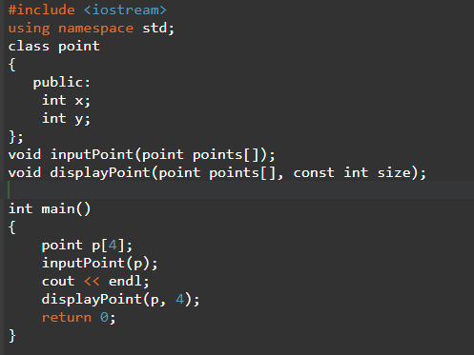
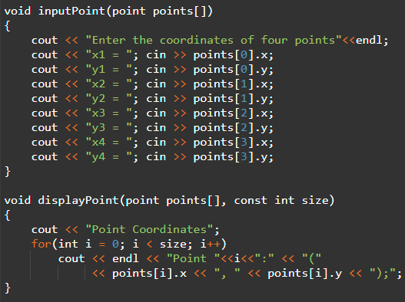
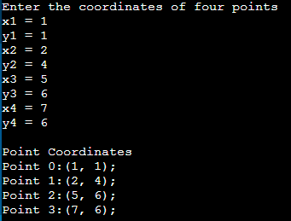
Arrays and Classes
Arrays and classes
An array of objects as argument
When declaring and implementing the function, provide the array in the parentheses of the function as regular variables.

Slide 5
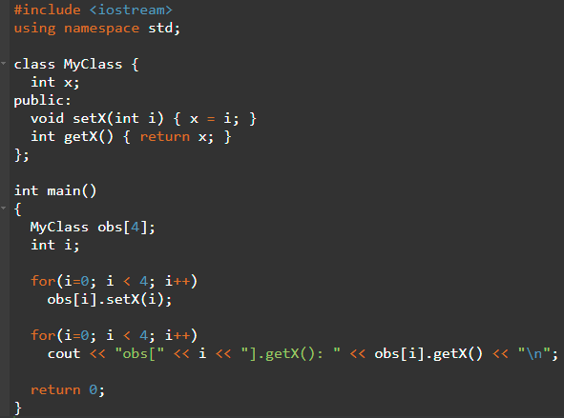
Arrays and Classes

