Slide 1
Classes and Pointers
A simple class
Inside the class definition, some data members are pointers
class node
{
private
int ID;
int x;
int y;
node *next; // pointer to next node
public:
};

Slide 2
Classes and Pointers
Allocating and deallocating space
new returns a pointer pointing to a new object of the specified class, delete releases the space
node *temp;
temp = new node;
……
delete temp;
To create and destroy an array of objects
node *temp;
temp = new node[10];
....
delete [] temp;

Slide 3
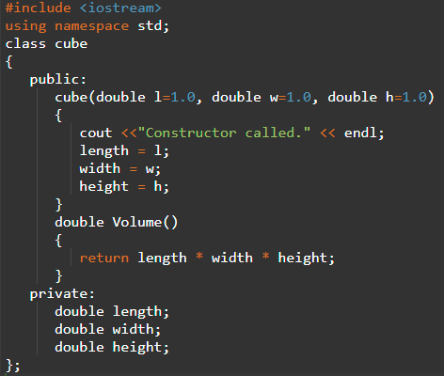
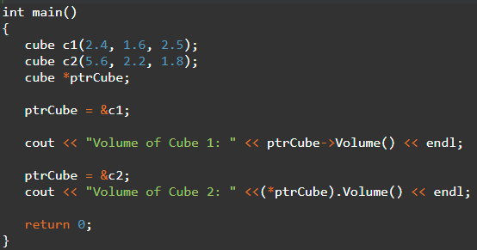
Classes and Pointers
A pointer to a class
Exactly the same way as a pointer to a structure
Access members of a pointer to a class using the member access operator -> operator
With all pointers, you must initialize the pointer before using it.

Slide 4
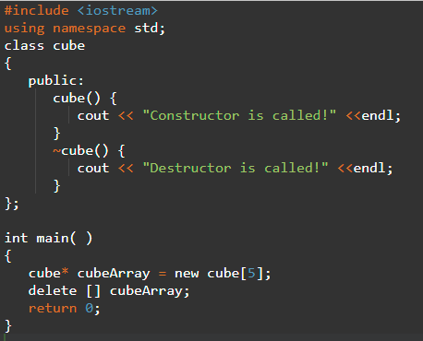
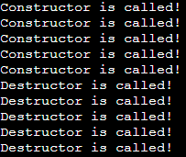
Classes and Pointers
Dynamic objects
Use new operator
Syntax to declare a pointer to an object
ClassName* VariableName = new ClassName;
Syntax to declare a pointer to an array of objects
ClassName *VariableName[Dimension];

Slide 5
Classes and Pointers
Pointers to member functions and data members
Declaring pointers to data members
Declaration :
datatype class_name :: *pointer_name ;
Assignment :
pointer_name = &class_name :: datamember_name ;
int A::*pmi; // declare pmi as a pointer to an int member of A
class A
{
public:
int num; int x;
};
int A::*pmi = &A::num; //initialize pmi

Slide 6
Classes and Pointers
Pointers to member functions and data members
Manipulate a data member through objects
Object.*pointerToMember
ObjectPointer->*pointerToMember //can be accessed
A a1;
A a2;
int n = a1.*pmi; // copy the value of a1.num to n
a1.*pmi = 5; // assign the value to a1.num
a2.*pmi = 6; // assign the value 6 to a2.num
Access a data member through a pointer to A below.
A * pa = new A;
int n = pa->*pmi; // assign to n the value of pa->num
pa->*pmi = 5; // assign the value 5 to pa->num

Slide 7
Classes and Pointers
Pointers to member functions and data members
Declaring pointers to member functions
return_type (class_name::*ptr_name) (argument_type) = &class_name::function_name ;
class A
{
public:
int func ();
};
int (A::*pmf) (); /* pmf is a pointer to some member
function of class A that returns int and takes no arguments*/

Slide 8
Classes and Pointers
Pointers to member functions and data members
Declaring pointers to member functions
A pointer to a member function looks just like a pointer to function, but it contains the class's name immediately followed by the :: operator
pmf = &A::func; //assign pmf
A a;
A *pa = &a;
(a.*pmf)(); // invoke a.func()
// call through a pointer to an object
(pa->*pmf)(); // calls pa->func()

Slide 9
Classes and Pointers
This pointer
An alternative to returning an object from one of its member functions
Instead of explicitly declaring a variable when implementing a function that returns the same object, the compiler simply needs to know what object you want to return: the object that called the method or a newly declared one.
If you want to return the same object, you can use a special pointer called this.

Slide 10
Classes and Pointers
This pointer
An alternative to returning an object from one of its member functions
Every object has access to its own address through this pointer.
The this pointer is an implicit parameter to all member functions.
Inside a member function, this may be used to refer to the invoking object.
Only member functions have a this pointer. (friend functions don’t have it)

Slide 11
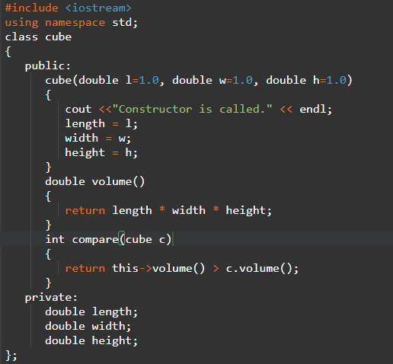
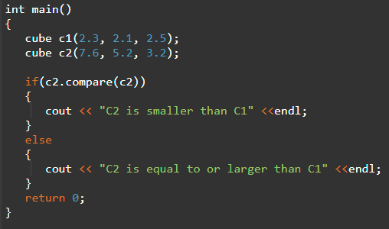
Classes and Pointers
This pointer

