Slide 1
Enumeration
What is enumeration?
Sets up a new data type
Defines a set of integer constants
Syntax
enum enumeration_name {enumerator1, enumerator2, ... , enumeratorN};
Each enumerator has a constant integer value
Default: the first one’s value is 0 and each succeeding one incremented by one
Can specify any of them

Slide 2
Enumeration
Why enumeration?
Regular variable assigned to a value has no sensible meaning
Enumeration establishes a set of values that a variable can take on
You may not need to know the values, only the relative values, making the names more valuable
Types of enumerations
With name, you can declare variables
Without name, you cannot declare variables

Slide 3
Enumeration
Examples
enum color {green, blue, yellow};
enum {start, end};
enum {moe, larry, curly, shemp};
color hue; // valid, hue can be green or blue or yellow color hue = green; // a valid initialization color hue = 2; // INVALID: hue is a color, so it can only have values
of green, blue, or yellow color hue = color(2); // this would assign yellow to hue via a cast int x = hue; // hue is promoted to an int automatically enum exit {door = 7, window = 3, chimney, drain = 1}; so, door is 7, window is 3, chimney is 4, and drain is 1.

Slide 4
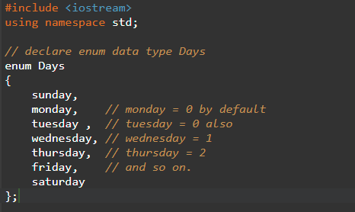
Sample program 1

Slide 5
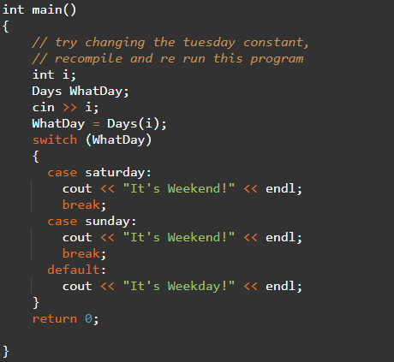
Sample program 1

Slide 6
Sample program 1
3
It's Weekday!

Slide 7
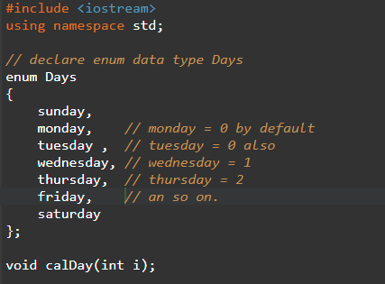
Sample program 2

Slide 8
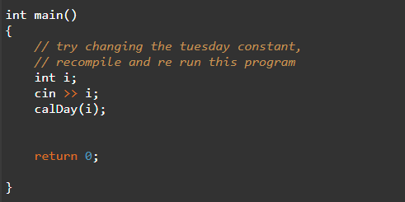
Sample program 2

Slide 9
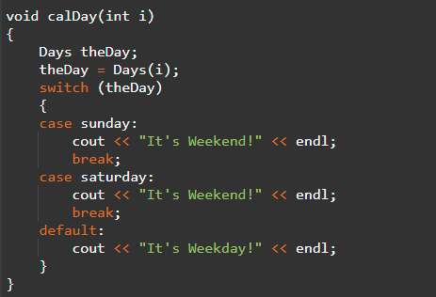
Sample program 2

