Slide 1
Inline Functions
Inline function
The basic idea is to save time
Use inline keyword to define inline functions
Whenever calling the function, the compiler will replace the function call with the actual code from the function
Function calls are more time consuming than the codes without functions
If you call a functions a big number of times, it is more time consuming to use inline functions and increase the program size than function calls

Slide 2
Inline Functions
Inline function
Example
inline void hello()
{ cout<<"hello";}
int main()
{ hello(); //Call it like a normal function...
cin.get();}
Once program is compiled, the function will be replaced by the code
Good for saving time, but if you use them too often or with large functions you will have a tremendously large program, sometimes less efficient

Slide 3
Inline Functions
Inline function
Best for small functions that are called often
The compiler may ignore your inline functions if you make a mistake or you have many large size functions with a big number of times
Inline functions should be small and simple
Inline functions should not have any functions calls or I/O statements
General rule: if a function has more than five statements, you should not use inline.
Inline function is just a request to the compiler, but it may be ignored

Slide 4
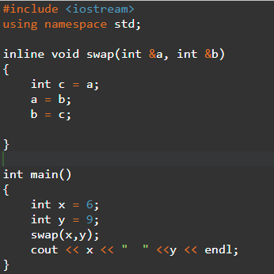
Inline Functions
Inline global functions
Put inline before the return type in the function header
Function definition appears before any calls to the function
Example

Slide 5
Inline Functions
Inline member functions
Implicit: defined within the class definition, and inline is not needed
class Date
{
public:
Date(int mm,int dd,int yy) {month = mm; day = dd; year = yy;}
void setdate(int mm,int dd,int yy) {month = mm; day = dd; year = yy;}
void showdate(); // not inlined
// additional member functions
private:
int month; int day; int year;
};

Slide 6
Inline Functions
Inline member functions
Explicit: inline is needed in the prototype, and defined outside of the class definition with inline keyword
class Date
{
public:
inline Date(int,int,int);
inline void setdate(int,int,int);
void showdate(); // not inlined
// additional member functions
private:
int month;
int day;
int year;
};

Slide 7
Inline Functions
Inline member functions
inline Date::Date(int mm,int dd,int yy)
{
month = mm;
day = dd;
year = yy;
}
inline void Date::setdate(int mm,int dd,int yy)
{
month = mm;
day = dd;
year = yy;
}
void showdate()
{ cout << month << '/' << day << '/' << year;}

Slide 8
Friend Functions
Friend functions
Defined outside that class’s scope
Has the right to access all private and protected members of the class
Prototype in the class definition, but not member functions
A friend can be a function, function template, a member function, a class, or a class template
Declare a function as a friend of a class, use friend keyword before the function prototype in the class definition

Slide 9
Friend Functions
Friend functions
Example
class Box
{
double width;
public:
double length;
friend void printWidth( Box box );
void setWidth( double wid );
};

Slide 10
Friend Functions
Friend functions
To declare all member functions of class Y as friends of class X, place the following declaration in the definition of class X:
friend class Y;

Slide 11
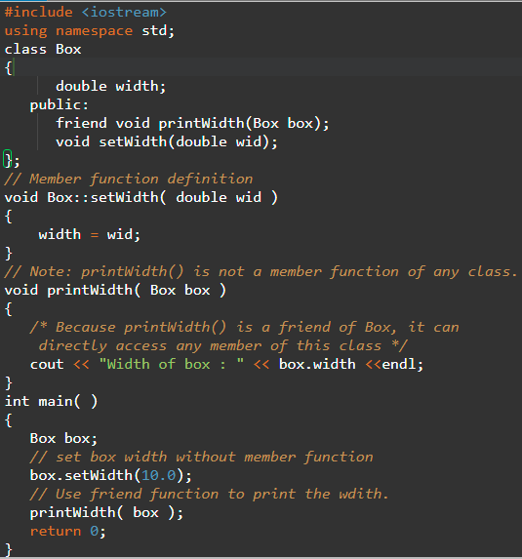
Friend Functions
Friend functions

Slide 12
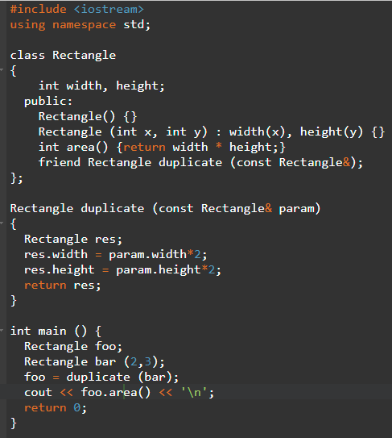
Friend Functions
Friend functions

Slide 13
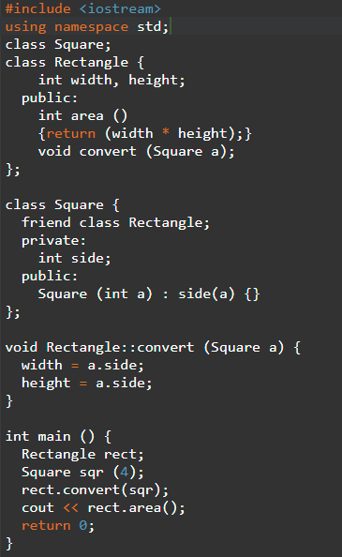
Friend Classes
Friend classes example

Slide 14
Friend Classes
Friend classes
Rectangle is a friend of class Square
Rectangle’s member functions can access private and protected members of Square, side
Empty declaration of Square is needed since Rectangle uses Square as a parameter and Square uses Rectangle as friend
Square is not a friend of Rectangle, so couldn’t access members of Rectangle
If needed, they can be declared as friends each other
Not transitive, a friend of a friend is not a friend automatically

