Slide 1
Pointers
Introduction
Declaring a variable will reserve a space in memory, which referred by an address
To use a variable, locate it when needed.
Use & and the variable name to see its address
int x=12;
cout << "x's value is: " <<x<<" at "<< &value<<endl;
x's value is: 12 at 001FDE10

Slide 2
Pointers
Why pointers?
When declaring a variable, compiler put it somewhere. When you know the address, you can use it.
Allow the functions to change the real value of the argument like call by reference. You can return many values.
When declaring an array, you need to specify the dimension. A pointer can store an array with almost any size. Compilers will handle this.

Slide 3
Pointers
Definition
Addresses are hard to read and interpret
Use another variable to refer to the address of the variable
A pointer is a variable that refers to another variable's address
Declare a pointer
DataType * PointerName;
The identifier should be the same type of identifier the pointer variable will point to
* lets the compiler know that the variable is a pointer

Slide 4
Pointers
Definition
Declare multiple pointer, put * before each variable
int *p1, *p2; or int *p1; int *p2;
int *p1, p2; //only p1 is a pointer, p2 is an integer
The name of a pointer is that of a variable, same naming rules
int x; int *p;
cout << "x lives at " << &x<< endl;
cout << "p lives at " << &p<<endl;
x lives at 0x7ffc990f126c
p lives at 0x7ffc990f1270

Slide 5
Pointers
Initialize a pointer
When a pointer to point to the variable we are interested in
Initialize the point by let the pointer point to that variable
Two ways to initialize a pointer
1: int *p=&x;
2: int *p;
p=&x; //no asterisk
int x= 12; int *p = &x;
cout << "x’s value is " << value << endl;
cout << "The pointed value is " << *p<<endl;
x value is 12
The pointed value is 12

Slide 6
Pointers
Initialize a pointer
You can declare the variable and the pointer first, and use them later
int x; int *p;
p = &x; x = 26;
Once pointed to a variable, if the value of the variable changes, the content of the point changes too
int x, *p; p = &x;
x = 16; cout << "x = " << x; cout << " *p = " << *p << endl;
x = 25; cout << "x = " << x ; cout << " *p = " << *p << endl;
x = 16 *p = 16
x = 25 *p = 25

Slide 7
Pointers
Initialize a pointer
Directly change the value of the pointed variable
int x, *p; p = &x;
x = 16; cout << "x = " << x; cout << " *p = " << *p << endl;
x = 25; cout << "x = " << x ; cout << " *p = " << *p << endl;
*p =100; cout << "x = " << x ; cout << " *p = " << *p << endl;
x = 16 *p = 16
x = 25 *p = 25
x = 100 *p = 100

Slide 8
A pointer to a pointer
A pointer to a pointer
Use two asterisks to define a pointer to a pointer
int x;
int *p;
int **p2p;
p=&x;
p2p=&p;

Slide 9
A pointer to a pointer
A pointer to a pointer
Change the value of the variable, others change accordingly
x=1000;
cout<<"After changing, the new values are: "<<endl;
cout << " x = " << x<<endl; cout << " *p = " << *p << endl;
cout << " **p2p = " << **p2p << endl;
After changing, the new values are:
x = 1000
*p = 1000
**p2p = 1000

Slide 10
A pointer to a pointer
A pointer to a pointer
Change the content of a pointer and a pointer to pointer, all related values will be updated.
*p=-360;
cout<<"After changing, the new values are: "<<endl;
cout << " x = " << x<<endl; cout << " *p = " << *p << endl;
cout << " **p2p = " << **p2p << endl;
After changing, the new values are:
x = -360
*p = -360
**p2p = -360

Slide 11
A pointer to a pointer
A pointer to a pointer
Change the content of a pointer and a pointer to pointer, all related values will be updated.
**p2p=-2000;
cout<<"After changing, the new values are: "<<endl;
cout << " x = " << x<<endl; cout << " *p = " << *p << endl;
cout << " **p2p = " << **p2p << endl;
After changing, the new values are:
x = -2000
*p = -2000
**p2p = -2000

Slide 12
Operations on Pointers
Get a value from user
Use cin to get a value from the user
int stud; int *pStud;
pStud = &stud;
cout << "The number of students is: ";
cin >> stud;
cout << endl<<"The number of students: " << stud<< endl <<"So there are " << *pStud << " students. ";
The number of students is: 35
The number of students: 35
So there are 35 students.

Slide 13
Operations on Pointers
Algebraic calculations and expressions
int x1; int x2; int sum; int *pX1; int *pX2; int *pSum;
pX1 = &x1;
pX2 = &x2;
pSum = &sum;
cout << "Value of x1:"; cin >> *pX1;
cout << "Value of x2: "; cin >> *pX2;
cout << endl<<"The sum is :";
cout << endl<<"x1:" << "\t" << x1 << "\nThat is: " << *pX1 ;
cout << endl<<"x2:" << "\t" << x2 << "\nThat is: " << *pX2 ;
sum= x1 + x2;
*pSum= *pX1 + *pX2;
cout << endl<<"The sum is: " << sum;
cout << endl<<"The sum is:" << *pSum ;
Value of x1:10
Value of x2: 20
The sum is :
x1: 10
That is: 10
x2: 20
That is: 20
The sum is: 30
The sum again is:30

Slide 14
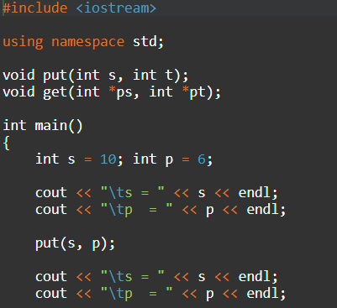
Passing pointers to functions
Pointers as augments of functions
When declaring the function, use the asterisk for each pointer (*)
When calling the function, use the references to the variables (&)

Slide 15
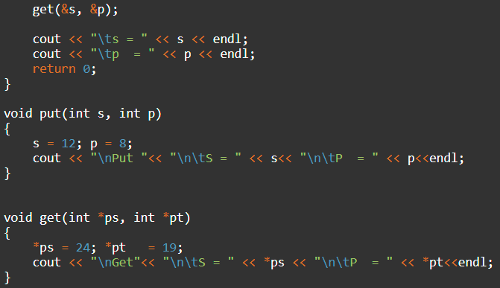
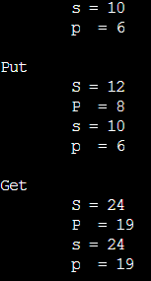
Passing pointers to functions
Pointers as augments of functions

Slide 16
A function with a returned pointer
Pointers as augments of functions
Add * after the returned data type
int *getNumber();
int main()
{
int *n;
n = getNumber();
cout << "The number = " << *n << endl;
return 0;
}
int *getNumber()
{
int *x=new int(1024);
return x;
}
The number = 1024

