Slide 1
Variables
Types of variables
Local variable
Global variables
Static variables
Local (Auto) variables
Defined within the scope of a function
Also called automatic variables
Cannot retain its value once the function returns
Scope and life is in the function it is defined in

Slide 2
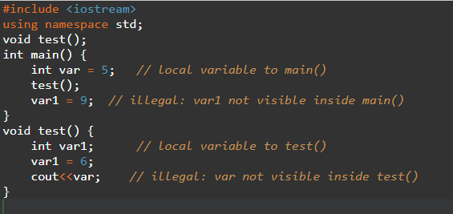
Variables
Local (Auto) variables
Not initialized by the compiler, but the programmer
Recommend to initialize it while defining the variable
Reinitialized every time the function is called
Destroyed once the function returns

Slide 3
Variables
Static variables
Static to the function and static to the file
Defined inside a function, but not destroyed once the function return and retain its value
Scope is inside the function, cannot be called from outside the function
Its life time is throughout the program execution
Retain its previous value because allocated from the data section of the memory
Uninitialized static variable are initialized to 0 by default

Slide 4
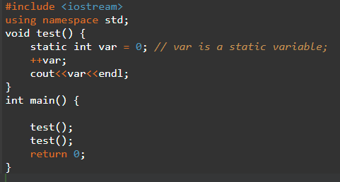
Variables
1
2

Slide 5
Variables
1
1
1
1
Static variables to file
Defined outside the function, but inside a file
Global to all the functions in the file
Cannot be externed by another file
Can be defined in header files, and each file including the header file will allocate a memory for the static variable and use their perspective copies during program execution

Slide 6
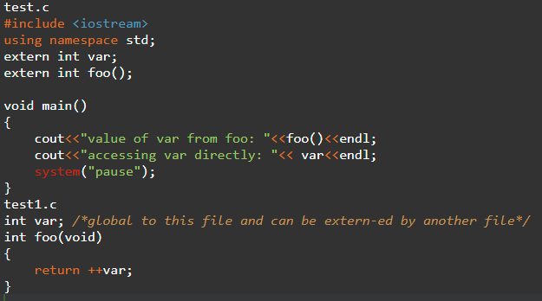
Variables
1
1
1
1

Slide 7
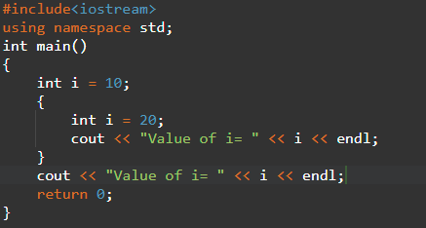
Behavior of static variables
Value of i= 20
Value of i= 10

Slide 8
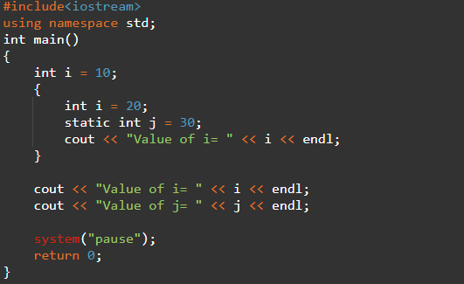
Behavior of static variables
main.cpp:13:28: error: ‘j’ was not declared in this scope
13 | cout << "Value of j= " << j << endl; | ^

Slide 9
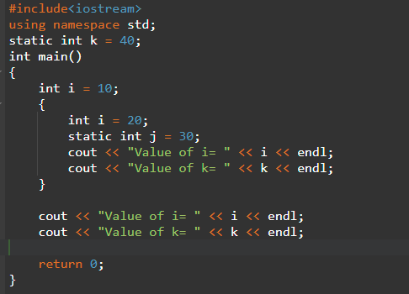
Behavior of static variables
Value of i= 20
Value of k= 40
Value of i= 10
Value of k= 40

Slide 10
Behavior of static variables
Value of i= 20
Value of k= 40
Value of i= 10
Value of k= 40

Slide 11
Variables
Global variables
Defined globally at the beginning of the file or in a head file
Retain the value throughout the life of the program
Can be accessed from any file with external linkage
Allocated from the data section of the memory
Initialized to 0 by default

