Slide 1

Chapter 1
C++ Basics
Copyright © 2016 Pearson, Inc. All rights reserved.

Slide 2
Learning Objectives
Introduction to C++
  Origins, Object-Oriented Programming, Terms
Variables, Expressions, and
Assignment Statements
Console Input/Output
Program Style
Libraries and Namespaces

Slide 3
Introduction to C++
C++ Origins
  Low-level languages
    Machine, assembly
  High-level languages
    C, C++, ADA, COBOL, FORTRAN
  Object-Oriented-Programming in C++
C++ Terminology
  Programs and functions
  Basic Input/Output (I/O) with cin and cout

Slide 4
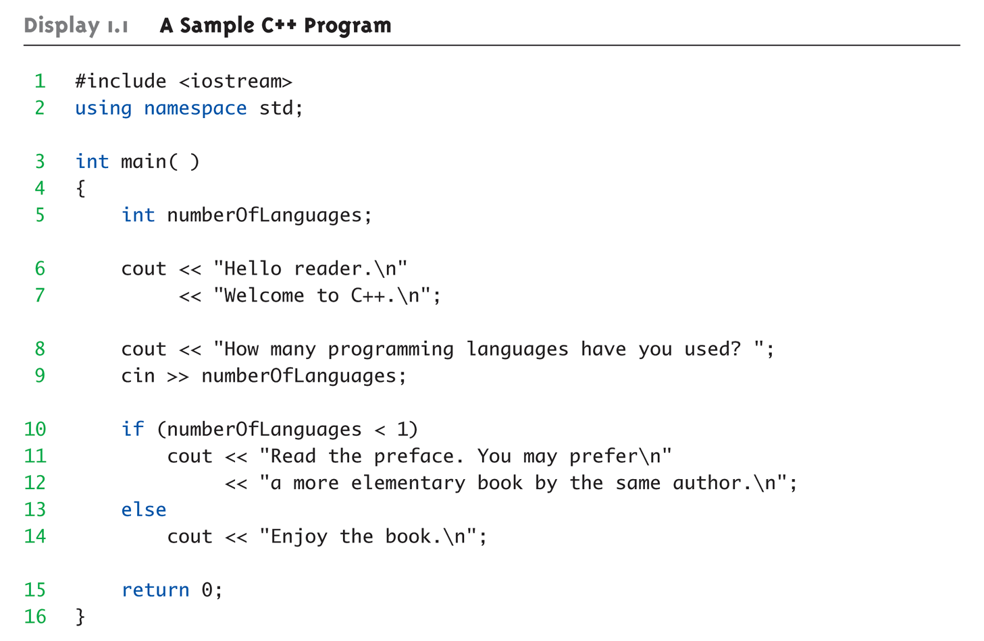
Display 1.1
A Sample C++ Program (1 of 2)

Slide 5
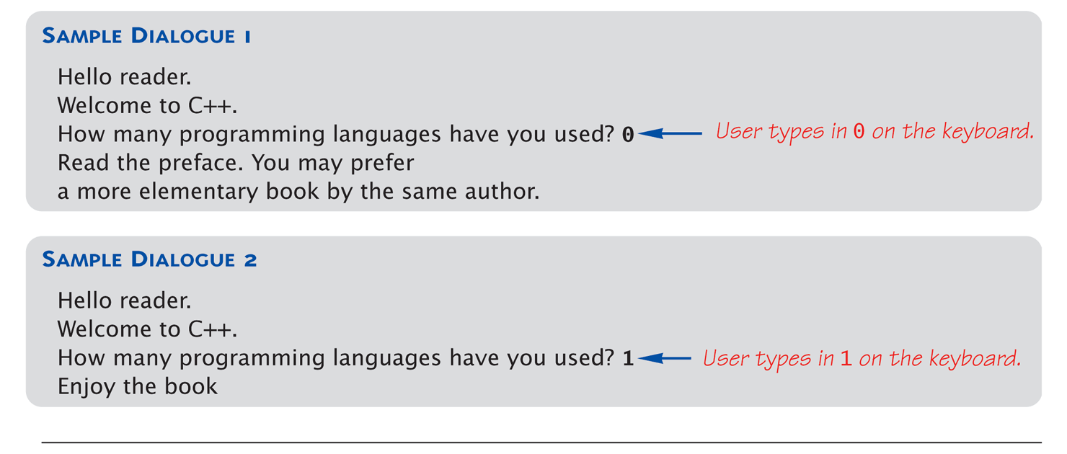
Display 1.1
A Sample C++ Program (2 of 2)

Slide 6
C++ Variables
C++ Identifiers
  Keywords/reserved words vs. Identifiers
  Case-sensitivity and validity of identifiers
  Meaningful names!
Variables
  A memory location to store data for a program
  Must declare all data before use in program

Slide 7
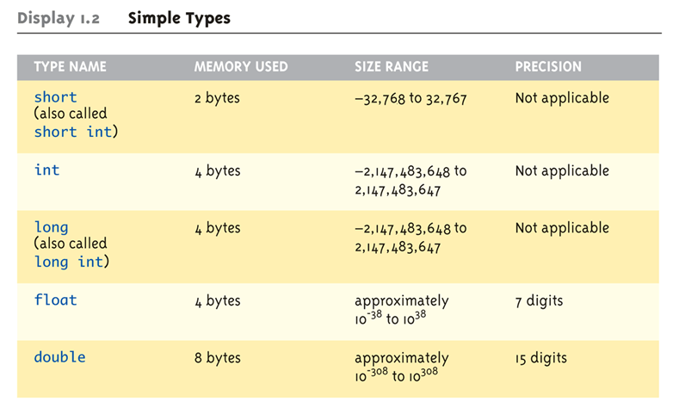
Data Types:
Display 1.2 Simple Types (1 of 2)

Slide 8
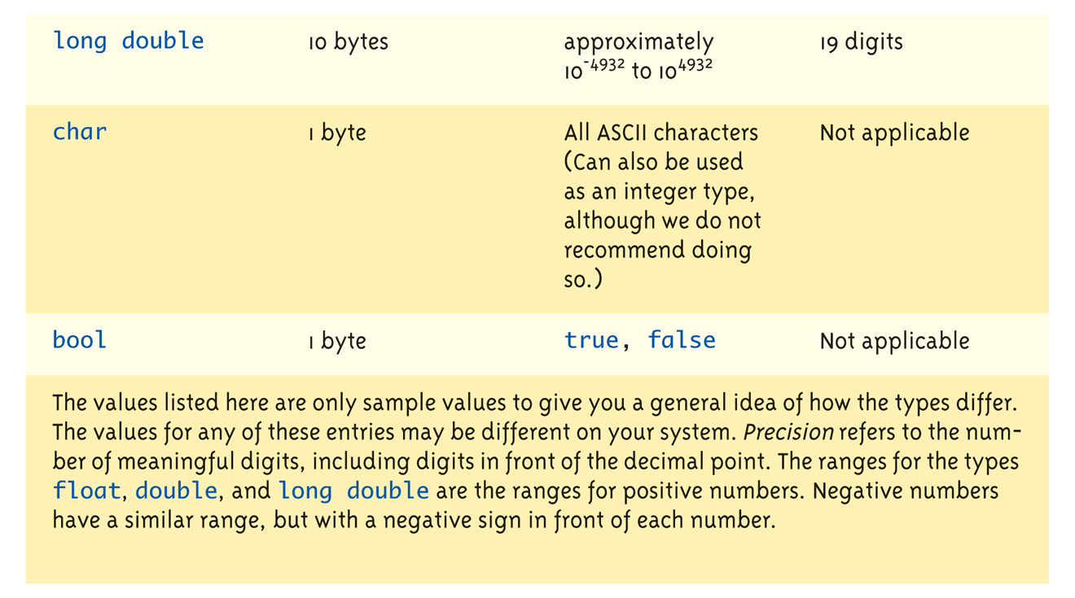
Data Types:
Display 1.2 Simple Types (2 of 2)

Slide 9
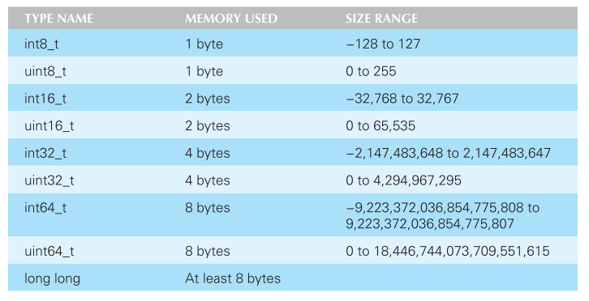
C++11 Fixed Width Integer Types
Avoids problem of variable integer sizes for different CPUs

Slide 10
New C++11 Types
auto
  Deduces the type of the variable based on the expression on the right side of the assignment statement
    auto x = expression;
  More useful later when we have verbose types
decltype
  Determines the type of the expression. In the example below, x*3.5 is a double so y is declared as a double.
  decltype(x*3.5) y;

Slide 11
Assigning Data
Initializing data in declaration statement
  Results "undefined" if you don’t!
    int myValue = 0;
Assigning data during execution
  Lvalues (left-side) & Rvalues (right-side)
    Lvalues must be variables
    Rvalues can be any expression
    Example:
    distance = rate * time;
    Lvalue: "distance"
    Rvalue: "rate * time"

Slide 12
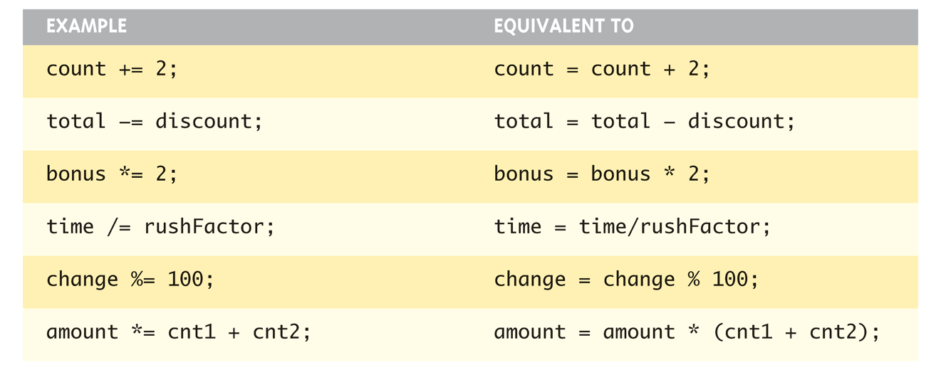
Assigning Data: Shorthand Notations

Slide 13
Data Assignment Rules
Compatibility of Data Assignments
  Type mismatches
    General Rule: Cannot place value of one type into variable of another type
  intVar = 2.99; // 2 is assigned to intVar!
    Only integer part "fits", so that’s all that goes
    Called "implicit" or "automatic type conversion"
  Literals
    2, 5.75, "Z", "Hello World"
    Considered "constants": can’t change in program

Slide 14
Literal Data
Literals
  Examples:
    2 // Literal constant int
    5.75 // Literal constant double
    "Z" // Literal constant char
    "Hello World" // Literal constant string
Cannot change values during execution
Called "literals" because you "literally typed"
them in your program!

Slide 15
Escape Sequences
"Extend" character set
Backslash, \ preceding a character
  Instructs compiler: a special "escape
  character" is coming
  Following character treated as
  "escape sequence char"
  Display 1.3 next slide

Slide 16
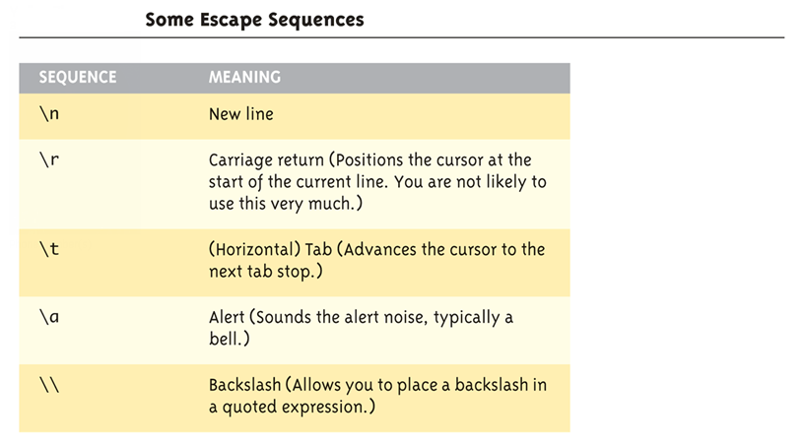
Display 1.4
Some Escape Sequences (1 of 2)

Slide 17
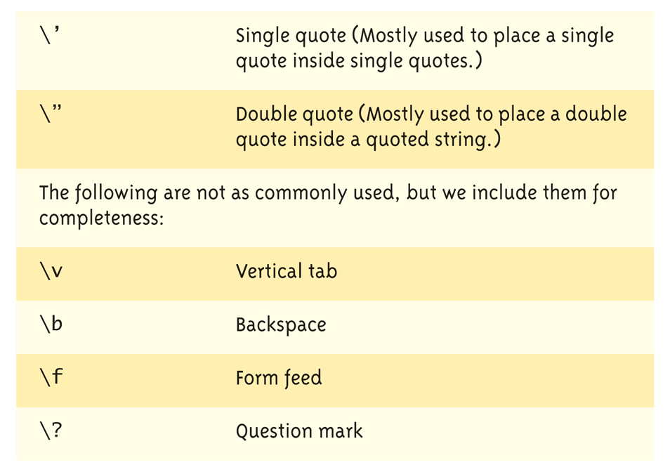
Display 1.4
Some Escape Sequences (2 of 2)

Slide 18
Raw String Literals
Introduced with C++11
Avoids escape sequences by literally interpreting everything in parens
  string s = R“(\t\\t\n)”;
The variable s is set to the exact string “\t\\t\n”
Useful for filenames with \ in the filepath

Slide 19
Constants
Naming your constants
  Literal constants are "OK", but provide
  little meaning
    e.g., seeing 24 in a pgm, tells nothing about
    what it represents
Use named constants instead
  Meaningful name to represent data
  const int NUMBER_OF_STUDENTS = 24;
    Called a "declared constant" or "named constant"
    Now use it’s name wherever needed in program
    Added benefit: changes to value result in one fix

Slide 20
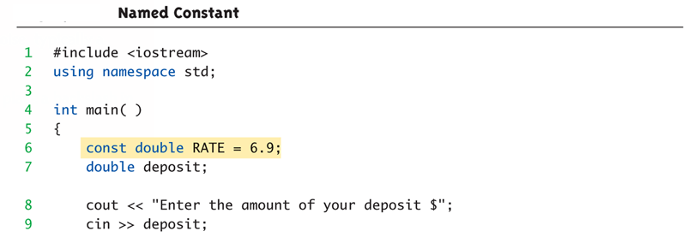
Arithmetic Operators:
Display 1.5 Named Constant (1 of 2)
Standard Arithmetic Operators
  Precedence rules – standard rules

Slide 21
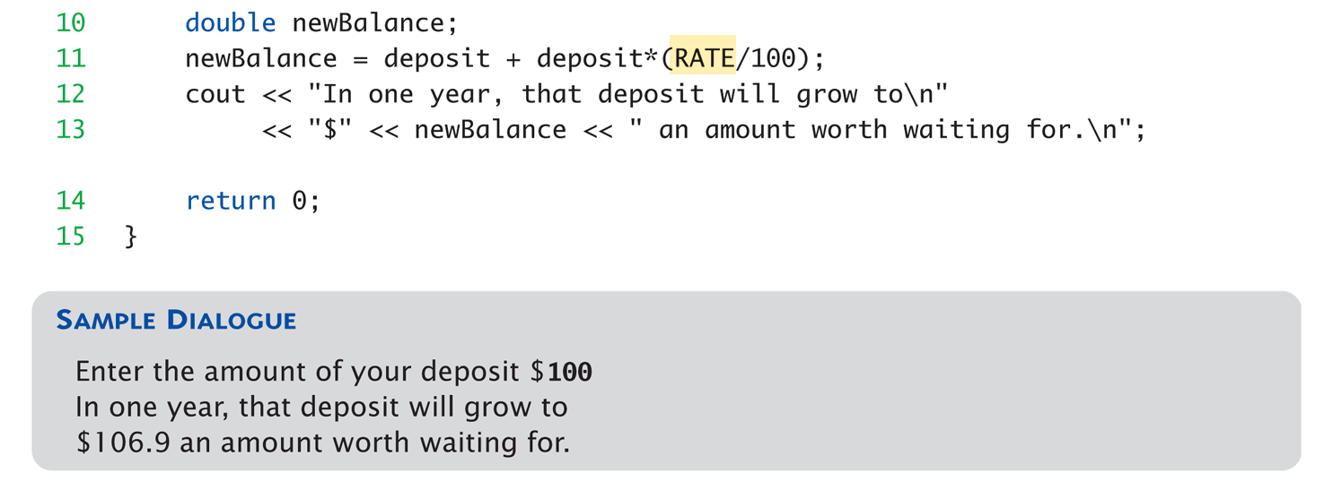
Arithmetic Operators:
Display 1.5 Named Constant (2 of 2)

Slide 22
Arithmetic Precision
Precision of Calculations
  VERY important consideration!
    Expressions in C++ might not evaluate as
    you’d "expect"!
  "Highest-order operand" determines type
  of arithmetic "precision" performed
  Common pitfall!

Slide 23
Arithmetic Precision Examples
Examples:
  17 / 5 evaluates to 3 in C++!
    Both operands are integers
    Integer division is performed!
  17.0 / 5 equals 3.4 in C++!
    Highest-order operand is "double type"
    Double "precision" division is performed!
  int intVar1 =1, intVar2=2;
  intVar1 / intVar2;
    Performs integer division!
    Result: 0!

Slide 24
Individual Arithmetic Precision
Calculations done "one-by-one"
  1 / 2 / 3.0 / 4 performs 3 separate divisions.
    First→ 1 / 2 equals 0
    Then→ 0 / 3.0 equals 0.0
    Then→ 0.0 / 4 equals 0.0!
So not necessarily sufficient to change
just "one operand" in a large expression
  Must keep in mind all individual calculations
  that will be performed during evaluation!

Slide 25
Type Casting
Casting for Variables
  Can add ".0" to literals to force precision
  arithmetic, but what about variables?
    We can’t use "myInt.0"!
  static_cast<double>intVar
  Explicitly "casts" or "converts" intVar to
  double type
    Result of conversion is then used
    Example expression:
    doubleVar = static_cast<double>intVar1 / intVar2;
      Casting forces double-precision division to take place
      among two integer variables!

Slide 26
Type Casting
Two types
  Implicit—also called "Automatic"
    Done FOR you, automatically
    17 / 5.5
    This expression causes an "implicit type cast" to
    take place, casting the 17 → 17.0
  Explicit type conversion
    Programmer specifies conversion with cast operator
    (double)17 / 5.5
    Same expression as above, using explicit cast
    (double)myInt / myDouble
    More typical use; cast operator on variable

Slide 27
Shorthand Operators
Increment & Decrement Operators
  Just short-hand notation
  Increment operator, ++
  intVar++; is equivalent to
  intVar = intVar + 1;
  Decrement operator, --
  intVar--; is equivalent to
  intVar = intVar – 1;

Slide 28
Shorthand Operators: Two Options
Post-Increment
intVar++
  Uses current value of variable, THEN increments it
Pre-Increment
++intVar
  Increments variable first, THEN uses new value
"Use" is defined as whatever "context"
variable is currently in
No difference if "alone" in statement:
intVar++; and ++intVar; → identical result

Slide 29
Post-Increment in Action
Post-Increment in Expressions:
int n = 2,
valueProduced;
valueProduced = 2 * (n++);
cout << valueProduced << endl;
cout << n << endl;
  This code segment produces the output:
  4
  3
  Since post-increment was used

Slide 30
Pre-Increment in Action
Now using Pre-increment:
int n = 2,
valueProduced;
valueProduced = 2 * (++n);
cout << valueProduced << endl;
cout << n << endl;
  This code segment produces the output:
  6
  3
  Because pre-increment was used

Slide 31
Console Input/Output
I/O objects cin, cout, cerr
Defined in the C++ library called
<iostream>
Must have these lines (called pre-
processor directives) near start of file:
  #include <iostream>
  using namespace std;
  Tells C++ to use appropriate library so we can
  use the I/O objects cin, cout, cerr

Slide 32
Console Output
What can be outputted?
  Any data can be outputted to display screen
    Variables
    Constants
    Literals
    Expressions (which can include all of above)
  cout << numberOfGames << " games played.";
  2 values are outputted:
  "value" of variable numberOfGames,
  literal string " games played."
Cascading: multiple values in one cout

Slide 33
Separating Lines of Output
New lines in output
  Recall: "\n" is escape sequence for the
  char "newline"
A second method: object endl
Examples:
  cout << "Hello World\n";
    Sends string "Hello World" to display, & escape
    sequence "\n", skipping to next line
  cout << "Hello World" << endl;
    Same result as above

Slide 34
String type
C++ has a data type of “string” to store sequences of characters
  Not a primitive data type; distinction will be made later
  Must add #include <string> at the top of the program
  The “+” operator on strings concatenates two strings together
  cin >> str where str is a string only reads up to the first whitespace character

Slide 35
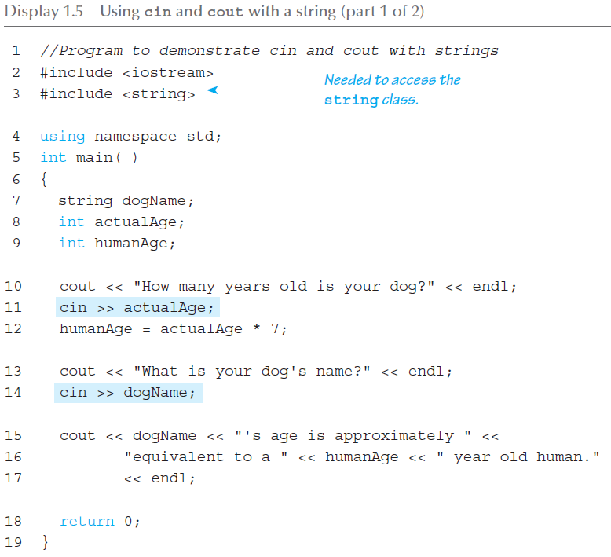
Input/Output (1 of 2)

Slide 36
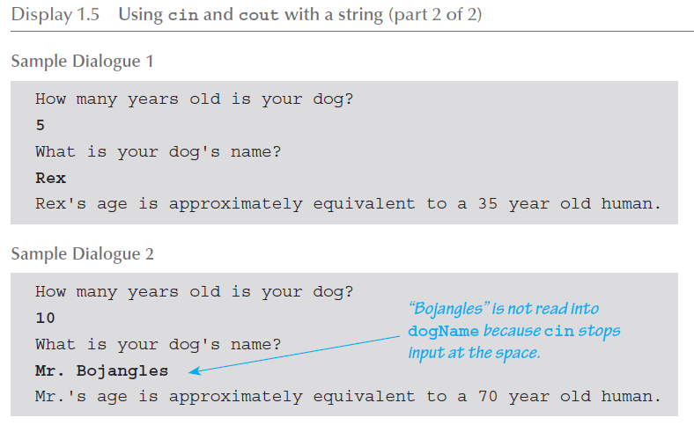
Input/Output (2 of 2)

Slide 37
Formatting Output
Formatting numeric values for output
  Values may not display as you’d expect!
  cout << "The price is $" << price << endl;
    If price (declared double) has value 78.5, you
    might get:
      The price is $78.500000 or:
      The price is $78.5
We must explicitly tell C++ how to output numbers in our programs!

Slide 38
Formatting Numbers
"Magic Formula" to force decimal sizes:
cout.setf(ios::fixed);
cout.setf(ios::showpoint);
cout.precision(2);
These stmts force all future cout’ed values:
  To have exactly two digits after the decimal place
  Example:
  cout << "The price is $" << price << endl;
    Now results in the following:
    The price is $78.50
Can modify precision "as you go" as well!

Slide 39
Error Output
Output with cerr
  cerr works same as cout
  Provides mechanism for distinguishing
  between regular output and error output
Re-direct output streams
  Most systems allow cout and cerr to be
  "redirected" to other devices
    e.g., line printer, output file, error console, etc.

Slide 40
Input Using cin
cin for input, cout for output
Differences:
  ">>" (extraction operator) points opposite
    Think of it as "pointing toward where the data goes"
  Object name "cin" used instead of "cout"
  No literals allowed for cin
    Must input "to a variable"
cin >> num;
  Waits on-screen for keyboard entry
  Value entered at keyboard is "assigned" to num

Slide 41
Prompting for Input: cin and cout
Always "prompt" user for input
cout << "Enter number of dragons: ";
cin >> numOfDragons;
  Note no "\n" in cout. Prompt "waits" on same
  line for keyboard input as follows:
    Enter number of dragons: ____
    Underscore above denotes where keyboard entry
    is made
Every cin should have cout prompt
  Maximizes user-friendly input/output

Slide 42
Program Style
Bottom-line: Make programs easy to read and modify
Comments, two methods:
  // Two slashes indicate entire line is to be ignored
  /*Delimiters indicates everything between is ignored*/
  Both methods commonly used
Identifier naming
  ALL_CAPS for constants
  lowerToUpper for variables
  Most important: MEANINGFUL NAMES!

Slide 43
Libraries
C++ Standard Libraries
#include <Library_Name>
  Directive to "add" contents of library file to
  your program
  Called "preprocessor directive"
    Executes before compiler, and simply "copies"
    library file into your program file
C++ has many libraries
  Input/output, math, strings, etc.

Slide 44
Namespaces
Namespaces defined:
  Collection of name definitions
For now: interested in namespace "std"
  Has all standard library definitions we need
Examples:
#include <iostream>
using namespace std;
    Includes entire standard library of name definitions
#include <iostream>using std::cin;
using std::cout;
    Can specify just the objects we want

Slide 45
Summary 1
C++ is case-sensitive
Use meaningful names
  For variables and constants
Variables must be declared before use
  Should also be initialized
Use care in numeric manipulation
  Precision, parentheses, order of operations
#include C++ libraries as needed

Slide 46
Summary 2
Object cout
  Used for console output
Object cin
  Used for console input
Object cerr
  Used for error messages
Use comments to aid understanding of
your program
  Do not overcomment

