Slide 1
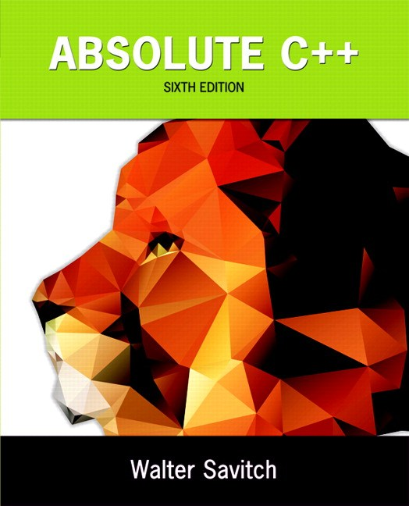
Chapter 16
Templates
Copyright © 2016 Pearson, Inc. All rights reserved.

Slide 2
Learning Objectives
Function Templates
  Syntax, defining
  Compiler complications
Class Templates
  Syntax
  Example: array template class
Templates and Inheritance
  Example: partially-filled array template class

Slide 3
Introduction
C++ templates
  Allow very "general" definitions for functions and classes
  Type names are "parameters" instead of
  actual types
  Precise definition determined at run-time

Slide 4
Function Templates
Recall function swapValues:
void swapValues(int& var1, int& var2)
{
int temp;
temp = var1;
var1 = var2;
var2 = temp;
}
Applies only to variables of type int
But code would work for any types!

Slide 5
Function Templates vs. Overloading
Could overload function for chars:
void swapValues(char& var1, char& var2)
{
char temp;
temp = var1;
var1 = var2;
var2 = temp;
}
But notice: code is nearly identical!
  Only difference is type used in 3 places

Slide 6
Function Template Syntax
Allow "swap values" of any type variables:
template<class T>
void swapValues(T& var1, T& var2)
{
T temp;
temp = var1;
var1 = var2;
var2 = temp;
}
First line called "template prefix"
  Tells compiler what’s coming is "template"
  And that T is a type parameter

Slide 7
Template Prefix
Recall:
template<class T>
In this usage, "class" means "type", or
"classification"
Can be confused with other "known" use
of word "class"!
  C++ allows keyword "typename" in place of
  keyword "class" here
  But most use "class" anyway

Slide 8
Template Prefix 2
Again:
template<class T>
T can be replaced by any type
  Predefined or user-defined (like a C++ class type)
In function definition body:
  T used like any other type
Note: can use other than "T", but T is
"traditional" usage

Slide 9
Function Template Definition
swapValues() function template is actually
large "collection" of definitions!
  A definition for each possible type!
Compiler only generates definitions when
required
  But it’s "as if" you’d defined for all types
Write one definition → works for all types
that might be needed

Slide 10
Calling a Function Template
Consider following call:
swapValues(int1, int2);
  C++ compiler "generates" function definition for two int parameters
  using template
Likewise for all other types
Needn’t do anything "special" in call
  Required definition automatically generated

Slide 11
Another Function Template
Declaration/prototype:
Template<class T>
void showStuff(int stuff1, T stuff2, T stuff3);
Definition:
template<class T>
void showStuff(int stuff1, T stuff2, T stuff3)
{
cout << stuff1 << endl
<< stuff2 << endl
<< stuff3 << endl;
}

Slide 12
showStuff Call
Consider function call:
showStuff(2, 3.3, 4.4);
Compiler generates function definition
  Replaces T with double
    Since second parameter is type double
Displays:
2
3.3
4.4

Slide 13
Compiler Complications
Function declarations and definitions
  Typically we have them separate
  For templates → not supported on
  most compilers!
Safest to place template function
definition in file where invoked
  Many compilers require it appear 1st
  Often we #include all template definitions

Slide 14
More Compiler Complications
Check your compiler’s specific requirements
  Some need to set special options
  Some require special order of arrangement
  of template definitions vs. other file items
Most usable template program layout:
  Template definition in same file it’s used
  Ensure template definition precedes all uses
    Can #include it

Slide 15
Multiple Type Parameters
Can have:
template<class T1, class T2>
Not typical
  Usually only need one "replaceable" type
  Cannot have "unused"
  template parameters
    Each must be "used" in definition
    Error otherwise!

Slide 16
Algorithm Abstraction
Refers to implementing templates
Express algorithms in "general" way:
  Algorithm applies to variables of any type
  Ignore incidental detail
  Concentrate on substantive parts
  of algorithm
Function templates are one way C++
supports algorithm abstraction

Slide 17
Defining Templates Strategies
Develop function normally
  Using actual data types
Completely debug "ordinary" function
Then convert to template
  Replace type names with type parameter
  as needed
Advantages:
  Easier to solve "concrete" case
  Deal with algorithm, not template syntax

Slide 18
Inappropriate Types in Templates
Can use any type in template for which
code makes "sense"
  Code must behave in appropriate way
e.g., swapValues() template function
  Cannot use type for which assignment operator isn’t defined
  Example: an array:
  int a[10], b[10];
  swapValues(a, b);
    Arrays cannot be "assigned"!

Slide 19
Class Templates
Can also "generalize" classes
template<class T>
  Can also apply to class definition
  All instances of "T" in class definition replaced by type parameter
  Just like for function templates!
Once template defined, can declare
objects of the class

Slide 20
Class Template Definition
template<class T>
class Pair
{
public:
Pair();
Pair(T firstVal, T secondVal);
void setFirst(T newVal);
void setSecond(T newVal);
T getFirst() const;
T getSecond() const;
private:
T first; T second;
};

Slide 21
Template Class Pair Members
template<class T>
Pair<T>::Pair(T firstVal, T secondVal)
{
first = firstVal;
second = secondVal;
}
template<class T>
void Pair<T>::setFirst(T newVal)
{
first = newVal;
}

Slide 22
Template Class Pair
Objects of class have "pair" of values of
type T
Can then declare objects:
Pair<int> score;
Pair<char> seats;
  Objects then used like any other objects
Example uses:
score.setFirst(3);
score.setSecond(0);

Slide 23
Pair Member Function Definitions
Notice in member function definitions:
  Each definition is itself a "template"
  Requires template prefix before
  each definition
  Class name before :: is "Pair<T>"
    Not just "Pair"
  But constructor name is just "Pair"
  Destructor name is also just "~Pair"

Slide 24
Class Templates as Parameters
Consider:
int addUP(const Pair<int>& the Pair);
  The type (int) is supplied to be used for T
  in defining this class type parameter
  It "happens" to be call-by-reference here
Again: template types can be used
anywhere standard types can

Slide 25
Class Templates
Within Function Templates
Rather than defining new overload:
template<class T>
T addUp(const Pair<T>& the Pair);
//Precondition: Operator + is defined for values
of type T
//Returns sum of two values in thePair
Function now applies to all kinds
of numbers

Slide 26
Restrictions on Type Parameter
Only "reasonable" types can be substituted
for T
Consider:
  Assignment operator must be "well-behaved"
  Copy constructor must also work
  If T involves pointers, then destructor must
  be suitable!
Similar issues as function templates

Slide 27
Type Definitions
Can define new "class type name"
  To represent specialized class template name
Example:
typedef Pair<int> PairOfInt;
Name "PairOfInt" now used to declare
objects of type Pair<int>:
PairOfInt pair1, pair2;
Name can also be used as parameter,
or anywhere else type name allowed

Slide 28
Friends and Templates
Friend functions can be used with
template classes
  Same as with ordinary classes
  Simply requires type parameter
  where appropriate
Very common to have friends of
template classes
  Especially for operator overloads (as
  we’ve seen)

Slide 29
Predefined Template Classes
Recall vector class
  It’s a template class!
Another: basic_string template class
  Deals with strings of "any-type" elements
  e.g.,
basic_string<char> works for char’s
basic_string<double> works for doubles
basic_string<YourClass> works for
YourClass objects

Slide 30
basic_string Template Class
Already used it!
Recall "string"
  It’s an alternate name for basic_string<char>
  All member functions behave similarly for
  basic_string<T>
basic_string defined in library <string>
  Definition is in std namespace

Slide 31
Templates and Inheritance
Nothing new here
Derived template classes
  Can derive from template or
  nontemplate class
  Derived class is then naturally a
  template class
Syntax same as ordinary class derived
from ordinary class

Slide 32
Summary
Function templates
  Define functions with parameter for a type
Class templates
  Define class with parameter for subparts of class
Predefined vector and basic_string
classes are template classes
Can define template class derived from
a template base class

