Slide 1

Chapter 2
Flow of Control
Copyright © 2016 Pearson, Inc. All rights reserved.

Slide 2
Learning Objectives
Boolean Expressions
  Building, Evaluating & Precedence Rules
Branching Mechanisms
  if-else
  switch
  Nesting if-else
Loops
  While, do-while, for
  Nesting loops
Introduction to File Input

Slide 3
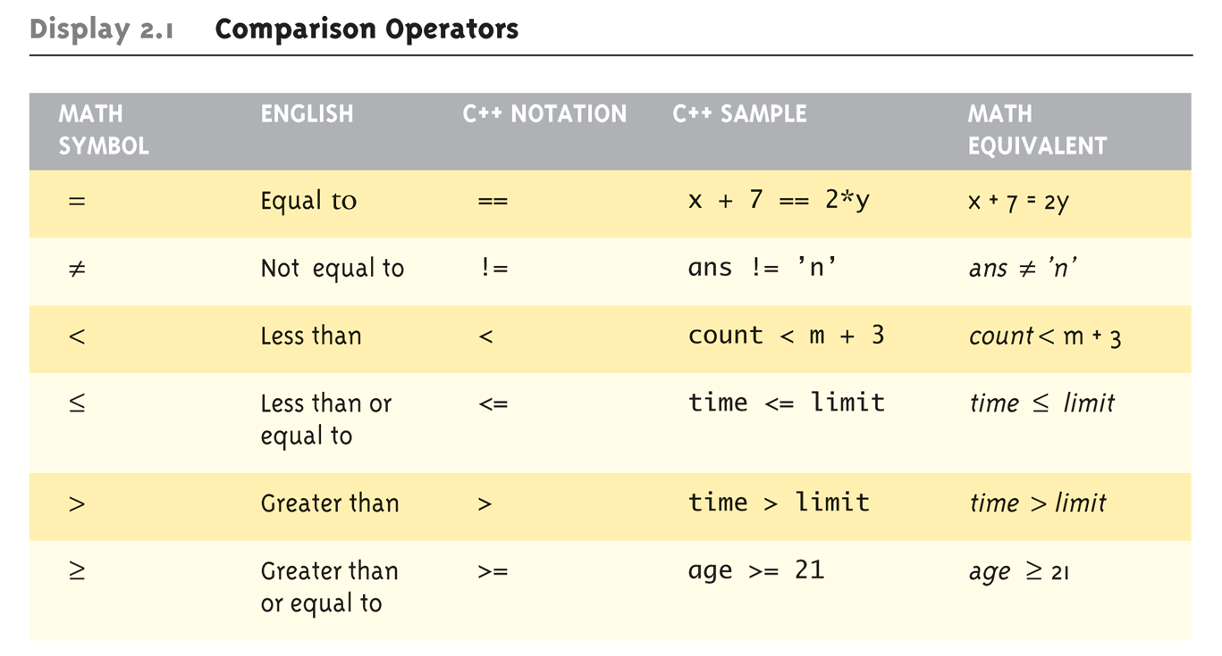
Boolean Expressions:
Display 2.1 Comparison Operators
Logical Operators
  Logical AND (&&)
  Logical OR (||)

Slide 4
Evaluating Boolean Expressions
Data type bool
  Returns true or false
  true, false are predefined library consts
Truth tables
  Display 2.2 next slide

Slide 5
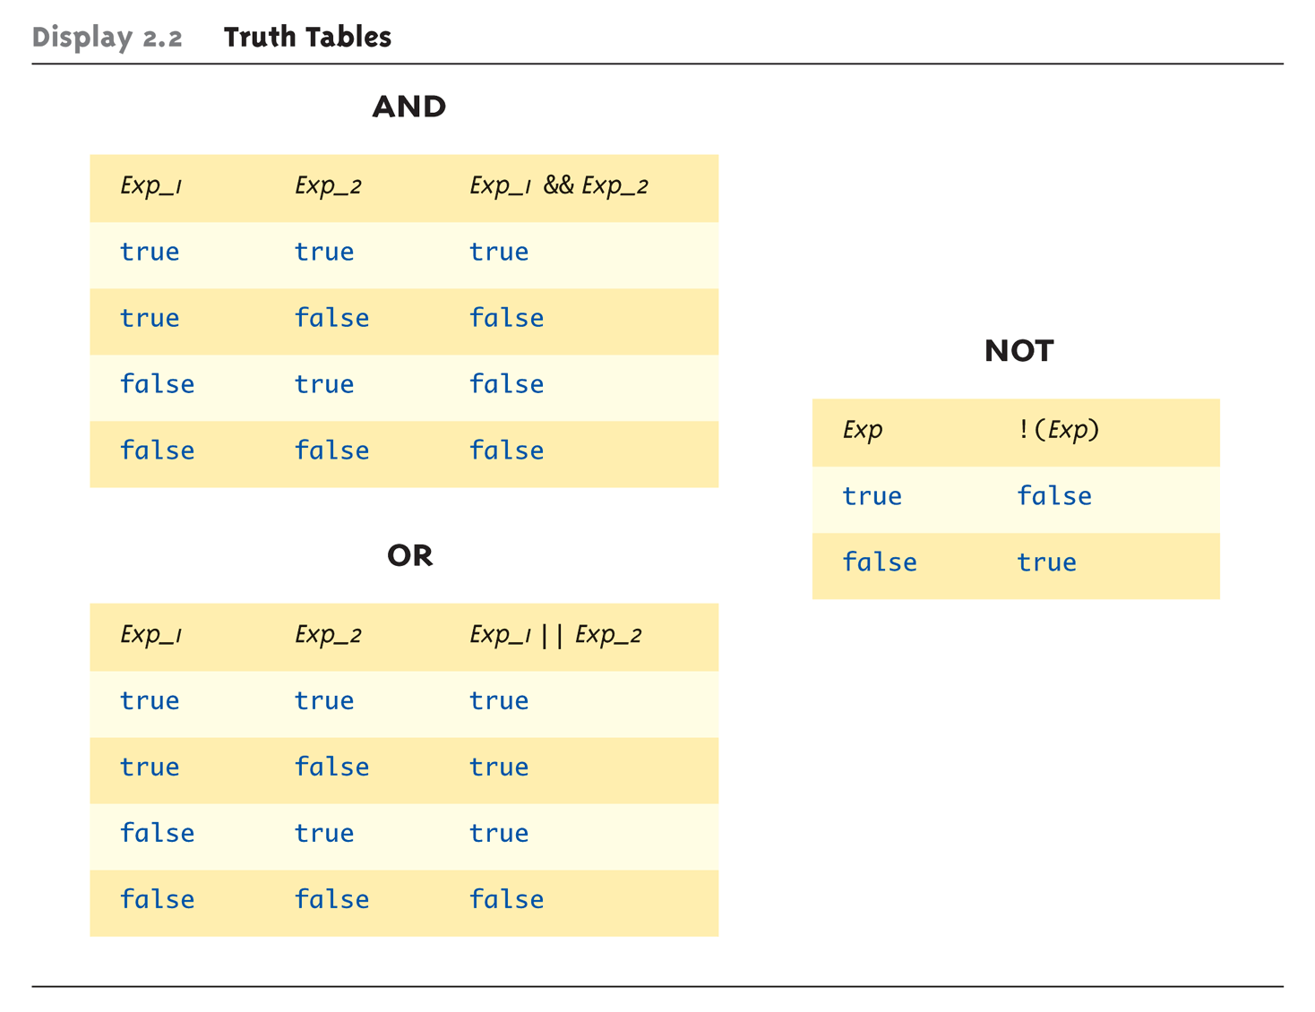
Evaluating Boolean Expressions: Display 2.2 Truth Tables

Slide 6
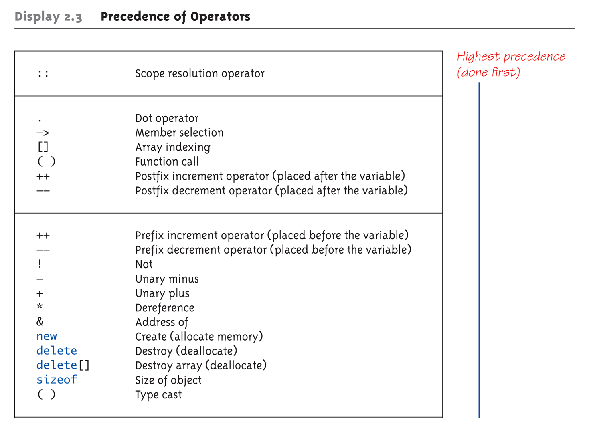
Display 2.3
Precedence of Operators (1 of 4)

Slide 7
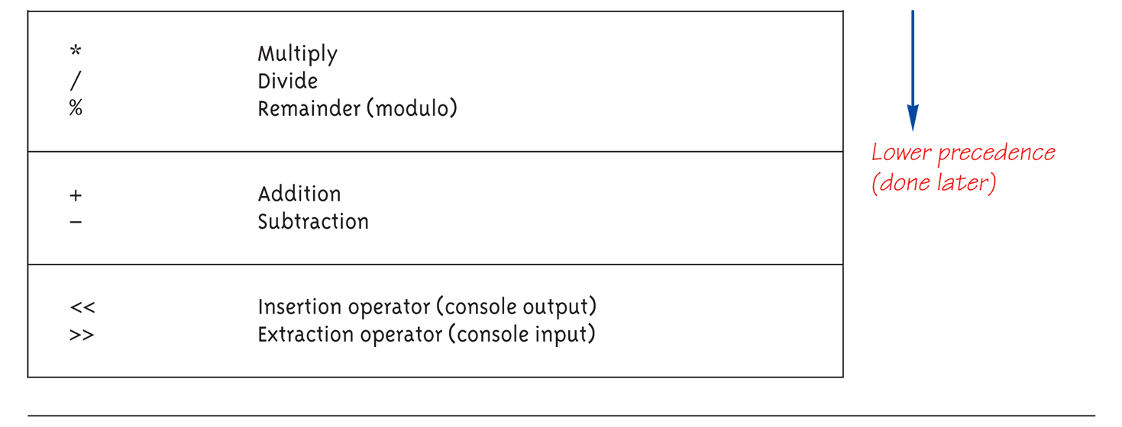
Display 2.3
Precedence of Operators (2 of 4)

Slide 8
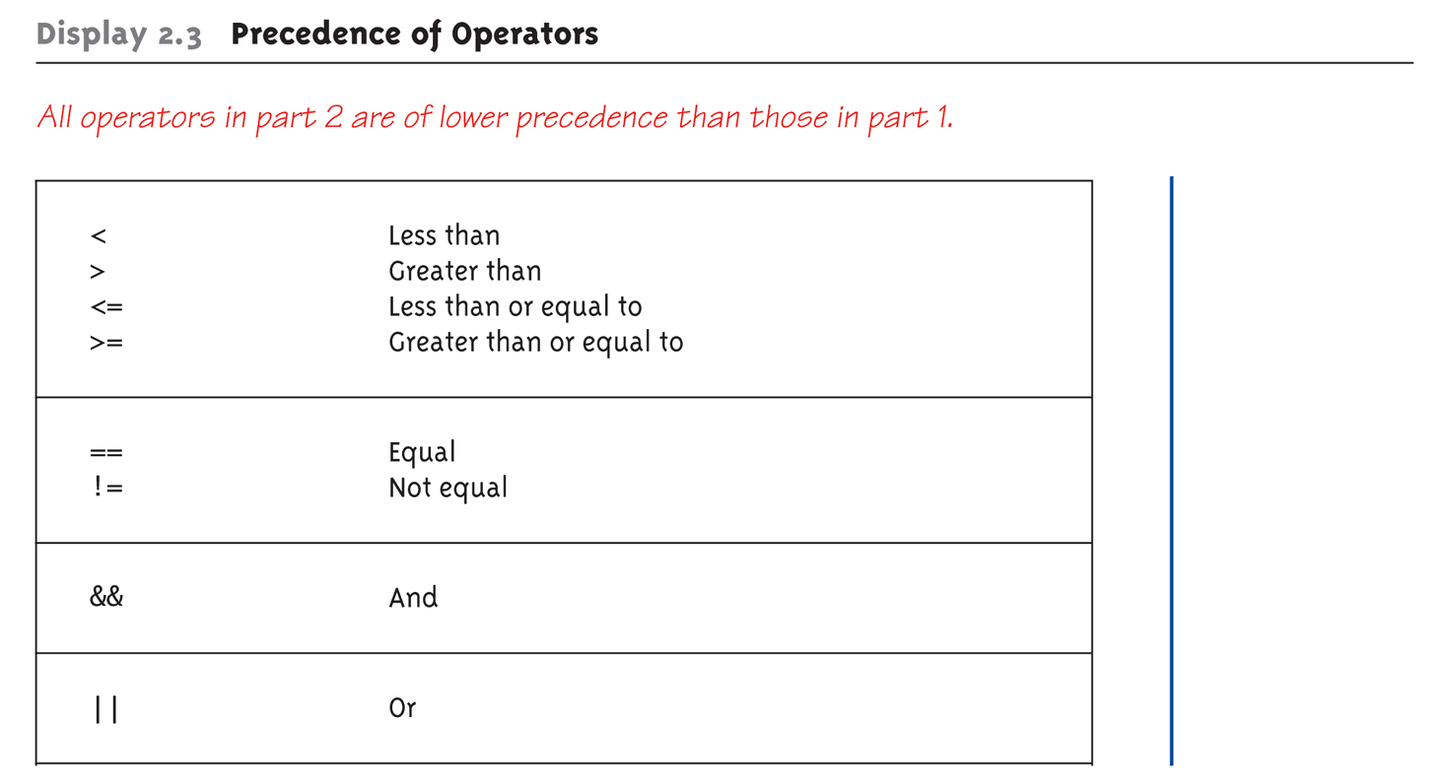
Display 2.3
Precedence of Operators (3 of 4)

Slide 9
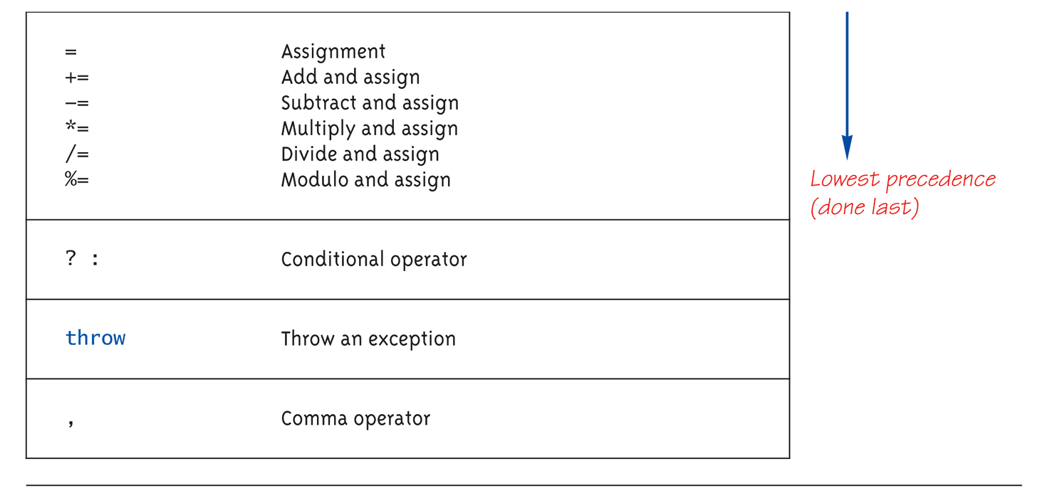
Display 2.3
Precedence of Operators (4 of 4)

Slide 10
Precedence Examples
Arithmetic before logical
  x + 1 > 2 || x + 1 < -3 means:
    (x + 1) > 2 || (x + 1) < -3
Short-circuit evaluation
  (x >= 0) && (y > 1)
  Be careful with increment operators!
    (x > 1) && (y++)
Integers as boolean values
  All non-zero values → true
  Zero value → false

Slide 11
Strong Enum
C++11 introduces strong enums or enum classes
  Does not act like an integer
  Examples
  Illegal: if (d == 0)
  Legal: if (d == Days::Wed)
enum class Days { Sun, Mon, Tue, Wed, Thu, Fri, Sat };
enum class Weather { Rain, Sun };
Days d = Days::Tue;
Weather w = Weather::Sun;

Slide 12
Branching Mechanisms
if-else statements
  Choice of two alternate statements based
  on condition expression
  Example:
  if (hrs > 40)
  grossPay = rate*40 + 1.5*rate*(hrs-40);
  else
  grossPay = rate*hrs;

Slide 13
if-else Statement Syntax
Formal syntax:
if (<boolean_expression>)
<yes_statement>
else
<no_statement>
Note each alternative is only
ONE statement!
To have multiple statements execute in
either branch → use compound statement

Slide 14
Compound/Block Statement
Only "get" one statement per branch
Must use compound statement { }
for multiples
  Also called a "block" stmt
Each block should have block statement
  Even if just one statement
  Enhances readability

Slide 15
Compound Statement in Action
Note indenting in this example:
if (myScore > yourScore)
{
cout << "I win!\n";
wager = wager + 100;
}
else
{
cout << "I wish these were golf scores.\n";
wager = 0;
}

Slide 16
Common Pitfalls
Operator "=" vs. operator "=="
One means "assignment" (=)
One means "equality" (==)
  VERY different in C++!
  Example:
  if (x = 12) ←Note operator used!
  Do_Something
  else
  Do_Something_Else

Slide 17
The Optional else
else clause is optional
  If, in the false branch (else), you want "nothing" to happen, leave it out
  Example:
  if (sales >= minimum)
  salary = salary + bonus;
  cout << "Salary = %" << salary;
  Note: nothing to do for false condition, so there is no else clause!
  Execution continues with cout statement

Slide 18
Nested Statements
if-else statements contain smaller statements
  Compound or simple statements (we’ve seen)
  Can also contain any statement at all, including another if-else stmt!
  Example:
  if (speed > 55)
  if (speed > 80)
  cout << "You’re really speeding!";
  else
  cout << "You’re speeding.";
    Note proper indenting!

Slide 19
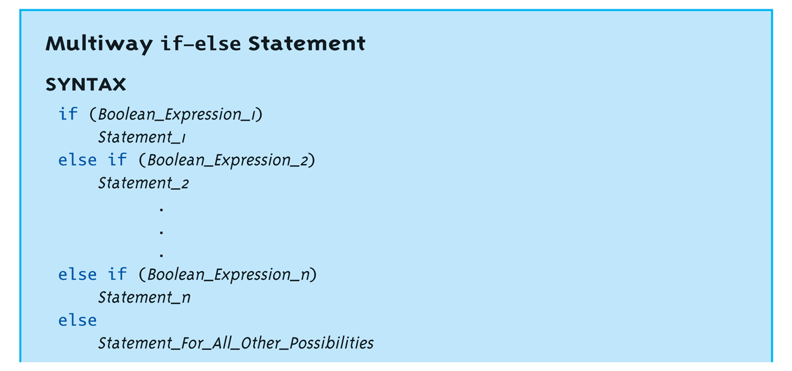
Multiway if-else
Not new, just different indenting
Avoids "excessive" indenting
  Syntax:

Slide 20
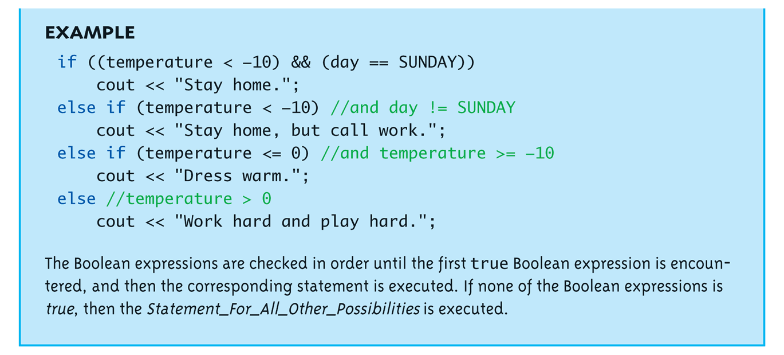
Multiway if-else Example

Slide 21
The switch Statement
A statement for controlling multiple branches
Can do the same thing with if statements but sometimes switch is more convenient
Uses controlling expression which returns bool data type (true or false)
Syntax:
  Next slide

Slide 22
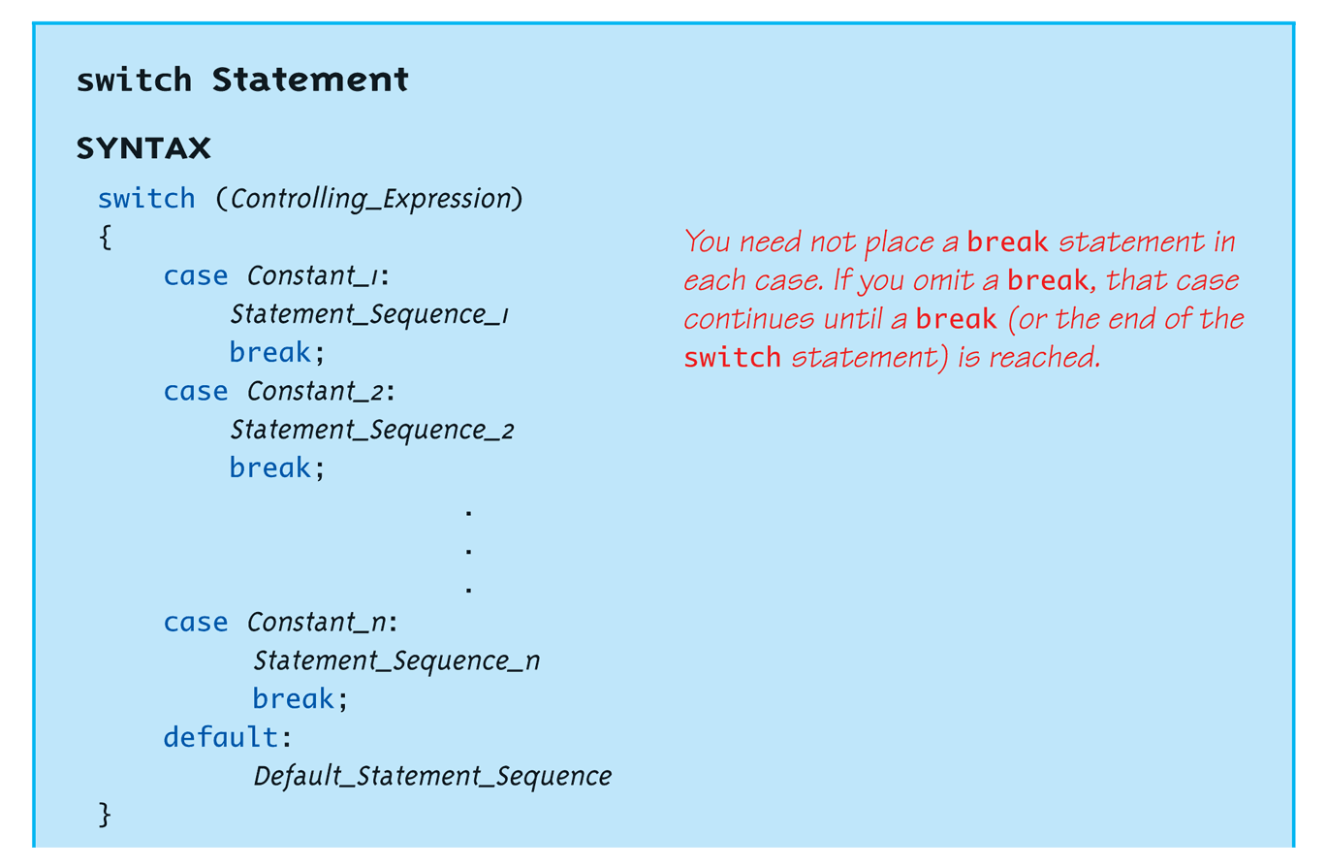
switch Statement Syntax
The controlling expression must be integral! This includes char.

Slide 23
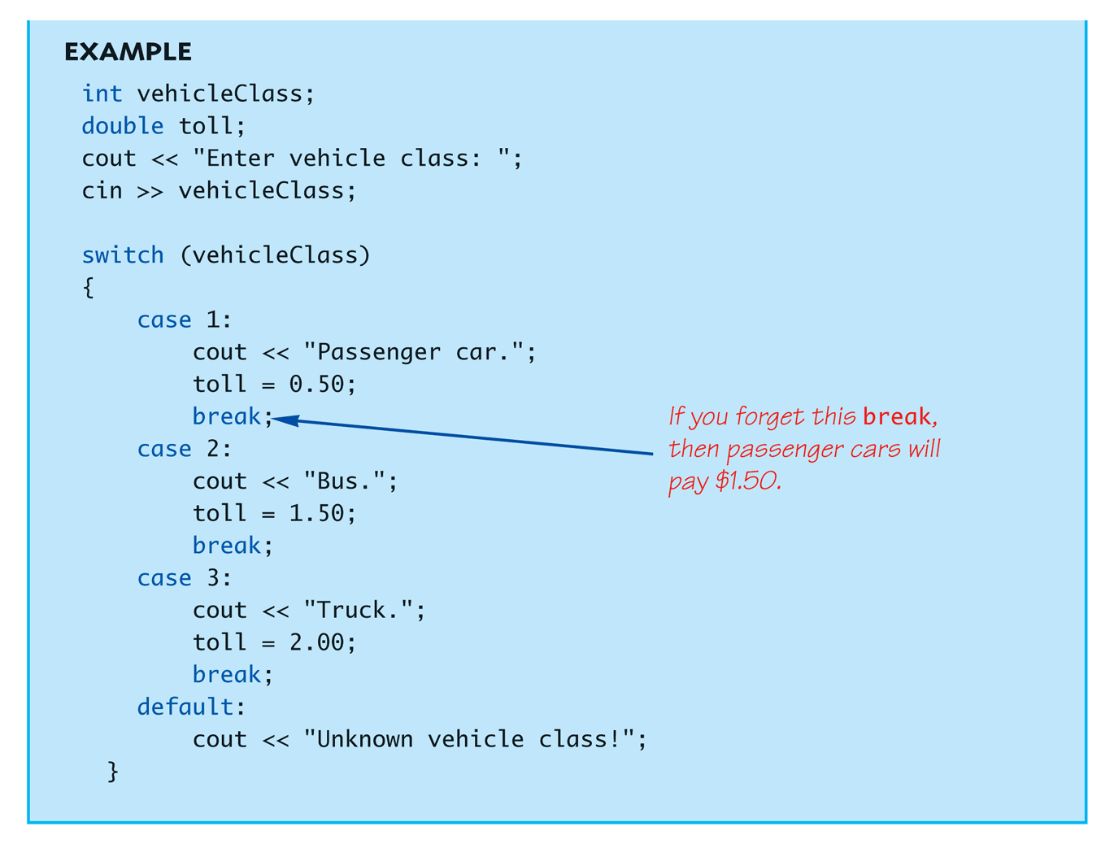
The switch Statement in Action

Slide 24
The switch: multiple case labels
Execution "falls thru" until break
  switch provides a "point of entry"
  Example:
  case 'A':
  case 'a':
  cout << "Excellent: you got an "A"!\n";
  break;
  case 'B':
  case 'b':
  cout << "Good: you got a "B"!\n";
  break;
  Note multiple labels provide same "entry"

Slide 25
switch Pitfalls/Tip
Forgetting the break;
  No compiler error
  Execution simply "falls thru" other cases until break;
Biggest use: MENUs
  Provides clearer "big-picture" view
  Shows menu structure effectively
  Each branch is one menu choice

Slide 26
switch Menu Example
Switch stmt "perfect" for menus:
switch (response)
{
case 1:
// Execute menu option 1
break;
case 2:
// Execute menu option 2
break;
case 3:
// Execute menu option 3
break;
default:
cout << "Please enter valid response.";
}

Slide 27
Conditional Operator
Also called "ternary operator"
  Allows embedded conditional in expression
  Essentially "shorthand if-else" operator
  Example:
  if (n1 > n2)
  max = n1;
  else
  max = n2;
  Can be written:
  max = (n1 > n2) ? N1 : n2;
    "?" and ":" form this "ternary" operator

Slide 28
Loops
3 Types of loops in C++
  while
    Most flexible
    No "restrictions"
  do-while
    Least flexible
    Always executes loop body at least once
  for
    Natural "counting" loop

Slide 29
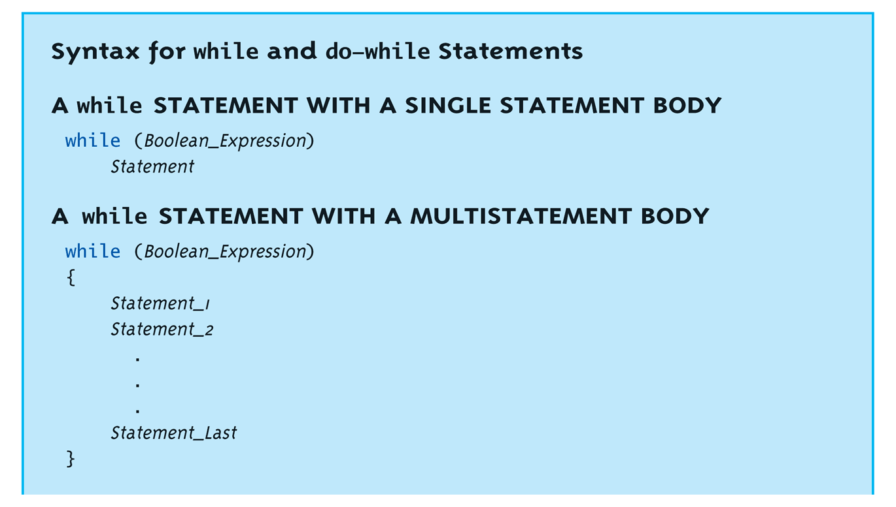
while Loops Syntax

Slide 30
while Loop Example
Consider:
count = 0; // Initialization
while (count < 3) // Loop Condition
{
cout << "Hi "; // Loop Body
count++; // Update expression
}
  Loop body executes how many times?

Slide 31
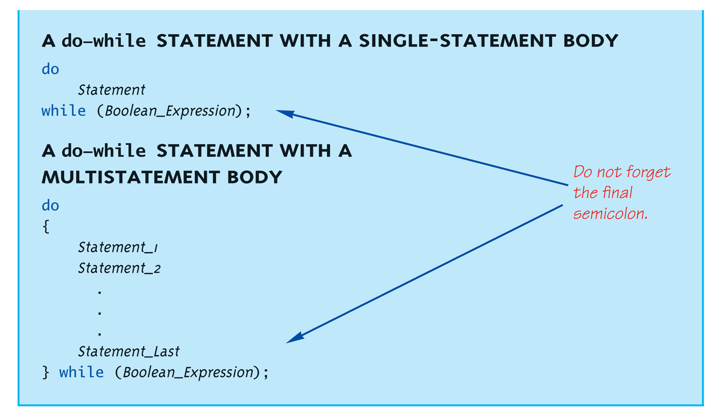
do-while Loop Syntax

Slide 32
do-while Loop Example
count = 0; // Initialization
do
{
cout << "Hi "; // Loop Body
count++; // Update expression
} while (count < 3); // Loop Condition
  Loop body executes how many times?
  do-while loops always execute body at least once!

Slide 33
while vs. do-while
Very similar, but…
  One important difference
    Issue is "WHEN" boolean expression is checked
    while: checks BEFORE body is executed
    do-while: checked AFTER body is executed
After this difference, they’re
essentially identical!
while is more common, due to it’s
ultimate "flexibility"

Slide 34
Comma Operator
Evaluate list of expressions, returning
value of the last expression
Most often used in a for-loop
Example:
first = (first = 2, second = first + 1);
  first gets assigned the value 3
  second gets assigned the value 3
No guarantee what order expressions will
be evaluated.

Slide 35
for Loop Syntax
for (Init_Action; Bool_Exp; Update_Action)
Body_Statement
Like if-else, Body_Statement can be
a block statement
  Much more typical

Slide 36
for Loop Example
for (count=0;count<3;count++)
{
cout << "Hi "; // Loop Body
}
How many times does loop body execute?
Initialization, loop condition and update all
"built into" the for-loop structure!
A natural "counting" loop

Slide 37
Loop Issues
Loop’s condition expression can be ANY boolean expression
Examples:
  while (count<3 && done!=0)
  {
  // Do something
  }
  for (index=0;index<10 && entry!=-99)
  {
  // Do something
  }

Slide 38
Loop Pitfalls: Misplaced ;
Watch the misplaced ; (semicolon)
  Example:
  while (response != 0) ;←
  {
  cout << "Enter val: ";
  cin >> response;
  }
  Notice the ";" after the while condition!
Result here: INFINITE LOOP!

Slide 39
Loop Pitfalls: Infinite Loops
Loop condition must evaluate to false at
some iteration through loop
  If not → infinite loop.
  Example:
  while (1)
  {
  cout << "Hello ";
  }
  A perfectly legal C++ loop → always infinite!
Infinite loops can be desirable
  e.g., "Embedded Systems"

Slide 40
The break and continue Statements
Flow of Control
  Recall how loops provide "graceful" and clear flow of control in and out
  In RARE instances, can alter natural flow
break;
  Forces loop to exit immediately.
continue;
  Skips rest of loop body
These statements violate natural flow
  Only used when absolutely necessary!

Slide 41
Nested Loops
Recall: ANY valid C++ statements can be
inside body of loop
This includes additional loop statements!
  Called "nested loops"
Requires careful indenting:
for (outer=0; outer<5; outer++)
for (inner=7; inner>2; inner--)
cout << outer << inner;
  Notice no { } since each body is one statement
  Good style dictates we use { } anyway

Slide 42
Introduction to File Input
We can use cin to read from a file in a manner very similar to reading from the keyboard
Only an introduction is given here, more details are in chapter 12
  Just enough so you can read from text files and process larger amounts of data that would be too much work to type in

Slide 43
Opening a Text File
Add at the top
  #include <fstream>
  using namespace std;
You can then declare an input stream just as you would declare any other variable.
  ifstream inputStream;
Next you must connect the inputStream variable to a text file on the disk.
  inputStream.open("filename.txt");
The “filename.txt” is the pathname to a text file or a file in the current directory

Slide 44
Reading from a Text File
Use
  inputStream >> var;
The result is the same as using cin >> var except the input is coming from the text file and not the keyboard
When done with the file close it with
inputStream.close();

Slide 45
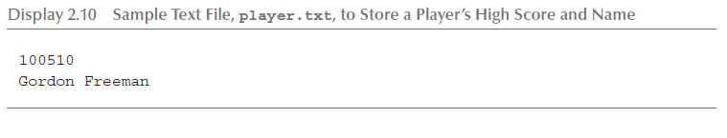
File Input Example (1 of 2)
Consider a text file named player.txt with the following text

Slide 46
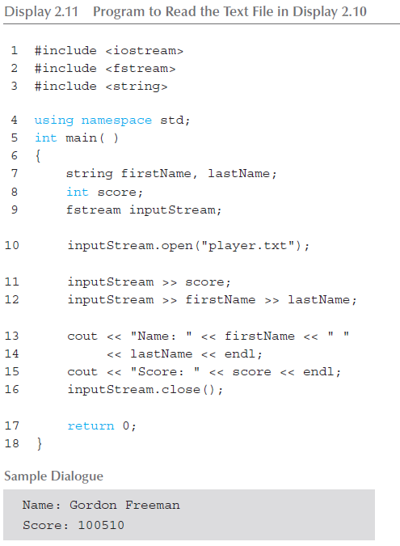
File Input Example (2 of 2)

Slide 47
Summary 1
Boolean expressions
  Similar to arithmetic → results in true or false
C++ branching statements
  if-else, switch
  switch statement great for menus
C++ loop statements
  while
  do-while
  for

Slide 48
Summary 2
do-while loops
  Always execute their loop body at least once
for-loop
  A natural "counting" loop
Loops can be exited early
  break statement
  continue statement
  Usage restricted for style purposes
Reading from a text file is similar to reading from cin

