Slide 1
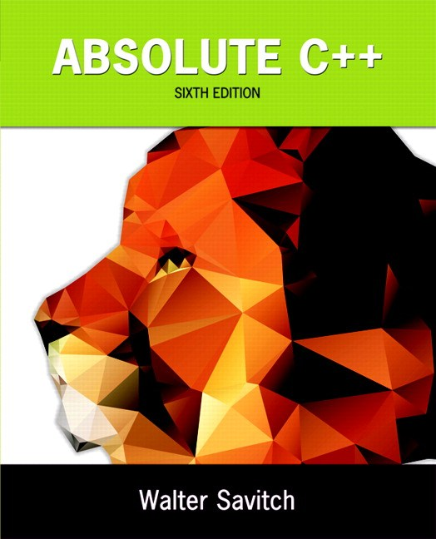
Chapter 3
Function Basics
Copyright © 2016 Pearson, Inc. All rights reserved.

Slide 2
Learning Objectives
Predefined Functions
  Those that return a value and those that don’t
Programmer-defined Functions
  Defining, Declaring, Calling
  Recursive Functions
Scope Rules
  Local variables
  Global constants and global variables
  Blocks, nested scopes

Slide 3
Introduction to Functions
Building Blocks of Programs
Other terminology in other languages:
  Procedures, subprograms, methods
  In C++: functions
I-P-O
  Input – Process – Output
  Basic subparts to any program
  Use functions for these "pieces"

Slide 4
Predefined Functions
Libraries full of functions for our use!
Two types:
  Those that return a value
  Those that do not (void)
Must "#include" appropriate library
  e.g.,
    <cmath>, <cstdlib> (Original "C" libraries)
    <iostream> (for cout, cin)

Slide 5
Using Predefined Functions
Math functions very plentiful
  Found in library <cmath.h>
  Most return a value (the "answer")
Example: theRoot = sqrt(9.0);
  Components:
  sqrt = name of library function
  theRoot = variable used to assign "answer" to
  9.0 = argument or "starting input" for function
  In I-P-O:
    I = 9.0
    P = "compute the square root"
    O = 3, which is returned & assigned to theRoot

Slide 6
The Function Call
Back to this assignment:
theRoot = sqrt(9.0);
  The expression "sqrt(9.0)" is known as a
  function call, or function invocation
  The argument in a function call (9.0) can be a
  literal, a variable, or an expression
  The call itself can be part of an expression:
    bonus = sqrt(sales)/10;
    A function call is allowed wherever it’s legal to use
    an expression of the function’s return type

Slide 7
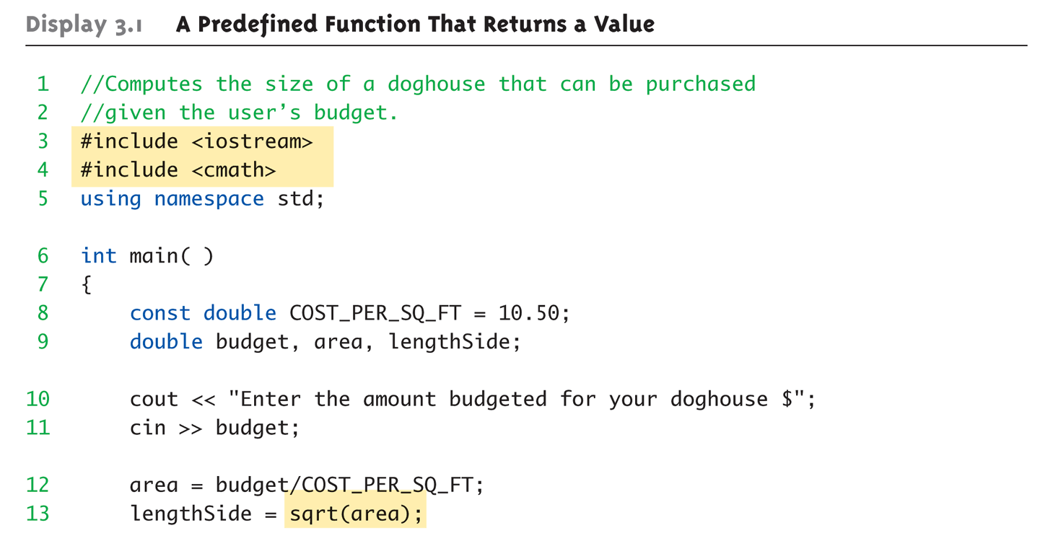
A Larger Example:
Display 3.1 A Predefined Function That Returns a Value (1 of 2)

Slide 8
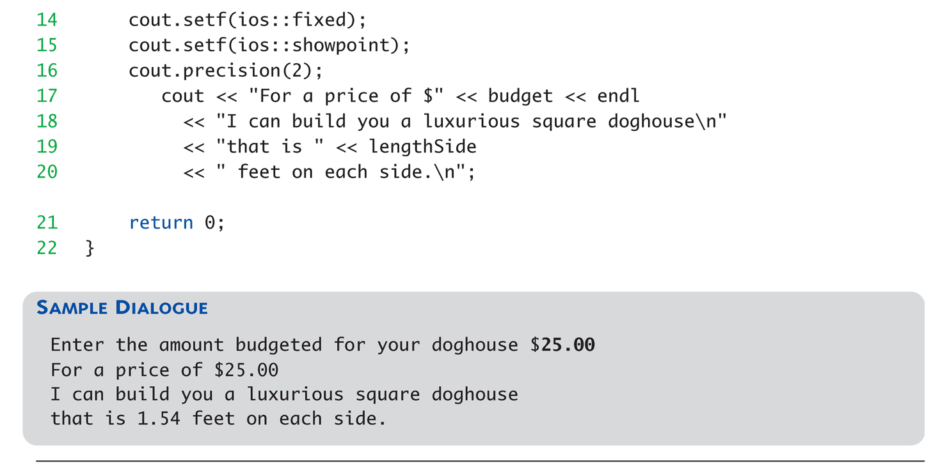
A Larger Example:
Display 3.1 A Predefined Function That Returns a Value (2 of 2)

Slide 9
More Predefined Functions
#include <cstdlib>
  Library contains functions like:
    abs() // Returns absolute value of an int
    labs() // Returns absolute value of a long int
    *fabs() // Returns absolute value of a float
  *fabs() is actually in library <cmath>!
    Can be confusing
    Remember: libraries were added after C++ was
    "born," in incremental phases
    Refer to appendices/manuals for details

Slide 10
More Math Functions
pow(x, y)
  Returns x to the power y
  double result, x = 3.0, y = 2.0;
  result = pow(x, y);
  cout << result;
    Here 9.0 is displayed since 3.0^{2.0} = 9.0
Notice this function receives two arguments
  A function can have any number of arguments, of varying data types

Slide 11
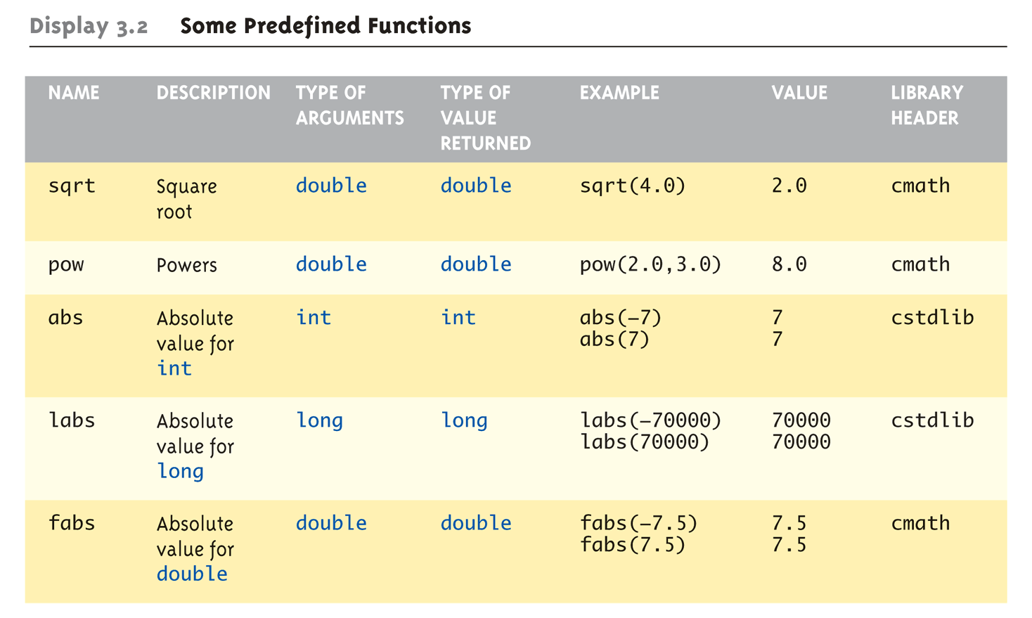
Even More Math Functions:
Display 3.2 Some Predefined
Functions (1 of 2)

Slide 12
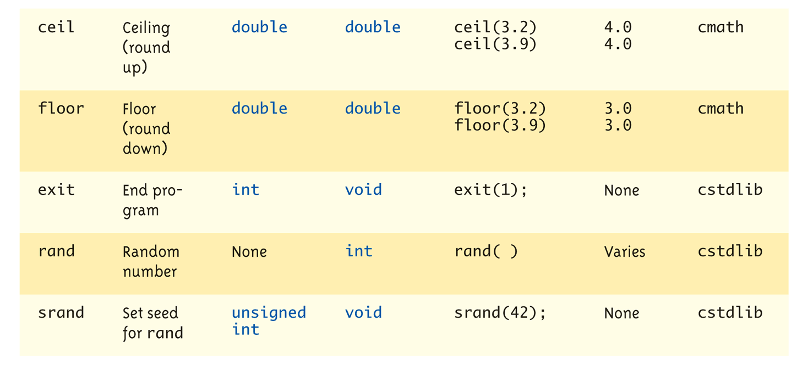
Even More Math Functions:
Display 3.2 Some Predefined
Functions (2 of 2)

Slide 13
Predefined Void Functions
No returned value
Performs an action, but sends no "answer"
When called, it’s a statement itself
  exit(1); // No return value, so not assigned
    This call terminates program
    void functions can still have arguments
All aspects same as functions that "return
a value"
  They just don’t return a value!

Slide 14
Random Number Generator
Return "randomly chosen" number
Used for simulations, games
  rand()
    Takes no arguments
    Returns value between 0 & RAND_MAX
  Scaling
    Squeezes random number into smaller range
    rand() % 6
    Returns random value between 0 & 5
  Shifting
  rand() % 6 + 1
    Shifts range between 1 & 6 (e.g., die roll)

Slide 15
Random Number Seed
Pseudorandom numbers
  Calls to rand() produce given "sequence"
  of random numbers
Use "seed" to alter sequence
srand(seed_value);
  void function
  Receives one argument, the "seed"
  Can use any seed value, including system time:
  srand(time(0));
  time() returns system time as numeric value
  Library <time> contains time() functions

Slide 16
Random Examples
Random double between 0.0 & 1.0:
(RAND_MAX – rand())/static_cast<double>(RAND_MAX)
  Type cast used to force double-precision division
Random int between 1 & 6:
rand() % 6 + 1
  "%" is modulus operator (remainder)
Random int between 10 & 20:
rand() % 10 + 10

Slide 17
Programmer-Defined Functions
Write your own functions!
Building blocks of programs
  Divide & Conquer
  Readability
  Re-use
Your "definition" can go in either:
  Same file as main()
  Separate file so others can use it, too

Slide 18
Components of Function Use
3 Pieces to using functions:
  Function Declaration/prototype
    Information for compiler
    To properly interpret calls
  Function Definition
    Actual implementation/code for what
    function does
  Function Call
    Transfer control to function

Slide 19
Function Declaration
Also called function prototoype
An "informational" declaration for compiler
Tells compiler how to interpret calls
  Syntax:
  <return_type> FnName(<formal-parameter-list>);
  Example:
  double totalCost( int numberParameter,
  double priceParameter);
Placed before any calls
  In declaration space of main()
  Or above main() in global space

Slide 20
Function Definition
Implementation of function
Just like implementing function main()
Example:
double totalCost( int numberParameter,
double priceParameter)
{
const double TAXRATE = 0.05;
double subTotal;
subtotal = priceParameter * numberParameter;
return (subtotal + subtotal * TAXRATE);
}
Notice proper indenting

Slide 21
Function Definition Placement
Placed after function main()
  NOT "inside" function main()!
Functions are "equals"; no function is ever
"part" of another
Formal parameters in definition
  "Placeholders" for data sent in
    "Variable name" used to refer to data in definition
return statement
  Sends data back to caller

Slide 22
Function Call
Just like calling predefined function
bill = totalCost(number, price);
Recall: totalCost returns double value
  Assigned to variable named "bill"
Arguments here: number, price
  Recall arguments can be literals, variables,
  expressions, or combination
  In function call, arguments often called
  "actual arguments"
    Because they contain the "actual data" being sent

Slide 23
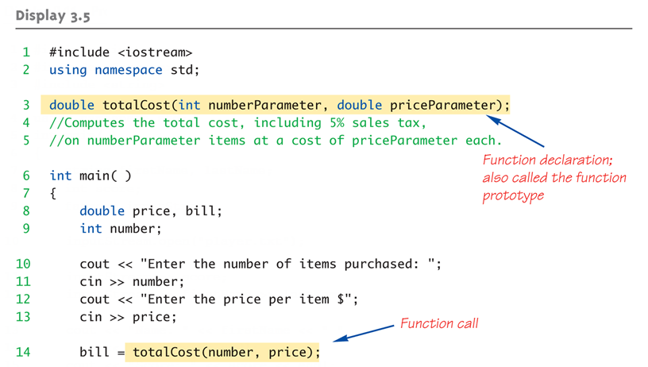
Function Example:
Display 3.5 A Function to Calculate Total Cost (1 of 2)

Slide 24
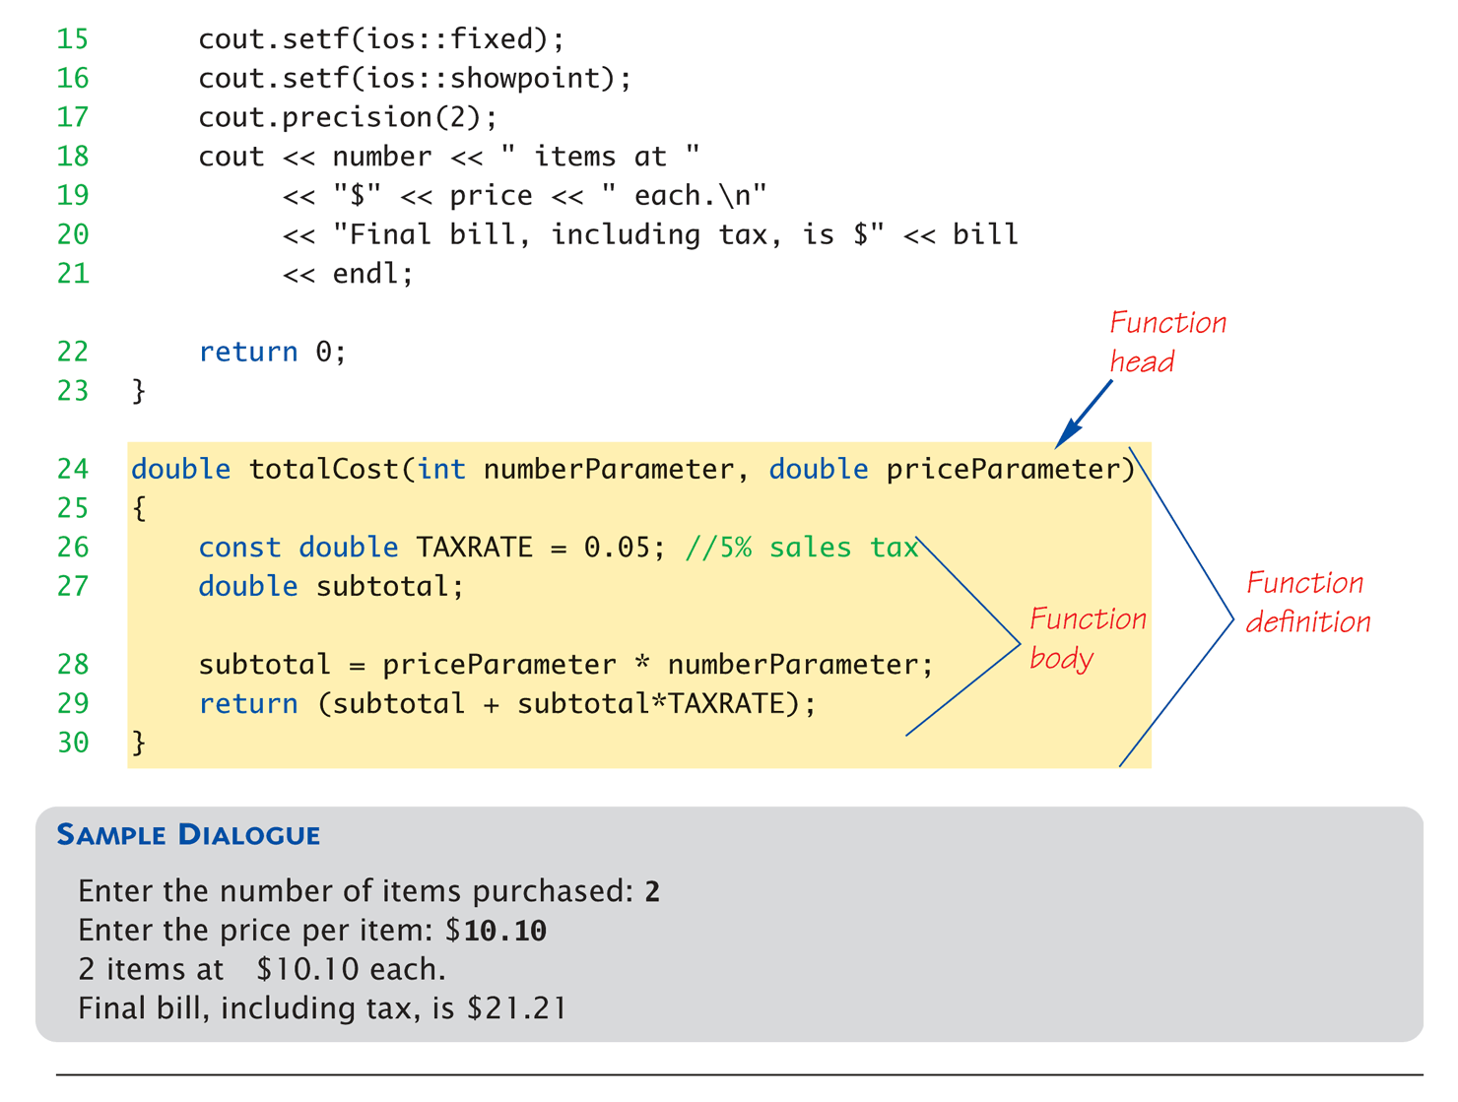
Function Example:
Display 3.5 A Function to Calculate Total Cost (1 of 2)

Slide 25
Alternative Function Declaration
Recall: Function declaration is "information"
for compiler
Compiler only needs to know:
    Return type
    Function name
    Parameter list
Formal parameter names not needed:
double totalCost(int, double);
  Still "should" put in formal parameter names
    Improves readability

Slide 26
Parameter vs. Argument
Terms often used interchangeably
Formal parameters/arguments
  In function declaration
  In function definition’s header
Actual parameters/arguments
  In function call
Technically parameter is "formal" piece
while argument is "actual" piece*
  *Terms not always used this way

Slide 27
Functions Calling Functions
We’re already doing this!
  main() IS a function!
Only requirement:
  Function’s declaration must appear first
Function’s definition typically elsewhere
  After main()"s definition
  Or in separate file
Common for functions to call many other
functions
Function can even call itself → "Recursion"

Slide 28
Boolean Return-Type Functions
Return-type can be any valid type
  Given function declaration/prototype:
  bool appropriate(int rate);
  And function’s definition:
  bool appropriate (int rate)
  {
  return (((rate>=10)&&(rate<20))||(rate==0);
  }
  Returns "true" or "false"
  Function call, from some other function:
  if (appropriate(entered_rate))
  cout << "Rate is valid\n";

Slide 29
Declaring Void Functions
Similar to functions returning a value
Return type specified as "void"
Example:
  Function declaration/prototype:
  void showResults( double fDegrees,
  double cDegrees);
    Return-type is "void"
    Nothing is returned

Slide 30
Declaring Void Functions
Function definition:
void showResults(double fDegrees, double cDegrees)
{
cout.setf(ios::fixed);
cout.setf(ios::showpoint);
cout.precision(1);
cout << fDegrees
<< " degrees fahrenheit equals \n"
<< cDegrees << " degrees celsius.\n";
}
Notice: no return statement
  Optional for void functions

Slide 31
Calling Void Functions
Same as calling predefined void functions
From some other function, like main():
  showResults(degreesF, degreesC);
  showResults(32.5, 0.3);
Notice no assignment, since no
value returned
Actual arguments (degreesF, degreesC)
  Passed to function
  Function is called to "do it’s job" with the
  data passed in

Slide 32
More on Return Statements
Transfers control back to "calling" function
  For return type other than void, MUST have
  return statement
  Typically the LAST statement in
  function definition
return statement optional for void functions
  Closing } would implicitly return control from
  void function

Slide 33
Preconditions and Postconditions
Similar to "I-P-O" discussion
Comment function declaration:
void showInterest(double balance, double rate);
//Precondition: balance is nonnegative account balance
// rate is interest rate as percentage
//Postcondition: amount of interest on given balance,
// at given rate …
Often called Inputs & Outputs

Slide 34
main(): "Special"
Recall: main() IS a function
"Special" in that:
  One and only one function called main()
  will exist in a program
Who calls main()?
  Operating system
  Tradition holds it should have return statement
    Value returned to "caller" → Here: operating system
  Should return "int" or "void"

Slide 35
Scope Rules
Local variables
  Declared inside body of given function
  Available only within that function
Can have variables with same names declared in different functions
  Scope is local: "that function is it’s scope"
Local variables preferred
  Maintain individual control over data
  Need to know basis
  Functions should declare whatever local data needed to "do their job"

Slide 36
Procedural Abstraction
Need to know "what" function does, not
"how" it does it!
Think "black box"
  Device you know how to use, but not it’s
  method of operation
Implement functions like black box
  User of function only needs: declaration
  Does NOT need function definition
    Called Information Hiding
    Hide details of "how" function does it’s job

Slide 37
Global Constants and Global Variables
Declared "outside" function body
  Global to all functions in that file
Declared "inside" function body
  Local to that function
Global declarations typical for constants:
  const double TAXRATE = 0.05;
  Declare globally so all functions have scope
Global variables?
  Possible, but SELDOM-USED
  Dangerous: no control over usage!

Slide 38
Blocks
Declare data inside compound statement
  Called a "block"
  Has "block-scope"
Note: all function definitions are blocks!
  This provides local "function-scope"
Loop blocks:
for (int ctr=0;ctr<10;ctr++)
{
sum+=ctr;
}
  Variable ctr has scope in loop body block only

Slide 39
Nested Scope
Same name variables declared in
multiple blocks
Very legal; scope is "block-scope"
  No ambiguity
  Each name is distinct within its scope

Slide 40
Summary 1
Two kinds of functions:
  "Return-a-value" and void functions
Functions should be "black boxes"
  Hide "how" details
  Declare own local data
Function declarations should self-document
  Provide pre- & post-conditions in comments
  Provide all "caller" needs for use

Slide 41
Summary 2
Local data
  Declared in function definition
Global data
  Declared above function definitions
  OK for constants, not for variables
Parameters/Arguments
  Formal: In function declaration and definition
    Placeholder for incoming data
  Actual: In function call
    Actual data passed to function

