Slide 1
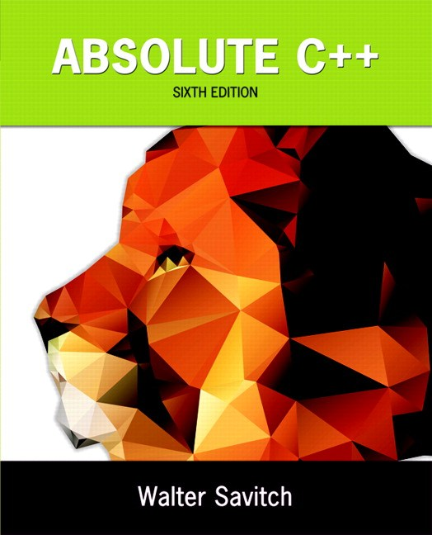
Chapter 6
Structures
and Classes
Copyright © 2016 Pearson, Inc. All rights reserved.

Slide 2
Learning Objectives
Structures
  Structure types
  Structures as function arguments
  Initializing structures
Classes
  Defining, member functions
  Public and private members
  Accessor and mutator functions
  Structures vs. classes

Slide 3
Structures
2nd aggregate data type: struct
Recall: aggregate meaning "grouping"
  Recall array: collection of values of same type
  Structure: collection of values of different types
Treated as a single item, like arrays
Major difference: Must first "define" struct
  Prior to declaring any variables

Slide 4
Structure Types
Define struct globally (typically)
No memory is allocated
  Just a "placeholder" for what our struct
  will "look like"
Definition:
struct CDAccountV1 ←Name of new struct "type"
{
double balance; ← member names
double interestRate;
int term;
};

Slide 5
Declare Structure Variable
With structure type defined, now declare
variables of this new type:
CDAccountV1 account;
  Just like declaring simple types
  Variable account now of type CDAccountV1
  It contains "member values"
    Each of the struct "parts"

Slide 6
Accessing Structure Members
Dot Operator to access members
  account.balance
  account.interestRate
  account.term
Called "member variables"
  The "parts" of the structure variable
  Different structs can have same name
  member variables
    No conflicts

Slide 7
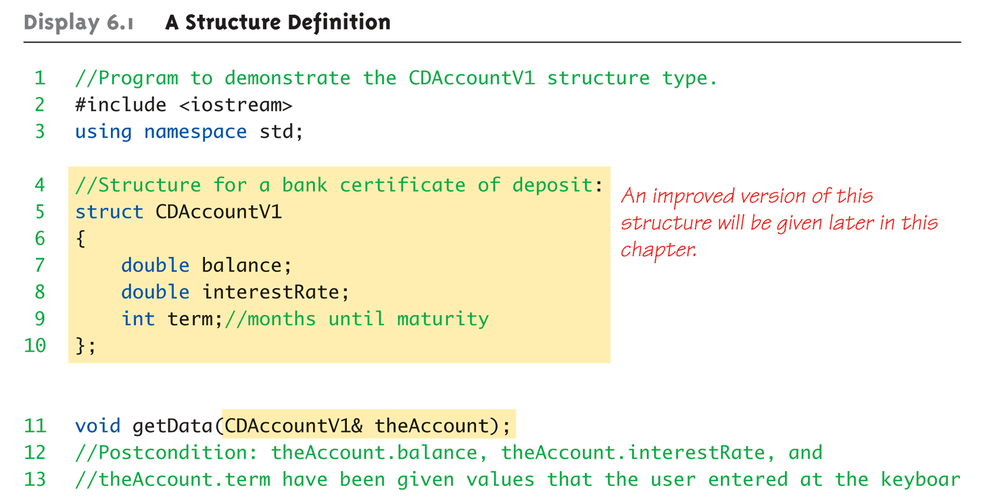
Structure Example:
Display 6.1 A Structure Definition (1 of 3)

Slide 8
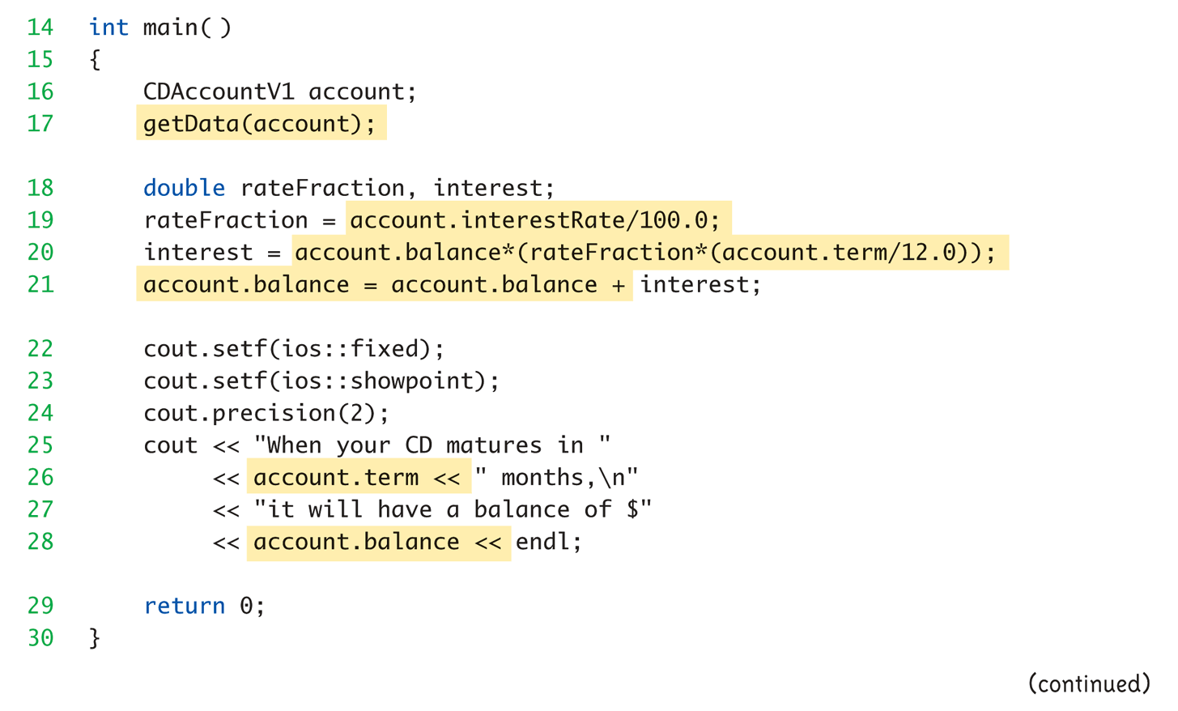
Structure Example:
Display 6.1 A Structure Definition (2 of 3)

Slide 9
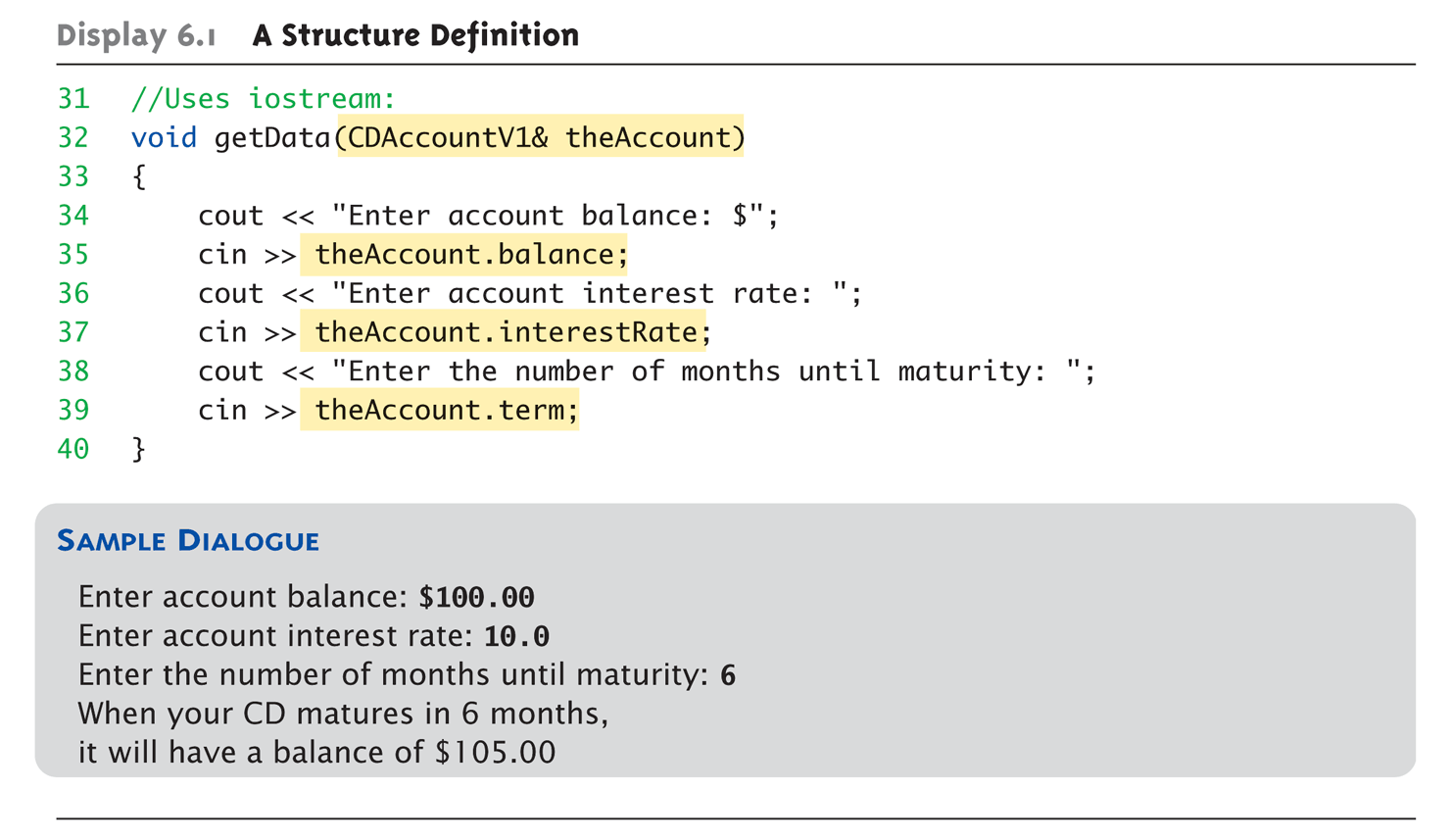
Structure Example:
Display 6.1 A Structure Definition (3 of 3)

Slide 10
Structure Pitfall
Semicolon after structure definition
  ; MUST exist:
  struct WeatherData
  {
  double temperature;
  double windVelocity;
  }; ← REQUIRED semicolon!
  Required since you "can" declare structure
  variables in this location

Slide 11
Structure Assignments
Given structure named CropYield
Declare two structure variables:
CropYield apples, oranges;
  Both are variables of "struct type CropYield"
  Simple assignments are legal:
  apples = oranges;
    Simply copies each member variable from apples
    into member variables from oranges

Slide 12
Structures as Function Arguments
Passed like any simple data type
  Pass-by-value
  Pass-by-reference
  Or combination
Can also be returned by function
  Return-type is structure type
  Return statement in function definition
  sends structure variable back to caller

Slide 13
Initializing Structures
Can initialize at declaration
  Example:
  struct Date
  {
  int month;
  int day;
  int year;
  };
  Date dueDate = {12, 31, 2003};
  Declaration provides initial data to all three member variables

Slide 14
Classes
Similar to structures
  Adds member FUNCTIONS
  Not just member data
Integral to object-oriented programming
  Focus on objects
    Object: Contains data and operations
    In C++, variables of class type are objects

Slide 15
Class Definitions
Defined similar to structures
Example:
class DayOfYear ← name of new class type
{
public:
void output(); ← member function!
int month;
int day;
};
Notice only member function’s prototype
  Function’s implementation is elsewhere

Slide 16
Declaring Objects
Declared same as all variables
  Predefined types, structure types
Example:
DayOfYear today, birthday;
    Declares two objects of class type DayOfYear
Objects include:
  Data
    Members month, day
  Operations (member functions)
    output()

Slide 17
Class Member Access
Members accessed same as structures
Example:
today.month
today.day
  And to access member function:
  today.output(); ← Invokes member function

Slide 18
Class Member Functions
Must define or "implement" class member
functions
Like other function definitions
  Can be after main() definition
  Must specify class:
  void DayOfYear::output()
  {…}
    :: is scope resolution operator
    Instructs compiler "what class" member is from
    Item before :: called type qualifier

Slide 19
Class Member Functions Definition
Notice output() member function’s
definition (in next example)
Refers to member data of class
  No qualifiers
Function used for all objects of the class
  Will refer to "that object’s" data when invoked
  Example:
  today.output();
    Displays "today" object’s data

Slide 20
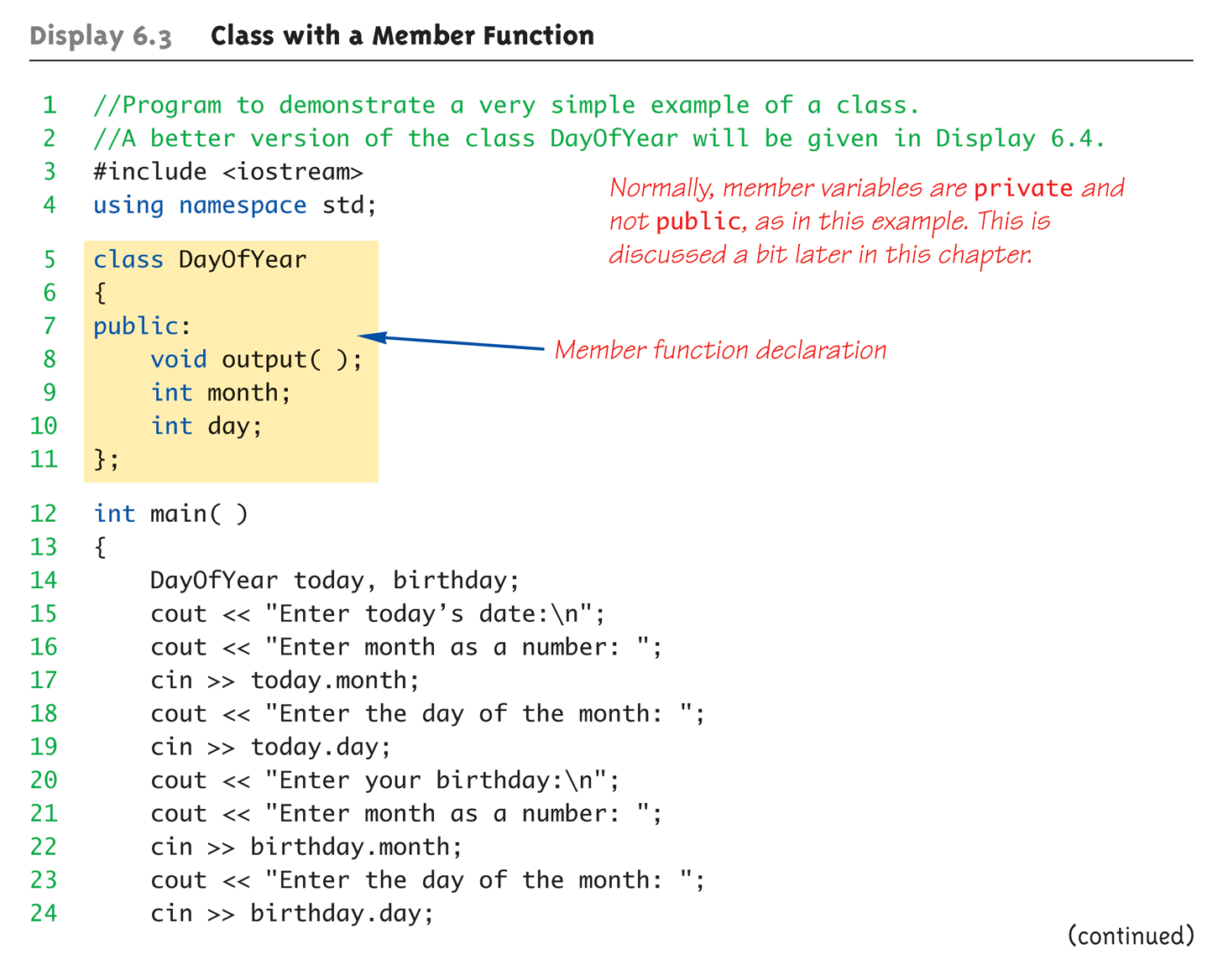
Complete Class Example:
Display 6.3 Class With a Member Function (1 of 4)

Slide 21
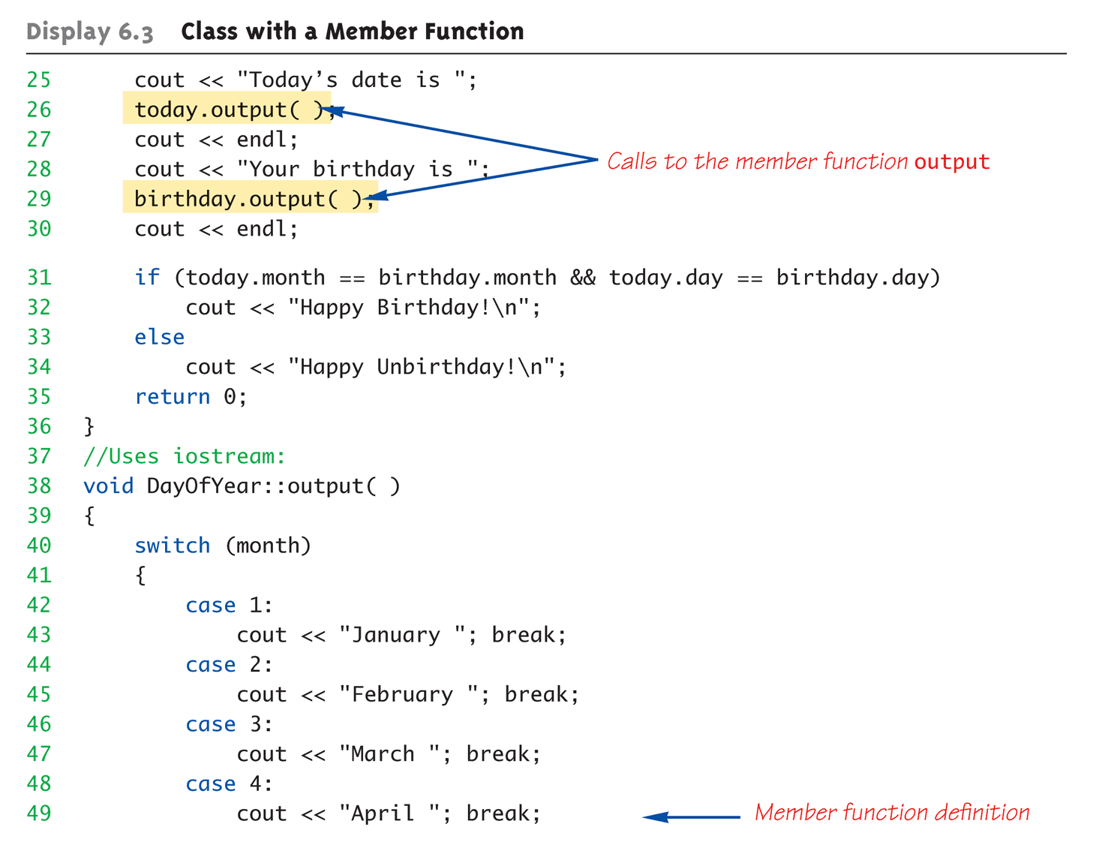
Complete Class Example:
Display 6.3 Class With a Member Function (2 of 4)

Slide 22
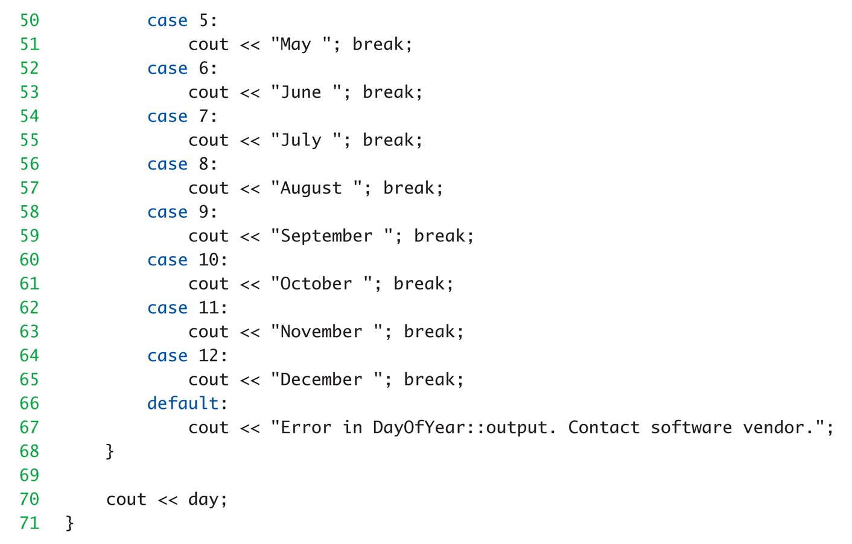
Complete Class Example:
Display 6.3 Class With a Member Function (3 of 4)

Slide 23
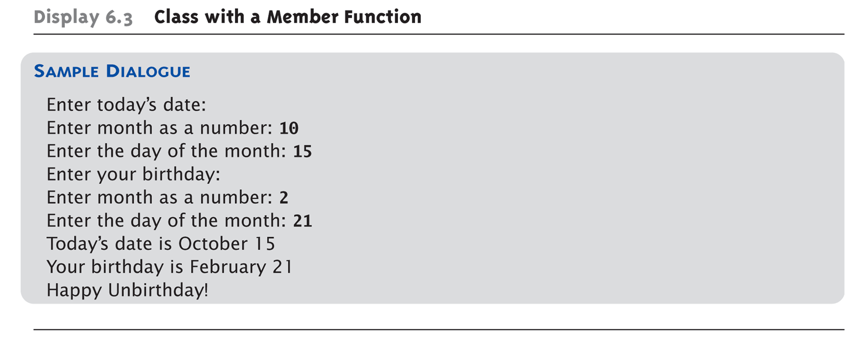
Complete Class Example:
Display 6.3 Class With a Member Function (4 of 4)

Slide 24
Dot and Scope Resolution Operator
Used to specify "of what thing" they are
members
Dot operator:
  Specifies member of particular object
Scope resolution operator:
  Specifies what class the function
  definition comes from

Slide 25
A Class’s Place
Class is full-fledged type!
  Just like data types int, double, etc.
Can have variables of a class type
  We simply call them "objects"
Can have parameters of a class type
  Pass-by-value
  Pass-by-reference
Can use class type like any other type!

Slide 26
Encapsulation
Any data type includes
  Data (range of data)
  Operations (that can be performed on data)
Example:
int data type has:
Data: -2147483648 to 2147483647 (for 32 bit int)
Operations: +,-,*,/,%,logical,etc.
Same with classes
  But WE specify data, and the operations to
  be allowed on our data!

Slide 27
Abstract Data Types
"Abstract"
  Programmers don’t know details
Abbreviated "ADT"
  Collection of data values together with set
  of basic operations defined for the values
ADT’s often "language-independent"
  We implement ADT’s in C++ with classes
    C++ class "defines" the ADT
  Other languages implement ADT’s as well

Slide 28
More Encapsulation
Encapsulation
  Means "bringing together as one"
Declare a class → get an object
Object is "encapsulation" of
  Data values
  Operations on the data (member functions)

Slide 29
Principles of OOP
Information Hiding
  Details of how operations work not known to "user" of class
Data Abstraction
  Details of how data is manipulated within
  ADT/class not known to user
Encapsulation
  Bring together data and operations, but keep "details" hidden

Slide 30
Public and Private Members
Data in class almost always designated
private in definition!
  Upholds principles of OOP
  Hide data from user
  Allow manipulation only via operations
    Which are member functions
Public items (usually member functions)
are "user-accessible"

Slide 31
Public and Private Example
Modify previous example:
class DayOfYear
{
public:
void input();
void output();
private:
int month;
int day;
};
Data now private
Objects have no direct access

Slide 32
Public and Private Example 2
Given previous example
Declare object:
DayOfYear today;
Object today can ONLY access
public members
  cin >> today.month; // NOT ALLOWED!
  cout << today.day; // NOT ALLOWED!
  Must instead call public operations:
    today.input();
    today.output();

Slide 33
Public and Private Style
Can mix & match public & private
More typically place public first
  Allows easy viewing of portions that can be
  USED by programmers using the class
  Private data is "hidden", so irrelevant to users
Outside of class definition, cannot change
(or even access) private data

Slide 34
Accessor and Mutator Functions
Object needs to "do something" with its data
Call accessor member functions
  Allow object to read data
  Also called "get member functions"
  Simple retrieval of member data
Mutator member functions
  Allow object to change data
  Manipulated based on application

Slide 35
Separate Interface and Implementation
User of class need not see details of how
class is implemented
  Principle of OOP → encapsulation
User only needs "rules"
  Called "interface" for the class
    In C++ → public member functions and
    associated comments
Implementation of class hidden
  Member function definitions elsewhere
  User need not see them

Slide 36
Structures versus Classes
Structures
  Typically all members public
  No member functions
Classes
  Typically all data members private
  Interface member functions public
Technically, same
  Perceptionally, very different mechanisms

Slide 37
Thinking Objects
Focus for programming changes
  Before → algorithms center stage
  OOP → data is focus
Algorithms still exist
  They simply focus on their data
  Are "made" to "fit" the data
Designing software solution
  Define variety of objects and how they interact

Slide 38
Summary 1
Structure is collection of different types
Class used to combine data and functions
into single unit -> object
Member variables and member functions
  Can be public → accessed outside class
  Can be private → accessed only in a member
  function’s definition
Class and structure types can be formal
parameters to functions

Slide 39
Summary 2
C++ class definition
  Should separate two key parts
    Interface: what user needs
    Implementation: details of how class works

