Slide 1
Constructors
Constructor
A special member function of a class executed whenever creating new objects of that class
Have the exact same name as the class
Doesn’t have any return type, even void
Useful for setting initial values for certain number of variables
Example

Slide 2
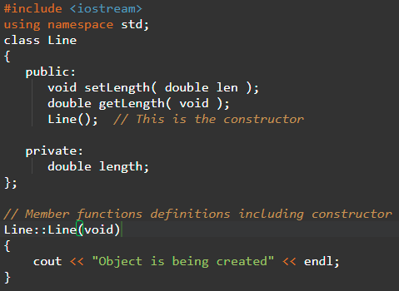
Constructors

Slide 3
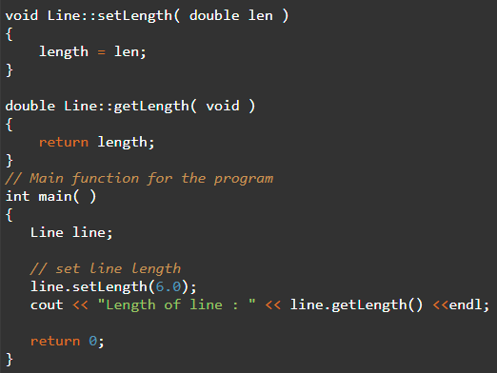
Constructors

Slide 4
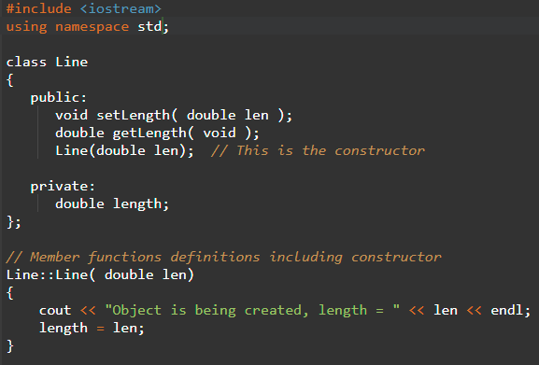
Constructors
Constructor with parameters
A default constructor doesn’t have parameters
Constructor can have parameters
Assign initial value to an object at the time of its creation

Slide 5
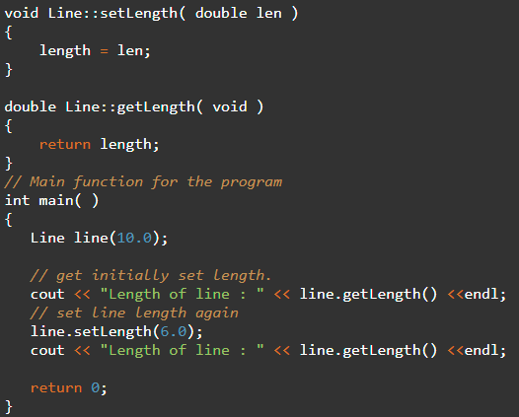
Constructors

Slide 6
Constructors
Use initialization list
Parameterized constructor
Line::Line( double len): length(len)
{
cout << "Object is being created, length = " << len << endl;
}
Same as the below.
Line::Line( double len)
{
cout << "Object is being created, length = " << len << endl;
length = len;
}

Slide 7
Constructors
Use initialization list
For a class of M with multiple fields X, Y, Z to be initiated
C::C( double a, double b, double c): X(a), Y(b), Z(c)
{
....
}
Constructor overloading
Can overload constructors like other functions
Signature has names of function and parameter list
Provide constructors for all possible argument lists, particularly how many

Slide 8
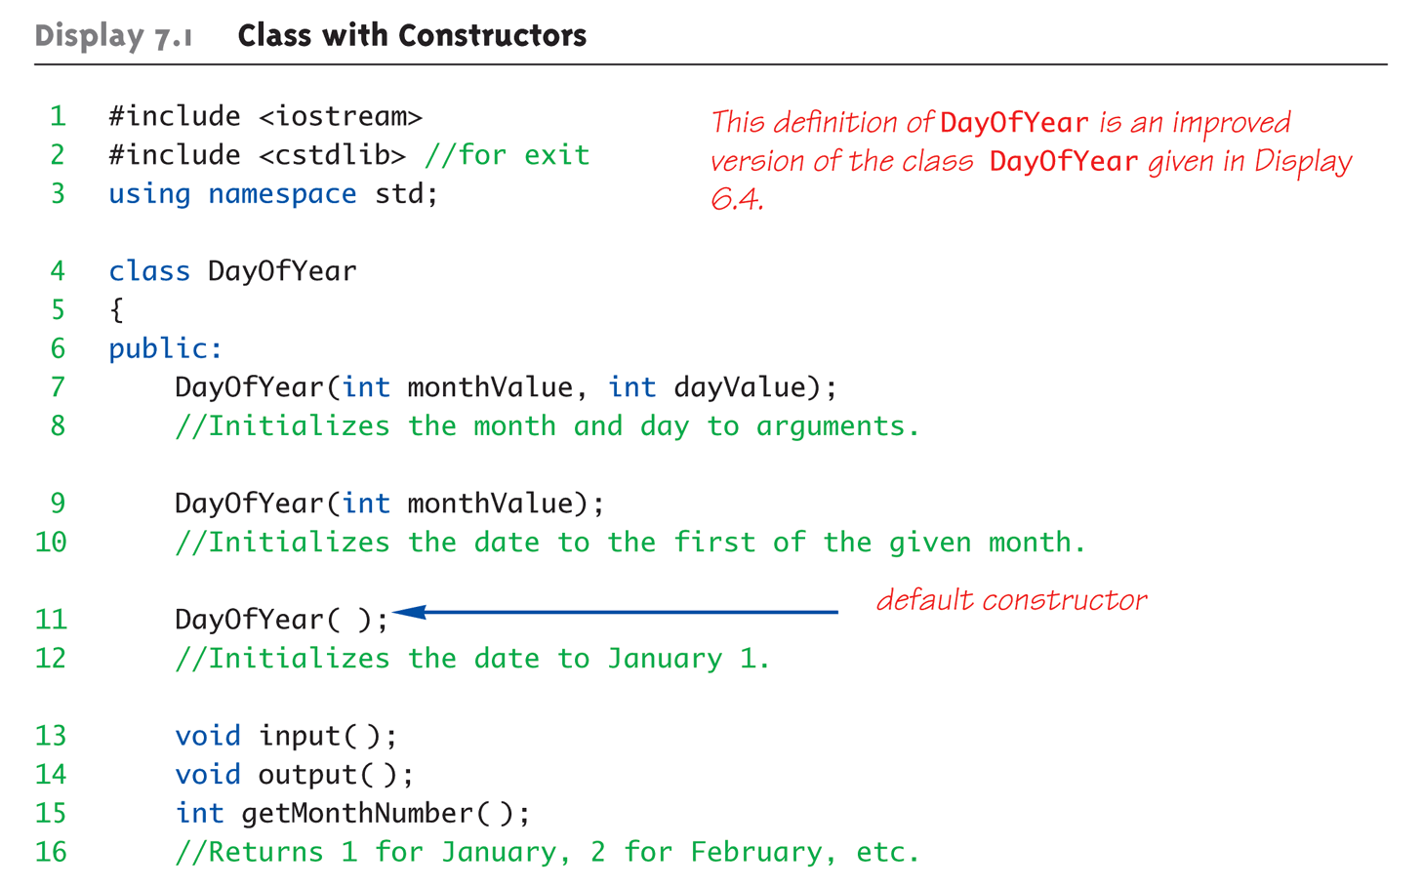
Constructors

Slide 9
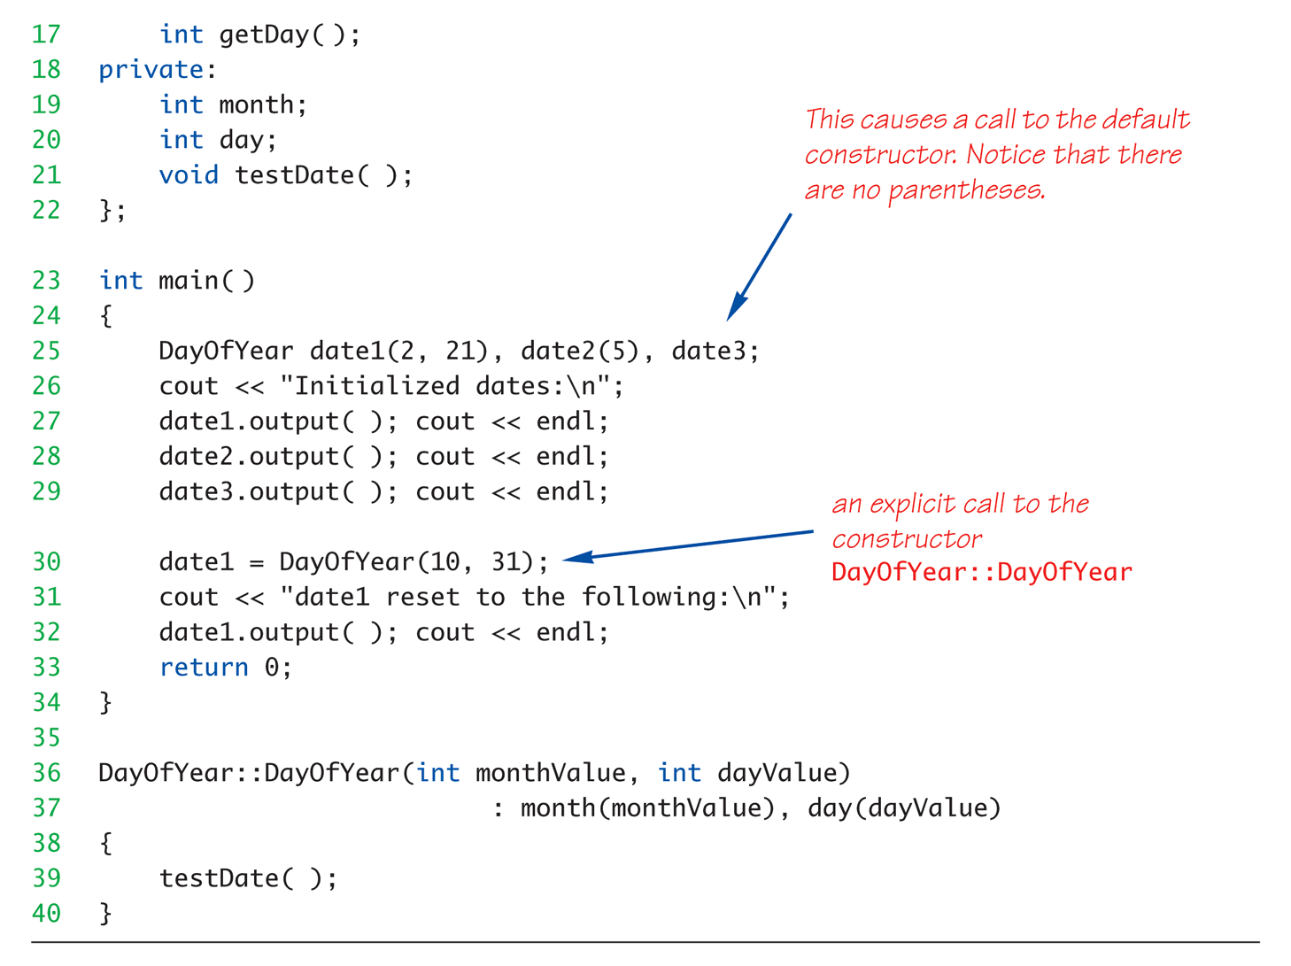
Constructors

Slide 10
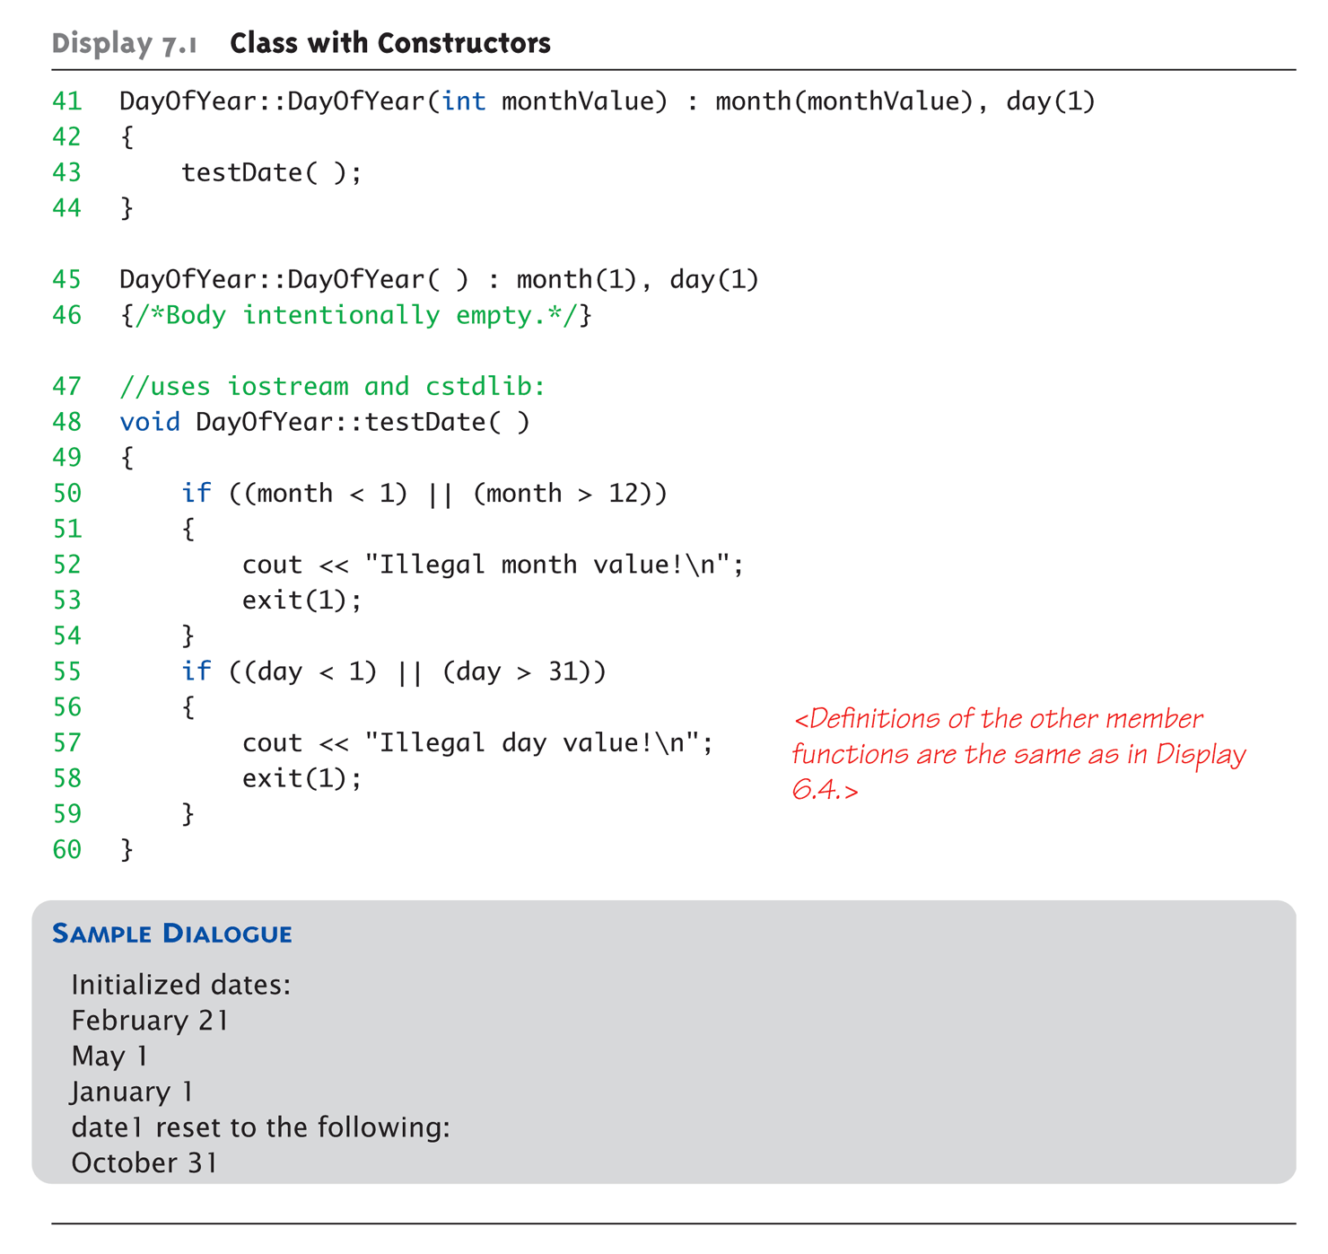
Constructors

Slide 11
Deconstructors
Deconstructor
A special member function of a class executed whenever an object of its class goes out of scope or whenever the delete expression is applied to a pointer to the object of that class
Has the exact same names as the class with a prefix of a tilde (~)
It neither returns a value nor takes any parameters
Used for releasing resources before the end of the program, such as closing files, releasing memory

Slide 12
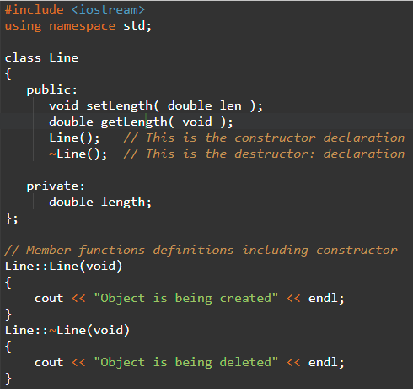
Deconstructors

Slide 13
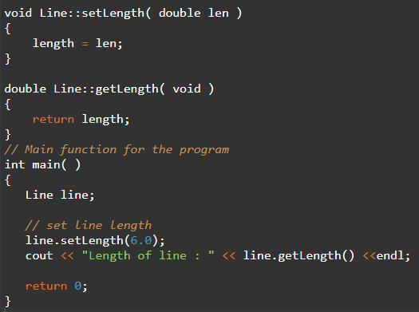
Deconstructors

