Slide 1
Copy Constructors
Copy constructor
A constructor creating an object by initializing it with an object of the same class created before.
Usage
Initialize one object from another of the same class
Copy an object to pass it as an argument to a function
Copy an object to return it from a function
If a copy constructor is not defined in a class, the compiler itself defines one
If the class has pointer variables and some dynamic memory allocations, it must have a copy constructor

Slide 2
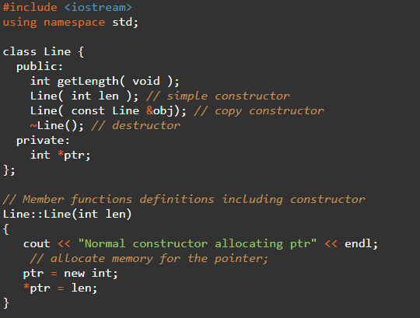
Copy Constructors
Copy constructor
Most common form of a copy constructor
className (const className &obj) {
// body of constructor
} //obj is a reference to an object being used to initialize another object
Examples

Slide 3
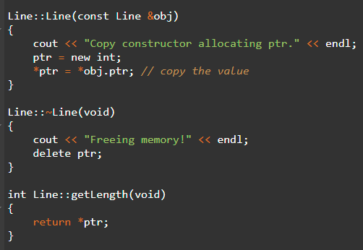
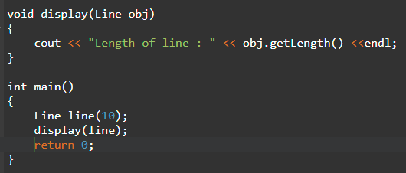
Copy Constructors

Slide 4
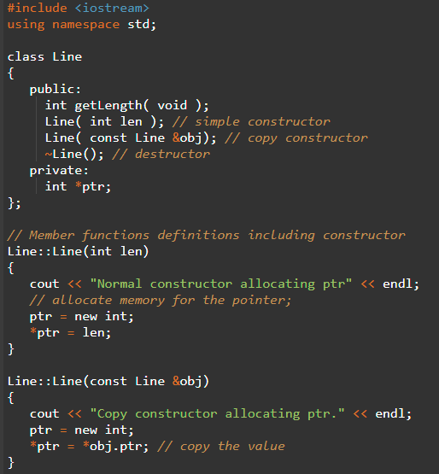
Copy Constructors

Slide 5
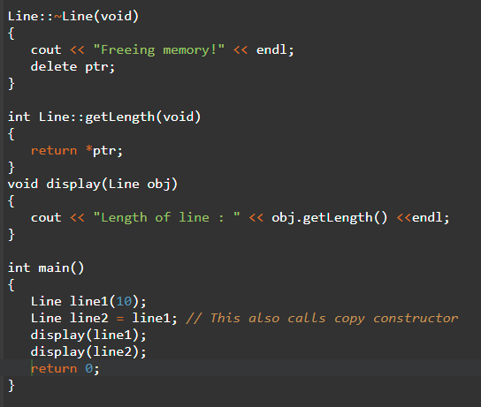
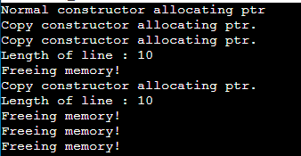
Copy Constructors

