Slide 1
Dynamic Arrays
1D Dynamic Array
Use new operator to dynamically create an array
DataType *ArrayName = new DataType[Dimensions];
Examples
double *rates = new double [10];
float *prices = new float [20];
int *ages = new int [15];
student * stu = new student[10];
After creating an array, the needed space is allocated in memory.
The space may have garbages, so we need to fill it up.

Slide 2
Dynamic Arrays
1D Dynamic Array
Access the members using the index on the array
int *p = new int [3];
p[0]=1;
p[1]=2;
p[2]=3;
Access address of the desired member and assign value
int *p = new int [3];
*p=1;
*(p+1)=2;
*(p+2)=3;

Slide 3
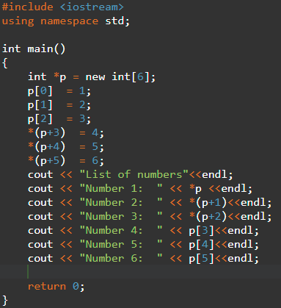
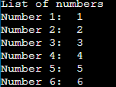
Dynamic Arrays

Slide 4
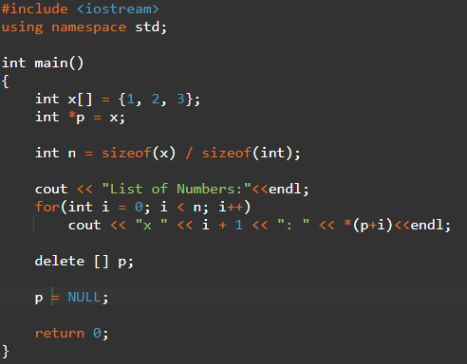
Dynamic Arrays
Disposing of memory
If you don’t need the array, you should delete it
delete [] variableName;
To avoid memory leak, you can assign NULL to the array

Slide 5
Dynamic Arrays
Dynamic 2D arrays
Specify a dimension for the pointer
int *p[2]; //declare 2 pointers
To specify the first pointer, use new to indicate its dimension
*p = new int [6]; //the first pointer has 8 elements
After using it, reclaim it using delete

Slide 6
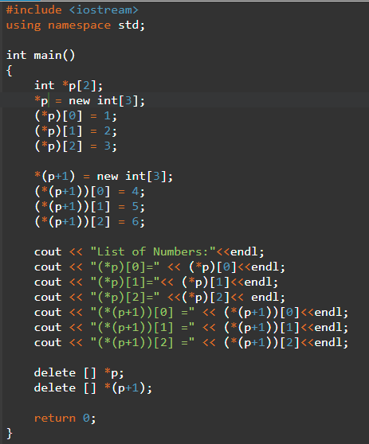
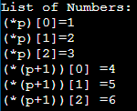
Dynamic Arrays
2D Dynamic Arrays

Slide 7
Dynamic Arrays
2D dynamic arrays
In general, we create 2D dynamic arrays below
int **dynamicArray ; //memory allocated for elements of rows.
dynamicArray = new int *[ROWS] ; //memory allocated for elements of
each column.
for( int i = 0 ; i < ROWS ; i++ )
dynamicArray[i] = new int[COLUMNS];
for( int i = 0 ; i < ROWS ; i++ ) //free the allocated memory
delete [] dynamicArray[i] ;
delete [] dynamicArray ;

Slide 8
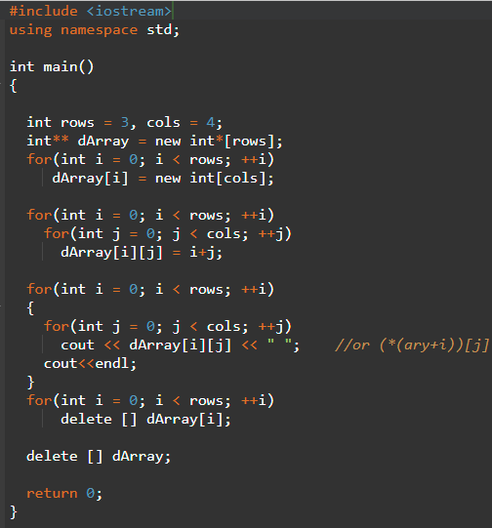
Dynamic Arrays
2D Dynamic Arrays

