Slide 1
C++ Compilation Model
C++ is a compiled language
Compiler converts the C++ program directly to machine code
Once the program is compiled, the resulting executable can be run any number of times, even if the source code is nowhere to be found
Compilation steps
1. Preprocessing, code segments are spliced and inserted
2. Compilation, code is converted to object code
3. Linking, compiled code is joined together into a final executable

Slide 2
C++ Compilation Model
Preprocessing (Preprocessor)
1. Scans over the C++ source code
2. Applies various transformations to it
3. #include directives are resolved to make various libraries available, #define-d constants are placed by their values
Compilation (Compiler)
1. Source file is read in by the compiler, optimized, and transformed into an object file
2. Machine specific, contain machine code which executes the instructions specified in the C++ file, with some extra information
3. Compiler reports syntax errors
Linking (Linker)
1. Gathers all object files necessary to build the final executable
2. Bundles them together with OS-specific information
3. Produces an executable file
4. linker may report some final errors that prevent it from generating a working C++ program

Slide 3
C++ Compilation Model
#include <iostream>
using namespace std;
int Factorial(int n); // Prototype
int main() {
cout << Factorial(10) << endl;
return 0;
}
This is a link error since we cannot find the definition of the function.

Slide 4
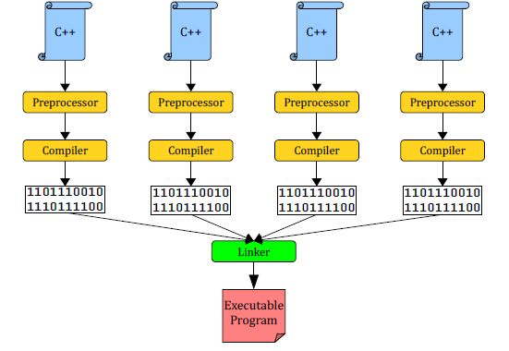
C++ Compilation Model
Main phases of compilation

Slide 5
C++ Compilation Model
Since the compiling and linking are separate, we can split the C++ program into multiple files
Advantages
1. Organized
2. Secure, only provide the compiled file without source files, binary files
3. Portable, put code in its own file, we can move the files from one project to another

Slide 6
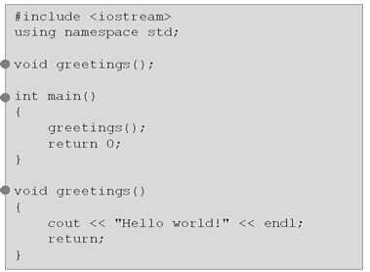
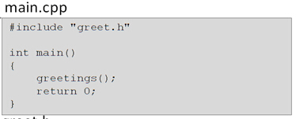
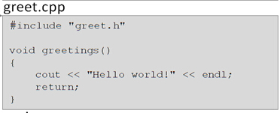
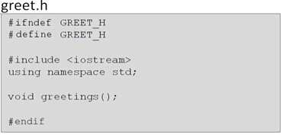

Slide 7
Multiple Files
Main file
1. Like first program without functions
2. Header file
3. Namespace
4. main function
Header file
1. Function prototypes, global constants, struct definitions, class definitions
2. Named by the project’s purpose
3. Have a .h extension
4. .h tells compiler that it is a header file and NOT to be compiled
5. Documenting file
Implementation file
1. Contain definitions of the functions that are prototyped in the header
2. .cpp files will be compiled

Slide 8
Preprocessor Directives
At the top
#ifndef MYFILE_H #define MYFILE_H
At the bottom
#endif
Examples (treeFarm.h)
#ifndef TREEFARM_H // treeFarm.h in uppercase follows the convention
#define TREEFARM_H const float OAK_DENSITY = 4.25; // pounds per square foot etc #endif
#ifndef MyStruct_Included
#define MyStruct_Included
struct MyStruct { int x; double y; char z; };
#endif

