Slide 1
Pointers and Memory
Pointers and memory
When declaring a variable, the compiler reserve an appropriate amount memory for it
It happens during compilation before program execution
This is called static allocation. Before initialized, it is empty
We also can ask compiler to allocation memory when executing, called dynamic allocation
Use new operator to assign new values to the pointer
PointerName = new DataType
If not used any more, reclaim it using delete
Use new operator

Slide 2
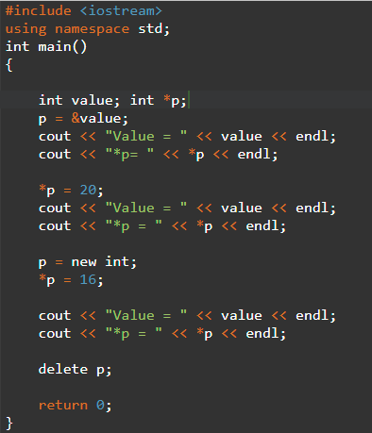
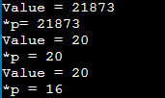
Pointers and Memory

Slide 3
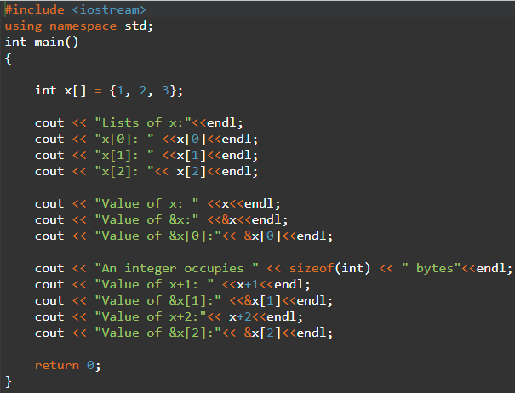
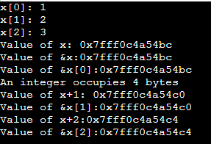
Arrays and Pointers
Relationship between a pointer and an array
For an array x, x, &x, and &x[0] have the same value
The name of the variable represents the address of the first value of the array

Slide 4
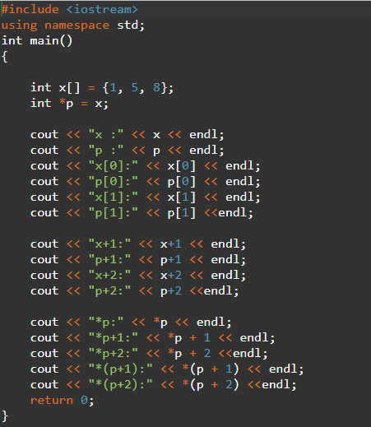
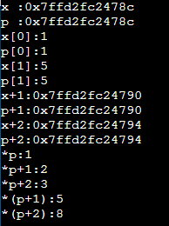
Relating Pointers to Arrays
Definition
Declare a pointer and initialize it with the array
Then, we can use the brackets with the pointer to retrieve the values

Slide 5
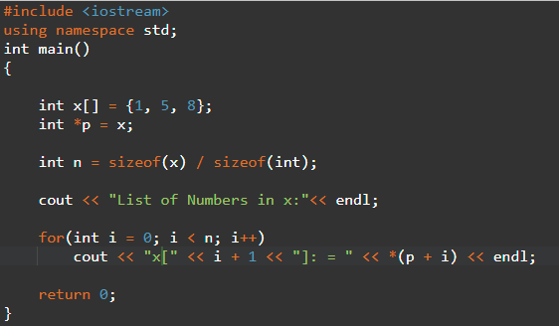
Relating Pointers to Arrays
Initialize a pointer
By incrementing the address of the variable, you can use a for loop to get each value of the array by letting the pointer point to that variable

Slide 6
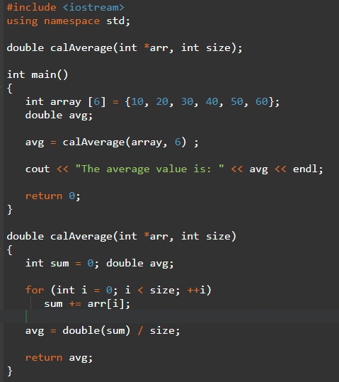
Passing Pointers as Parameters

Slide 7
Pointers and Multi-dimensional Arrays
2-D Arrays
1D Array, we use a pointer to point to it
2D Array, we use square brackets to add a dimension
int *p[2];
It creates two pointers, each of which points to an array of integers
Each one can point to an array of different dimensions
The first pointer, *(p+0), same as *p or *(p)
The second pointer, *(p+1)
For each pointer, you can specify their dimensions

Slide 8
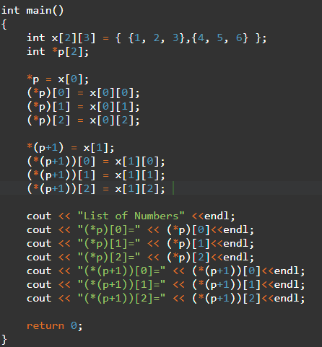
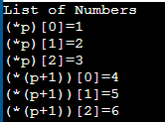
Pointers and Multi-dimensional Arrays
2-D Arrays

Slide 9
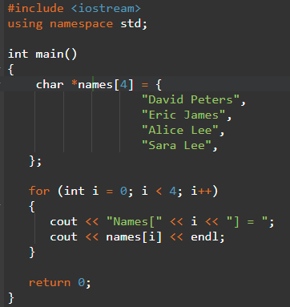
Pointers and Multi-dimensional Arrays
2-D Arrays

Slide 10
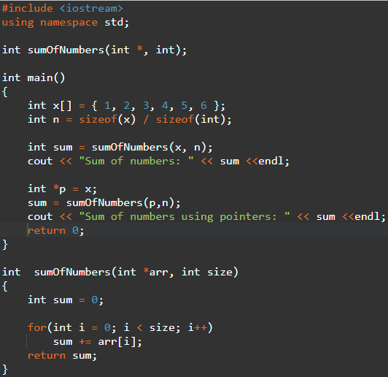
Pointers, Array, and Functions
1D Array

Slide 11
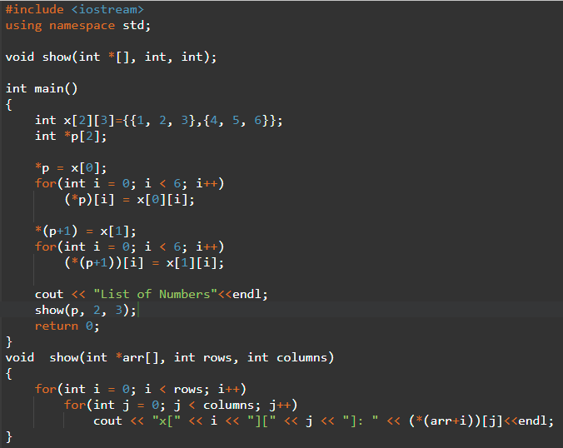
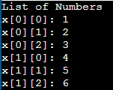
Pointers, Array, and Functions
2D Array

Slide 12
Pointers and Structs
Pointers and structs
Address of a struct can be assigned to a pointer variable
Pointer variable storing the address of struct must be declared as pointer to struct
Syntax
struct student
{
char name[10];
int age;
int grade;
}stud1; student *ptr; ptr = &stud1;

Slide 13
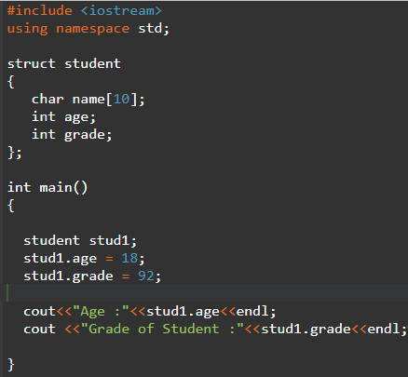
Pointers and Structs
Pointers and structs
Access the members
1. Use struct name
stud1.age
stud1.grade

Slide 14
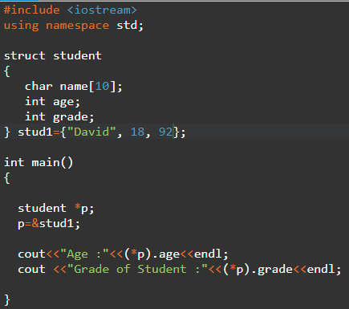
Pointers and Structs
Pointers and structs
Access the members
2. Use indirection operator and pointer
(*p).age
(*p).grade

Slide 15
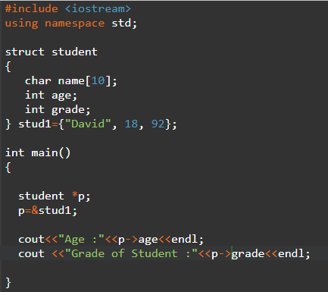
Pointers and Structs
Pointers and structs
Access the members
2. Use membership operator
p->age
P->grade

