Slide 1
Struct
struct
Previously just one data type for declarations
Struct data type can declare aggregate data types
A collection of related data items (different basic data types) stored in one place and can be referenced by using more than one name
Number of bytes varies according to the definition
Definition
Define a struct template
Its inside variables are called elements or members

Slide 2
Struct
Definition
Define a struct template
Its inside variables are called elements or members
Keyword struct, a label for the struct name
Example, a student data type
struct student
{
char id_num[5];
char name[10];
char gender;
int age;
};

Slide 3
Struct
Definition
Storage in memory
Declare a struct variable
struct student{
char id_num[5];
char name[10];
char gender;
int age;
} stu1,stu2;
struct {
char id_num[5];
char name[10];
char gender;
int age;
} stu1,stud2;
struct student{
char id_num[5];
char name[10];
char gender;
int age;
} ;
student stu1, stu2;

Slide 4
Struct
Definition
For definitions with tags, variables can be declared
For definitions without tags, cannot declare variables elsewhere
Access the elements of struct
Dot operator (.) and the element’s name
stu2.age=30;
For string assignment, we cannot directly assign a string to a character array

Slide 5
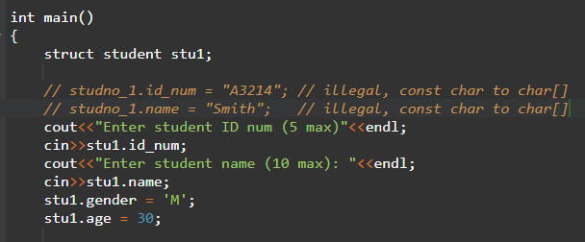
Struct
Example

Slide 6
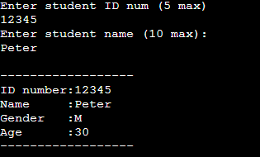
Struct
Output:

Slide 7
Struct
Arrays of struct
Declare an array of struct like normal arrays
Use the data type of the defined struct name
struct student
{
char id[5];
char name[80];
char gender;
int age;
}stu [100];
struct student
{
char id[5];
char name[80];
char gender;
int age;
};
student stu[100];

Slide 8
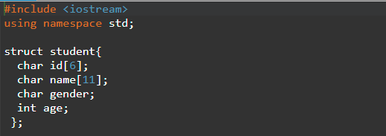
Struct
Arrays of struct
Print out the fifth student’s name
cout<<stu[4].name;
Initialize all the students’ ages 0
for(i=0; i<100; i++)
stud[i].age = 0;

Slide 9
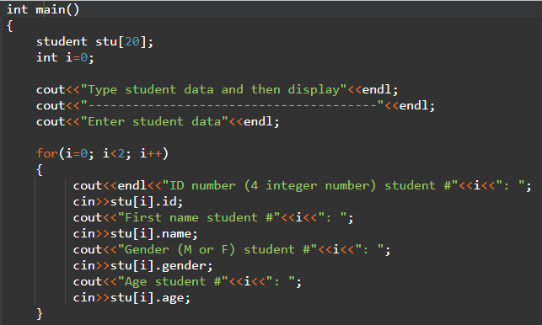
Struct

Slide 10
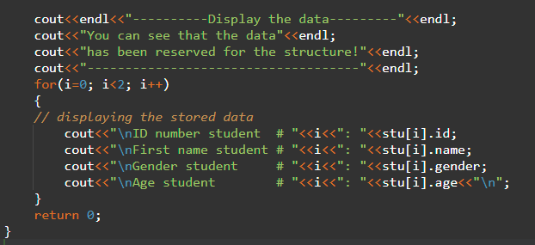
Struct

Slide 11
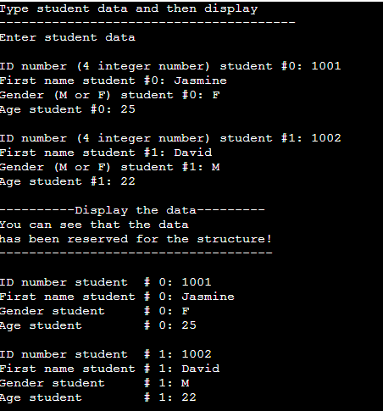
Struct
Output:

Slide 12
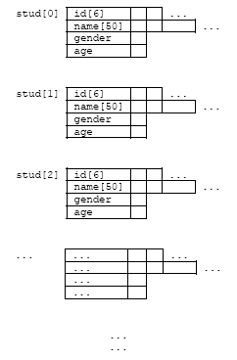
Struct
Structure template:

Slide 13
Struct and Functions
Struct and functions
Individual struct or its member can be passed to functions as arguments
change(stu[3].name);
Pass the entire struct
change(stu[3]);
change(&stu[3]);

Slide 14
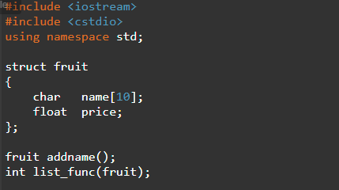
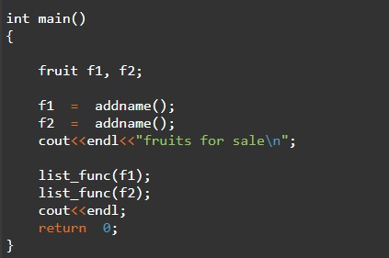
Struct and Functions
Example

Slide 15
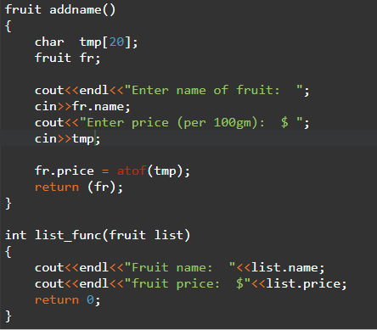
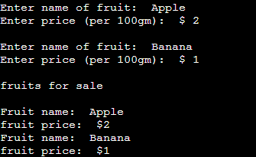
Struct and Functions
Example
Output:

Slide 16
Nested Struct
Nested struct
Struct written inside another struct
One struct as a member of another struct
struct date
{
int date;
int month;
int year;
};
struct Employee
{
char ename[20];
int ssn;
float salary;
struct date
{
int date;
int month;
int year;
}doj;
}emp1;
Accessing Month Field : emp1.doj.month
Accessing day Field : emp1.doj.day
Accessing year Field : emp1.doj.year
struct Employee
{
char ename[20];
int ssn;
float salary;
struct date doj;
}emp1;

Slide 17
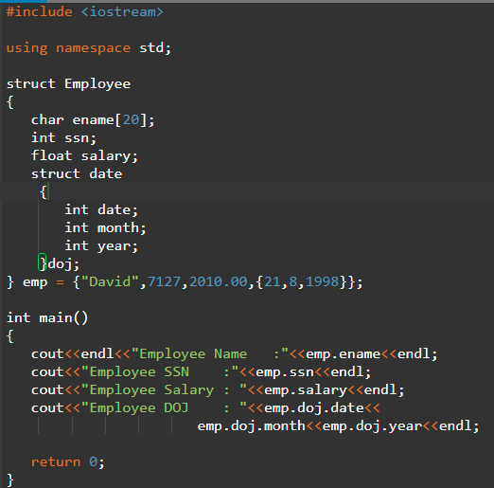
Nested Struct
Output:

Slide 18
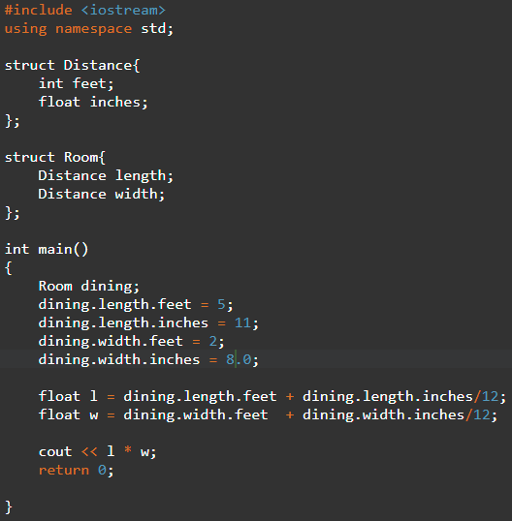
Nested Struct
Output:

Slide 19
Union
Union
A user defined variable which may hold members of different sizes and types
Uses a single memory location to hold more than one variable
Usage
Share a single memory location for a variable and use the same location for another variable of different data type when it is not required
Don’t know what type of data is to be passed to a function, and pass union which contains all the possible data types

Slide 20
Union
Define a union
union myUnion{
int v1;
float v2;
};
Declare a union
union myUnion{
int v1;
float v2;
} u1;
MyUnion u1;

Slide 21
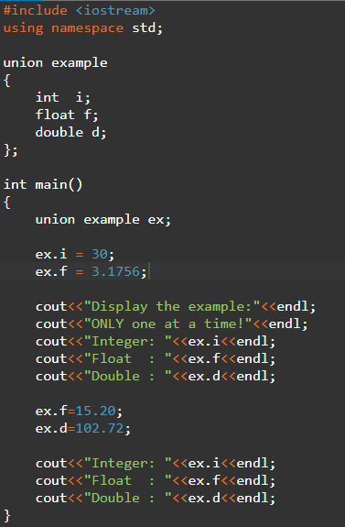
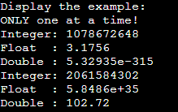
Union
Initialize a union
union myUnion{
int v1;
float v2;
} u1={20.5};
u1.v2=20.5;
Example
Output:

Slide 22
typedef
typedef
Do not introduce new data type
Introduces new name or creating synonym (or alias) for an existing type
Syntax
typedef type-declaration the_synonym;

Slide 23
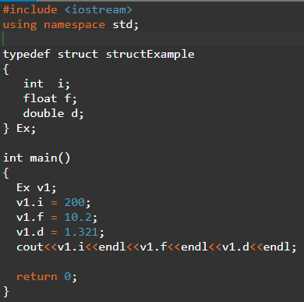
typedef
Example
Output:

