Slide 1
DEVS and DEVS Model
Dr. Feng Gu

Slide 2
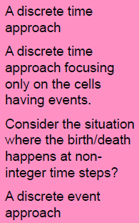
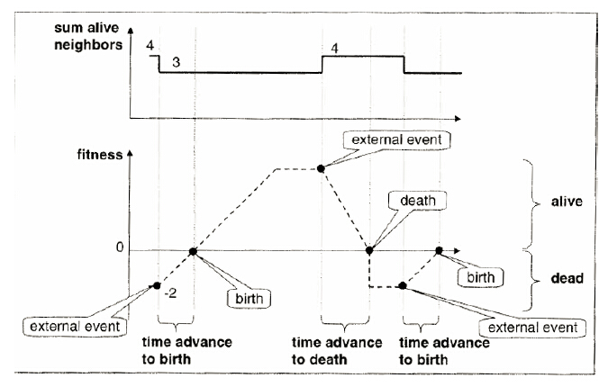
Cellular automata with fitness

Slide 3
Discrete time simulation
Assuming the simulation starts at time =0, and ends at time = T_{f}
t=0
While (t<=T_{f}){
for each cell ci in the cell space
q(t+1) = δ(q(t), q^{neighbor}(t))
t = t+1
}

Slide 4
Discrete time simulation
Assuming the simulation starts at time =0, and ends at time = T_{f}
t=0
activeCellSet = all cells
While (activeCellSet != null && t<=T_{f}){
tempCellSet = null;
for each cell ci in the activeCellSet{
q_{i}(t+1) = δ(q_{i}(t), q^{ineighbor}(t))
if (q_{i}(t+1)!=q_{i}(t)){
add ci to tempCellSet;
add all neighbors of ci to tempCellSet;
}
}
activeCellSet = tempCellSet;
t = t+1
}

Slide 5
Discrete event simulation
Assuming the simulation starts at time =0, and ends at time = T_{f}
t=0
eventList= initializeEventList()
While (eventList != null && t<=T_{f}){
remove and process the first event from eventList {
get the cell ci associated with this event
new state q_{i} = δ(q_{i}(t), q_{i}^{neighbor}(t))
schedule ci’s next event and inset it into eventList
compute the next events of all ci’s neighbors
update, or insert, or remove neighbors’ events into
the eventList
}
sort all the events in eventList
t = time of the earliest next event in eventList
}

Slide 6
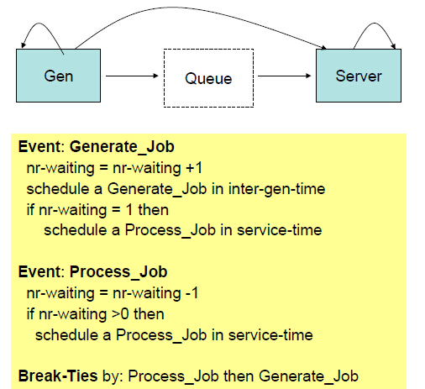
Event scheduling

Slide 7
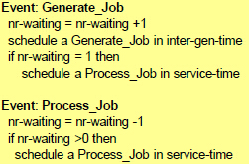
Event list Scheduling
(1) inter-gen-time = 7; service-time = 5
(2) inter-gen-time = 7; service-time = 10

Slide 8
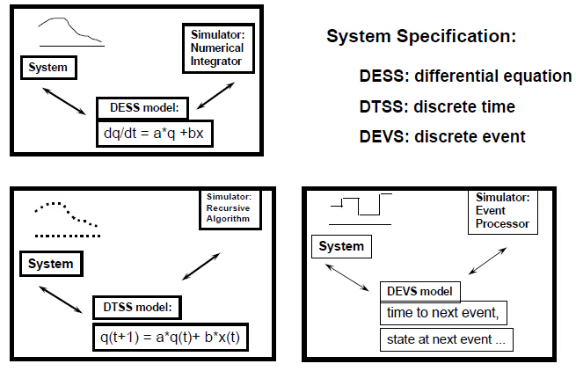
Framework for continuous and discrete models

Slide 9
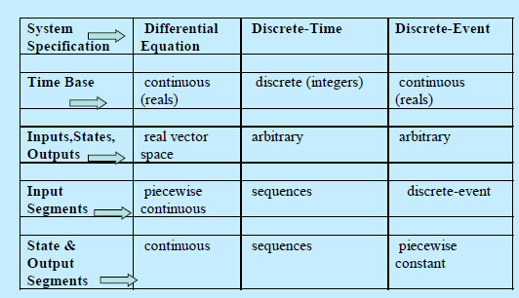
Framework for continuous and discrete models

Slide 10
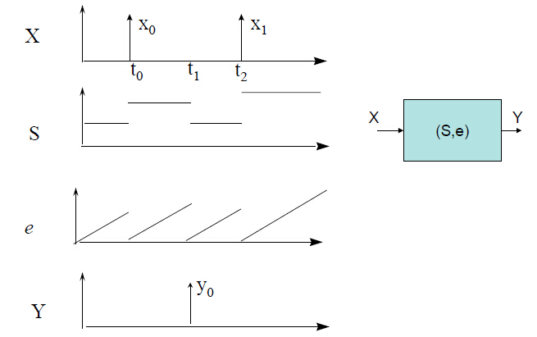
Discrete event time segments

Slide 11
DEVS background
DEVS = Discrete Event System Specification
Provides formal M&S framework: specification, simulation
Derived from Mathematical dynamical system theory
Supports hierarchical, modular composition
Object oriented implementation
Supports discrete and continuous paradigms
Exploits efficient parallel and distributed simulation techniques

Slide 12
DEVS background
DEVS is a modular modeling approach. A DEVS model does not directly schedule other models’ events.
DEVS separates a model and its simulator in an explicit way. We focus on the modeling aspect in this class.
DEVS defines a specification for discrete event models.

Slide 13
System

Slide 14
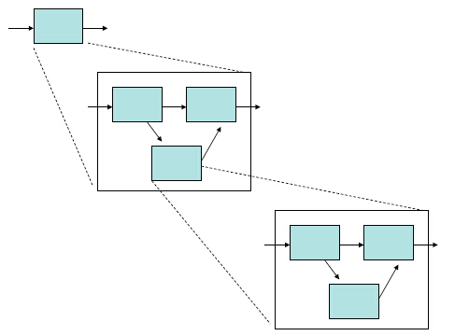
Hierarchical construction

Slide 15
DEVS models
Two kinds of models
Atomic Model
Coupled Model

Slide 16
DEVS atomic model
Elements of an atomic model
input events
output events
state variables
state transition functions
-External transition
-Internal transition
-Confluent transition
-Output function
time advance function

Slide 17
DEVS atomic model formalism
A Discrete Event System Specification (DEVS) is a structure
M = <X,S,Y,δ_{int},δ_{ext},δ_{con},λ, ta>
where
X is the set of input values.
S is a set of states.
Y is the set of output values.
δ_{int}: S → S is the internal transition function.
δ_{ext}: Q × X^{b} → S is the external transition function, where Q ∈ {(s,e) | s ∈ S, 0 ≤ e ≤ ta(s)} is the total state set, e is the time elapsed since last transition, X^{b} denotes the collection of bags over X.
δ_{con}: S × X^{b} → S is the confluent transition function.
λ: S → Y^{b} is the output function.
ta: S → R⁺_{0,} is the time advance function

Slide 18
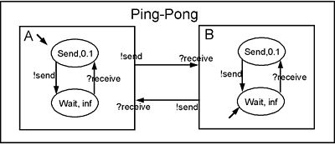
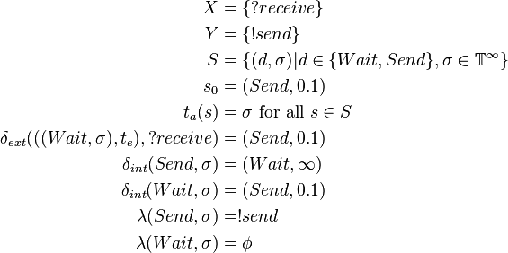
Ping-Pong Example

Slide 19
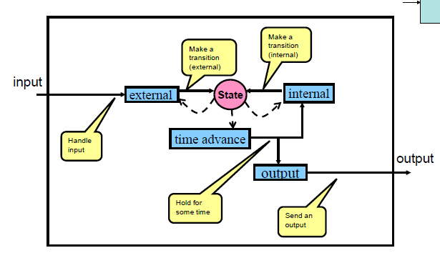
How an atomic model works
Modeling the lecturing classroom. Internal event, external event, output?
Let’s look at an informal description of this “system”: the class lasts for 2 hours … Internal event: class finishes
External events: fire alarm, students enter (5 minutes late, 1 hour late?)

Slide 20
Atomic model operation
Ports are represented explicitly – there can be any number of input and output ports on which values can be received and sent
The time advance function determines the maximum lifetime in a state
A bag can contain many elements with possibly multiple occurrences of its elements. Atomic DEVS models can handle bags of inputs and outputs.
The external transition function handles bags of inputs by causing an immediate state change, which also may modify the time advance.
The output function can generate a bag of outputs when the time advance has expired.
The internal transition function is activated immediately after the output function and causes an immediate state change, which also may modify the time advance.
The confluent transition function decides the next state in cases of collision between external and internal events.

Slide 21
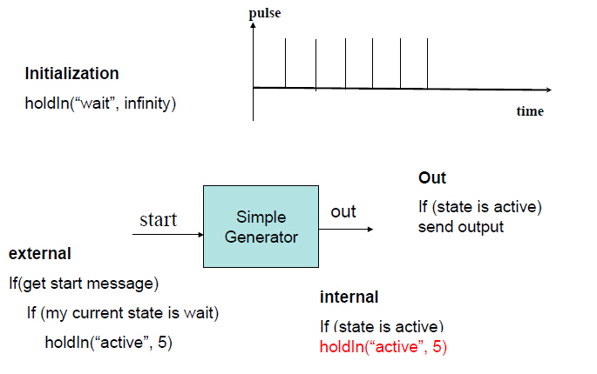
Atomic model examples

Slide 22
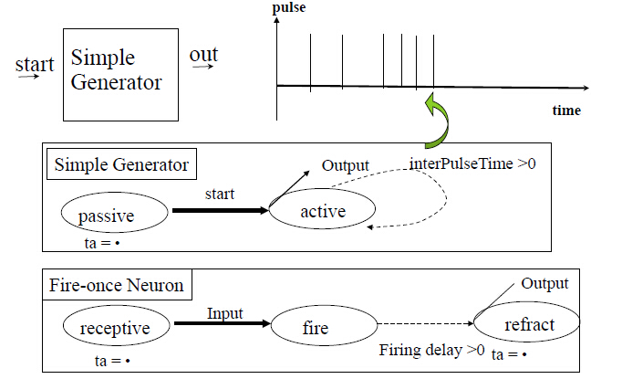
Atomic model examples

Slide 23
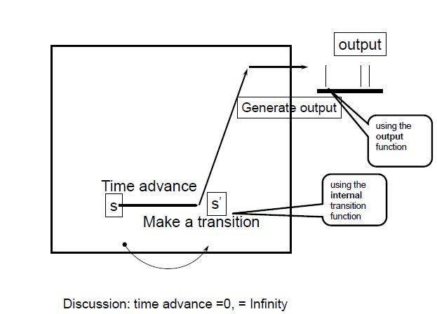
Internal transition/output generation

Slide 24
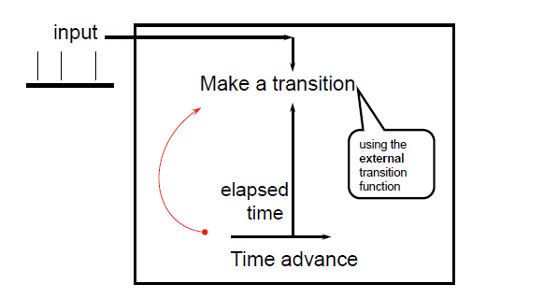
Response to external input
Discussion:
Multiple inputs at the same time
State transition depends on elapsed time
Want to stay at the same state for the rest of the remaining time

Slide 25
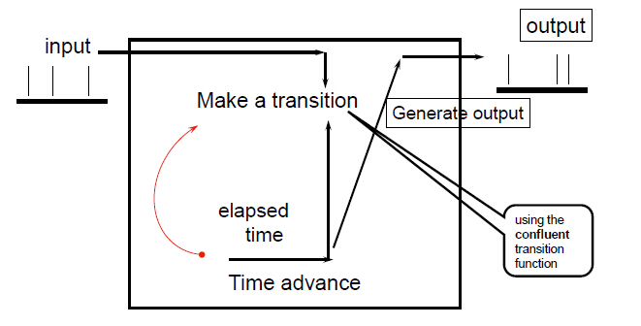
Response to simultaneous external input and internal event
Note: the output will be generated before the confluent function is executed

Slide 26
Discussion
There is no way to generate an output directly from an external input event. An output can only occur just before an internal transition.
To have an external event cause an output without delay, we have it “schedule” an internal state with a hold time of zero
The output function does not change a model’s state
In general, the only way to interact with a model is through input/output ports.
An implementation issue -- An atomic model works with any object-oriented classes
A coupled model does not have its own states or state transition functions.

Slide 27
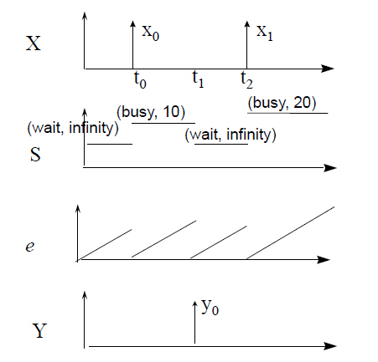
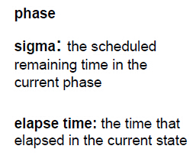
Basic atomic variables

Slide 28
Work with simple SISO atomic models
passive
storage
generator
binaryCounter
ramp

Slide 29
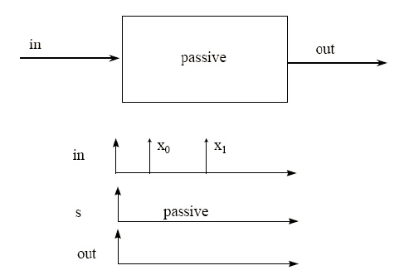
Passive model

Slide 30
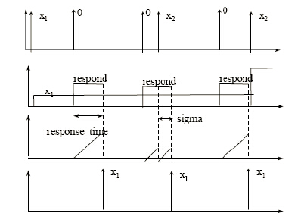
Storage model
The system responds to its input and store it forever, or until the next input comes along. Input zero signals a query. When that happens, the system sends out an output within a time, response_time, with the last non-zero input.

Slide 31
Generator model
The system generates an output every time period defined by period.

Slide 32
Binary counter model
The system outputs a “one” for every two “one”s that it receives.

Slide 33
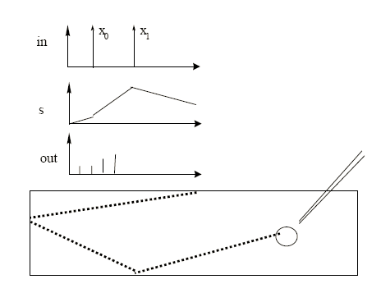
Ramp model

Slide 34
Switch model (with multiple ports)

Slide 35
Generator that can be started/stopped and set period
pulseGenr in DEVSJAVA3_0

Slide 36
DEVS coupled model
Elements of a coupled model
Components
Interconnections Internal Couplings
External Input Couplings
External Output Couplings

Slide 37
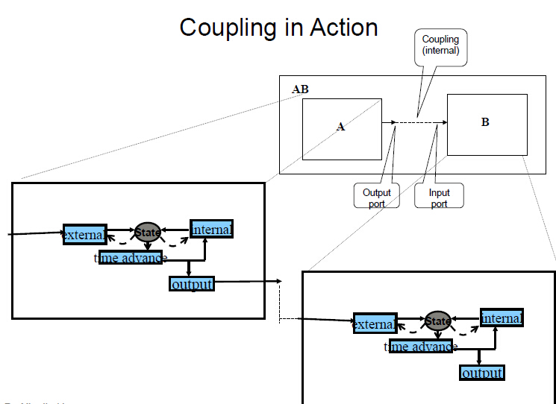

Slide 38
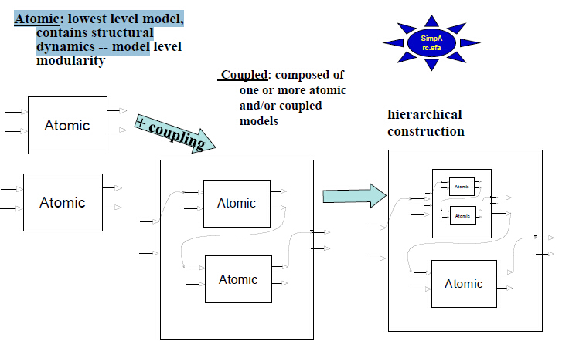
DEVS hierarchical modular composition

Slide 40
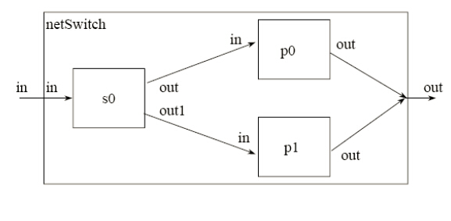
Switch network

Slide 41
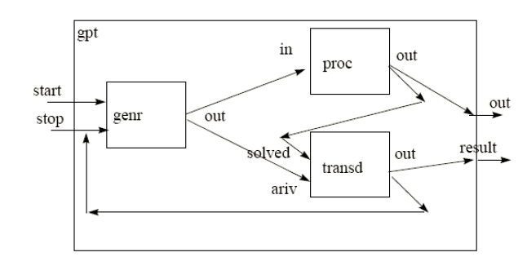
Generator/Processor/Transducer

Slide 42
Exercise
Define the DEVS model for the Cellular Automata With Fitness

Slide 43
DEVS-based modeling and simulation
References:
B. P. Zeigler, Hessam S. Sarjoughian, Introduction to DEVS Modeling and Simulation with JAVA: Developing Component-Based Simulation Models, http://www.acims.arizona.edu/SOFTWARE/devsjava_licensed/CBMSManuscript.zip
B. P. Zeigler, H. Preahofer, T. G. Kim, Theory of Modeling and Simulation, New York, NY, Academic Press, 2000.
http://www.acims.arizona.edu

