Slide 1
Develop DEVS Models Using DEVSJAVA
Dr. Feng Gu

Slide 2

DEVS atomic model
Elements of an atomic model
input events
output events
state variables
state transition functions
-External transition
-Internal transition
-Confluent transition
-Output function
time advance function

Slide 3
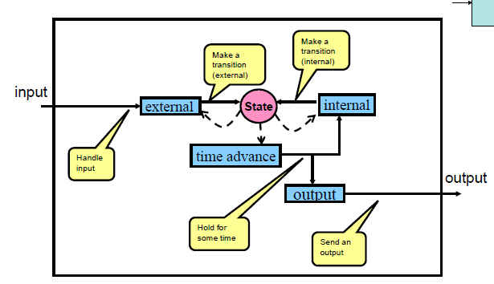
How an atomic model works

Slide 4
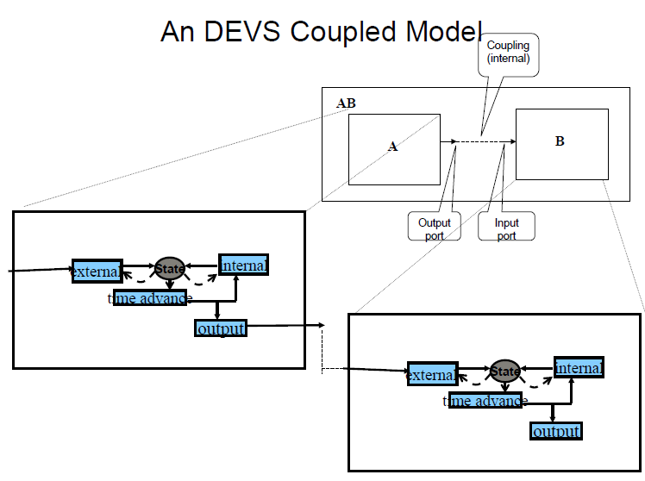

Slide 5
DEVSJAVA environment
Package structure
How to develop models - programming
How to run simulations – the SimView interface

Slide 6
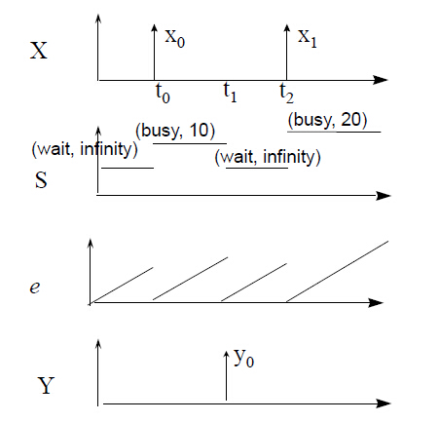
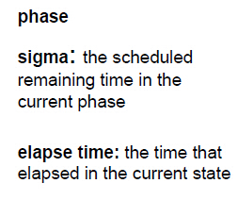
Basic atomic variables

Slide 7
Basic atomic methods
public double ta() : the time advance function; returns the value of sigma for atomic models
public message out() : the output function; releases the message just before an internal transition
public void deltint(): the internal transition function
public void deltext(double e,message x): the external transition function
public void deltcon(double e,message x): the confluent transition function
public void Continue(double e) : subtract e from sigma; use to retain the same time of next event after an external event
public void holdIn(String phase, double sigma) : set the phase and sigma values as given in the arguments
public void passivateIn(String phase) : set the phase as given in the argument and sigma to INFINITY
public void passivate() : set the phase to passive and sigma to INFINITY
public boolean phaseIs(String phase) : return true if the current phase equals the argument
public double ta(){return sigma; }
public message out(){return new message()}
//override
public void deltint() {} //override
public void deltext(double e,message x) {} //override
public void deltcon(double e,message x){}//default
deltint();
deltext(0,x);
}
public void Continue(double e){
if (sigma < INFINITY)
sigma = sigma - e;
}
public void holdIn(String phase, double sigma) {
this.phase = phase;
this.sigma = sigma;
}
public void passivateIn(String phase) {
holdIn(phase, INFINITY);
}
public void passivate() {
passivateIn("passive");
}
public boolean phaseIs(String phase){
return this.phase.equals(phase);
}

Slide 8
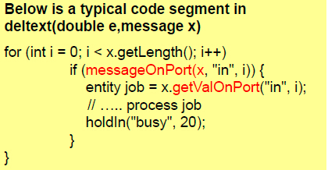
Other commonly used methods
The following methods are defined in devs, but commonly used by an atomic model
-void Initialize()
-boolean messageOnPort(message x,String p, int i)
-ContentInterface makeContent(PortInterface port,EntityInterface value)

Slide 9
Class friendlyAtomic Methods
public boolean somethingOnPort(message x,String port) : is there a value on the given port, e.g., somethingOnPort(x,”in”)
public double geEntityOnPort(message x,String port): get the entity on the given port, e.g., getEntityOnPort(x,”in”)
public double getIntValueOnPort(message x,String port): get the integer value on the given port, e.g., getIntValueOnPort(x,”in”) Note – assumes that the port only receives integer values
public double getRealValueOnPort(message x,String port): get the real (double) value on the given port, e.g., getRealValueOnPort(x,”in”) Note – assumes that the port only receives real values
public double sumValuesOnPort(message x,String port): sum up all the real values on the given port, e.g., sumValuesOnPort(x,”in”) Note – assumes that the port only receives real values
public double getNameOnPort(message x,String port): get the name (string) value on the given port, e.g., getStringOnPort(x,”in”) Note – assumes that the port only receives name values
public message outputNameOnPort(String nm,String port): output a name (string) on the given port, e.g., outputNameOnPort(“hello”,”out”)
public message outputRealOnPort(double r,String port): output a real value (double) on the given port, e.g., outputRealOnPort(5,”out”)
public message outputIntOnPort(int r,String port): output an integer value on the given port
public void addNameTestInput(String port,String name,double elapsed): add a test which inputs the given name on the given port after an elapsed time, e.g., addNameTestInput(“in”,”hello”,5)
public void addRealTestInput(String port,double value,double): add a test which inputs the given value on the given port after an elapsed time, e, e.g., addRealTestInput(“in”,10,5)

Slide 10
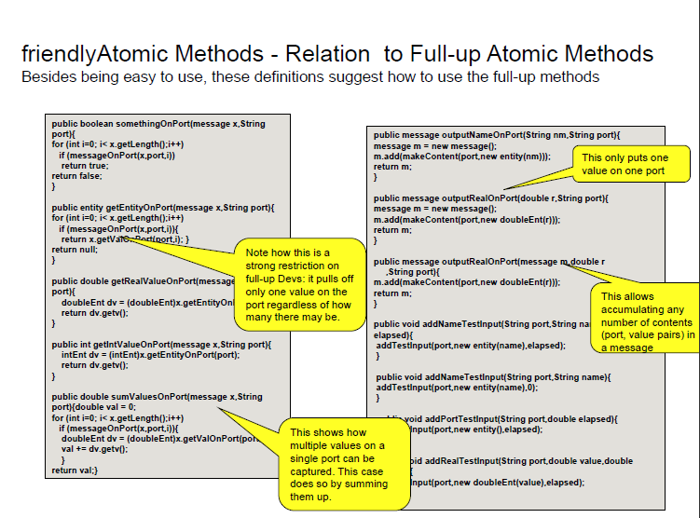

Slide 11
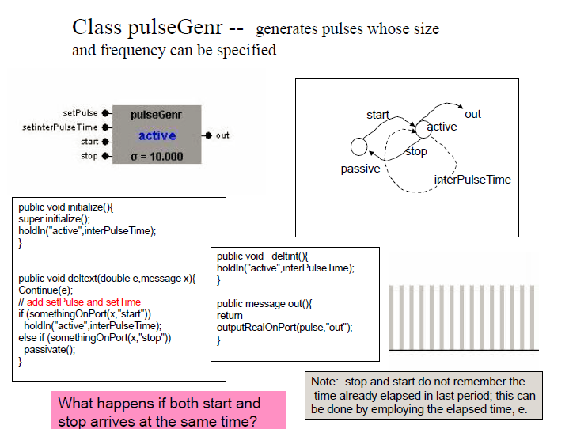

Slide 12
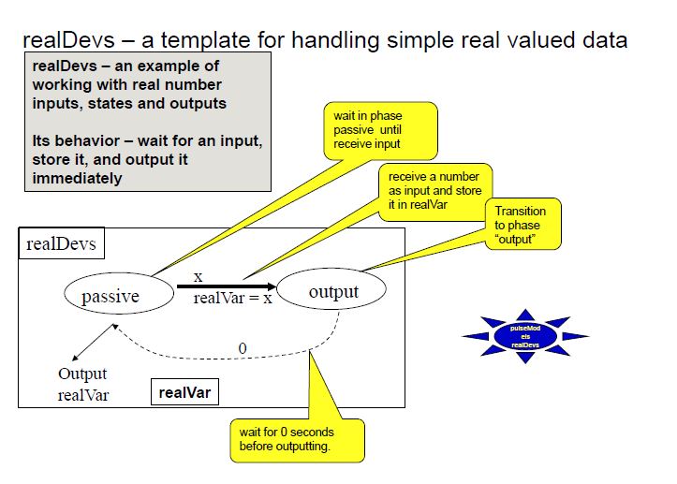

Slide 13
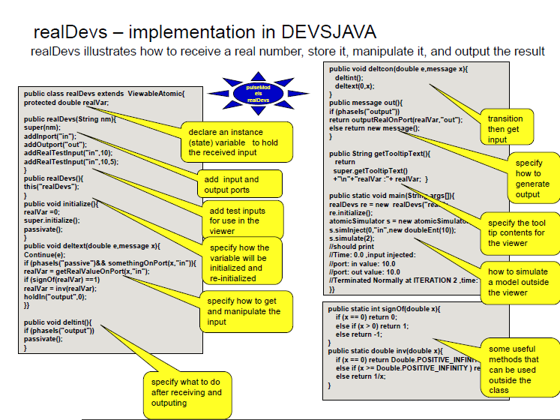

Slide 14
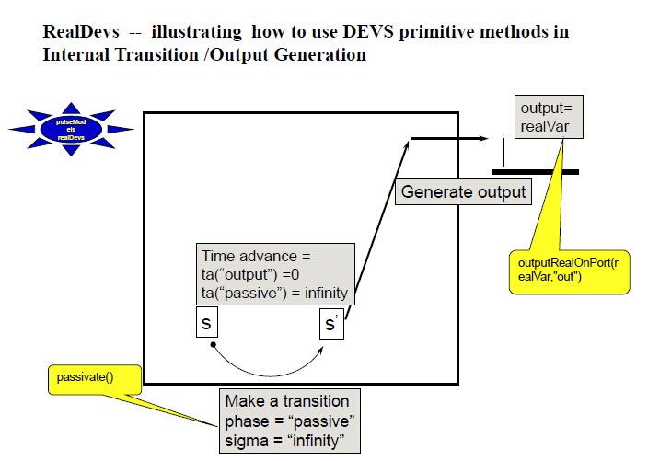

Slide 15
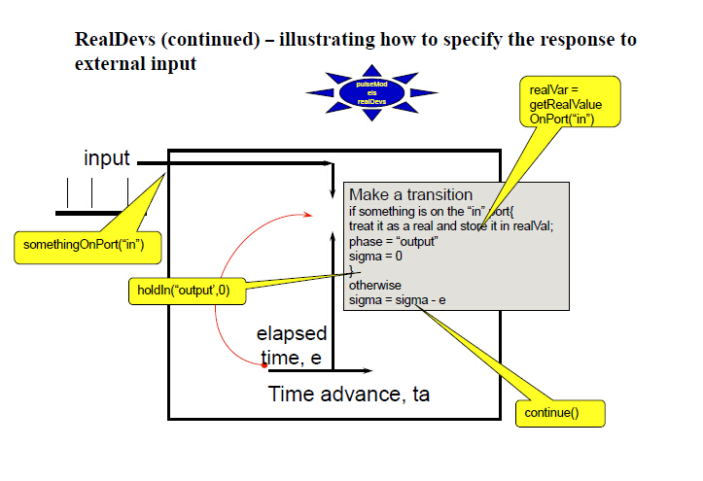

Slide 16
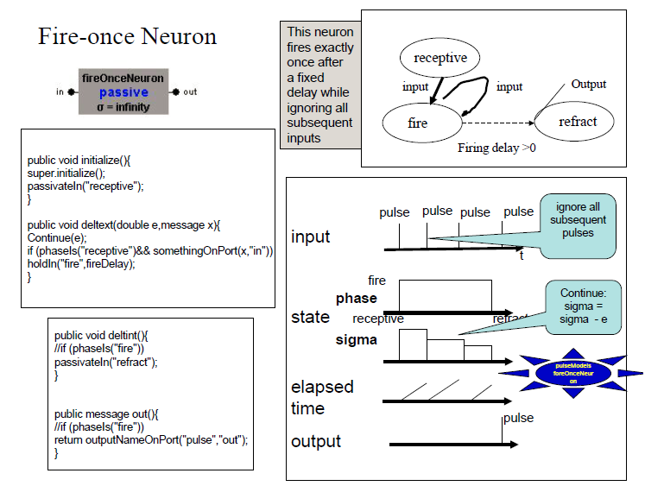

Slide 17
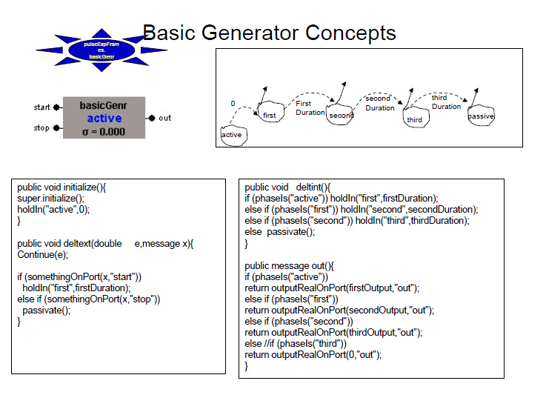

Slide 18
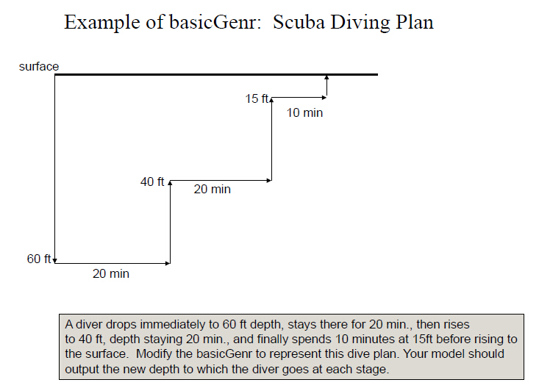

Slide 19
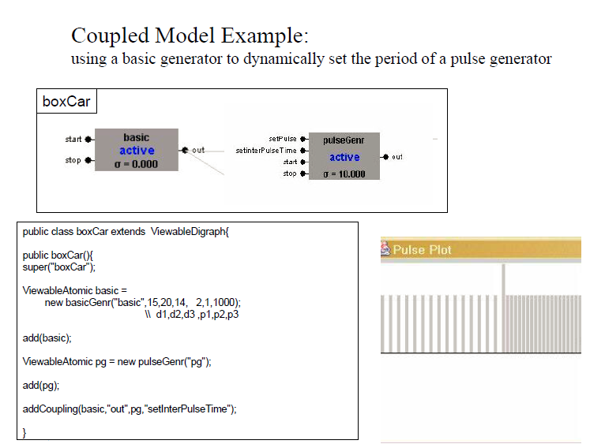

Slide 20
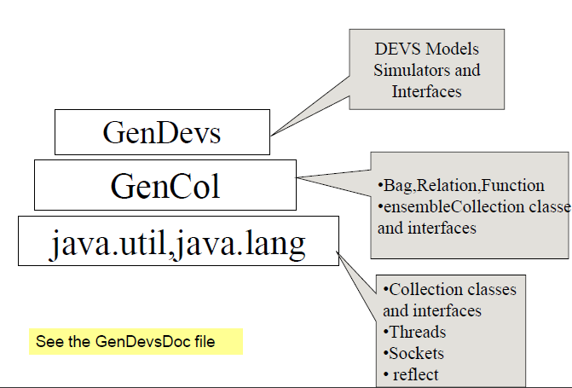
The GenDevs architecture

Slide 21
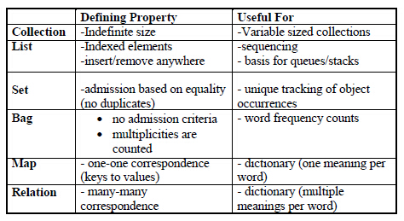
Collections, maps, relations

Slide 22
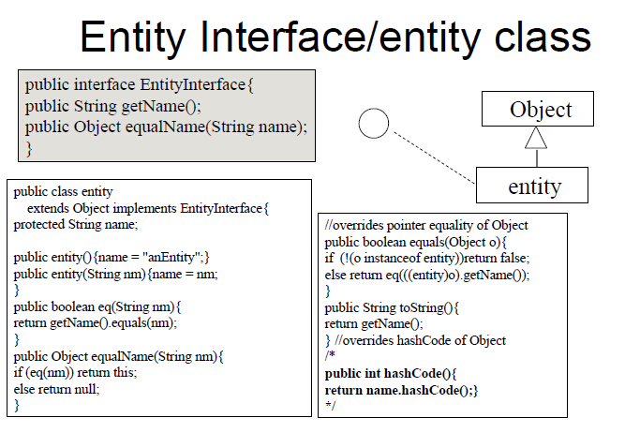

Slide 23
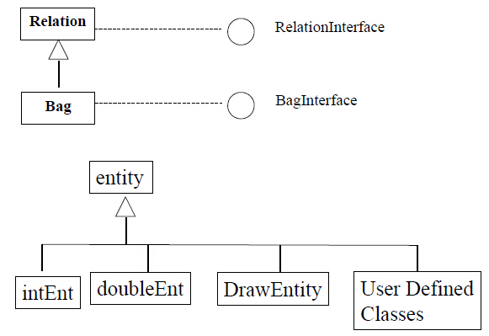
GenDevs collection classes

Slide 24
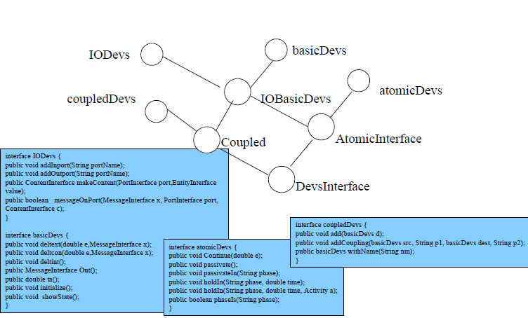
DEVS interfaces

Slide 25
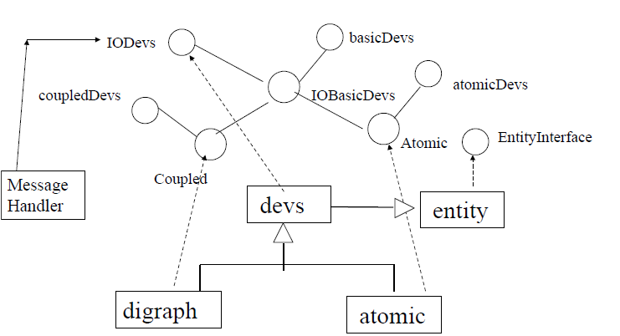
DEVS-Canonical implementation

Slide 26
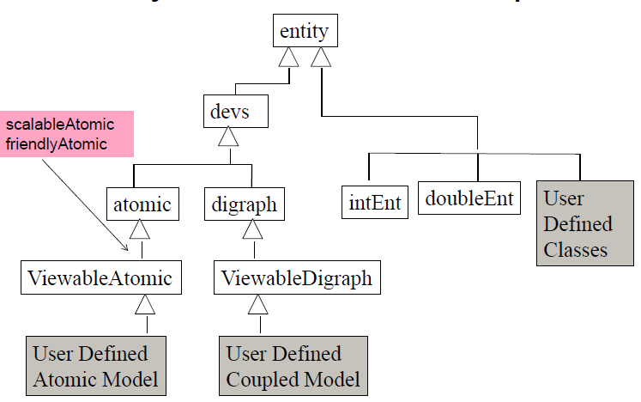
Major class relationships

Slide 27
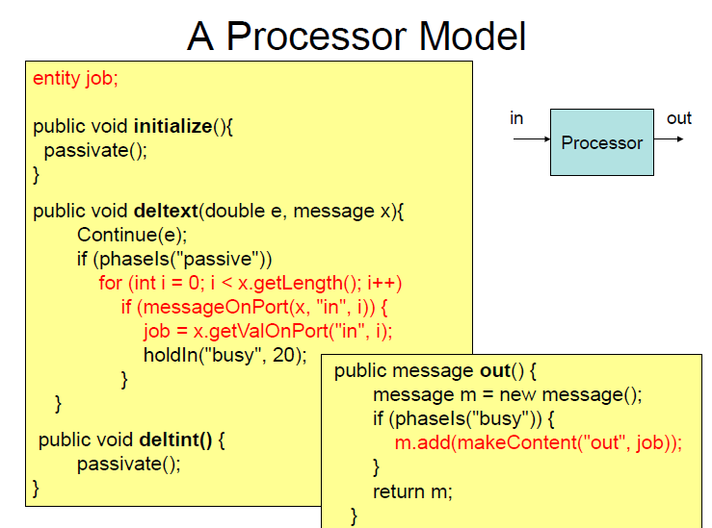

Slide 28
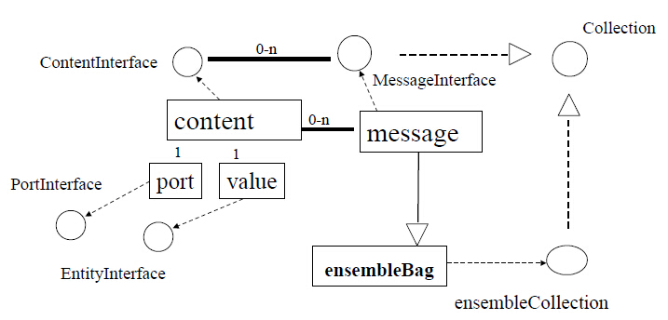
Ports, content, and message

Slide 29
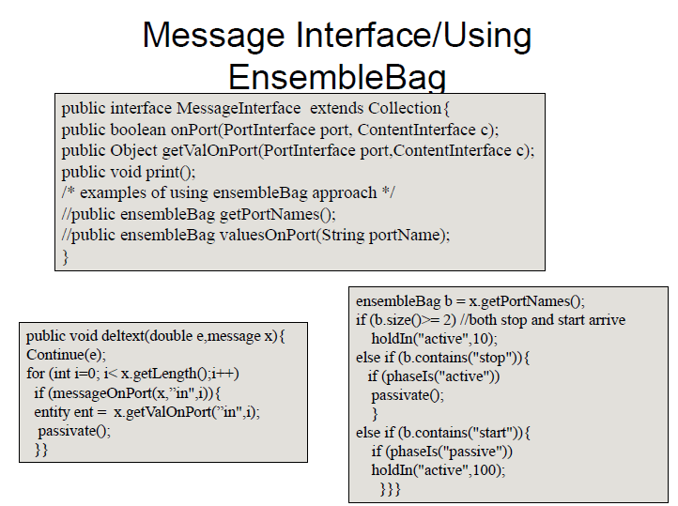

Slide 30
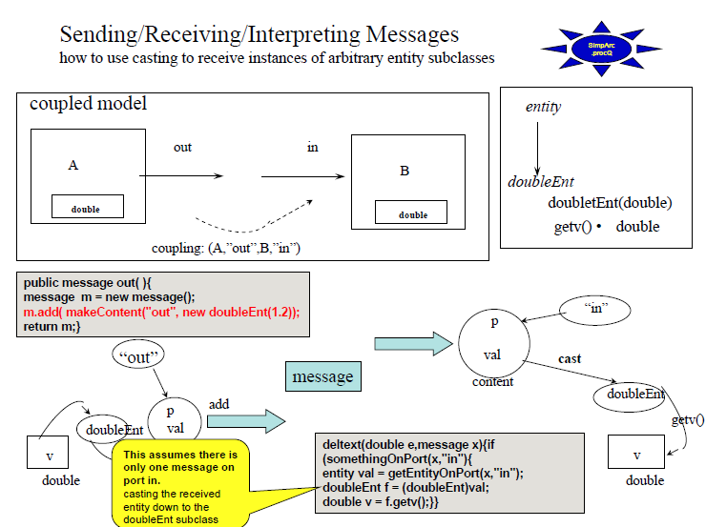

Slide 31
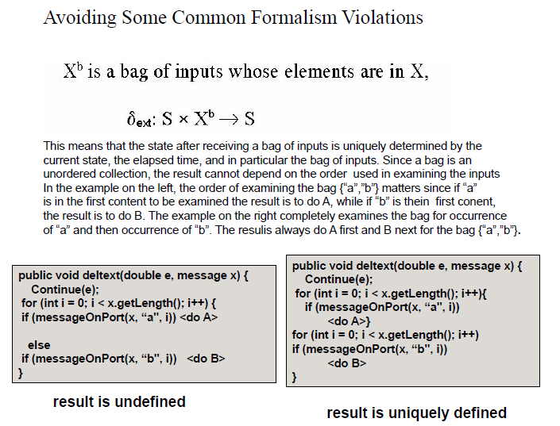

Slide 32
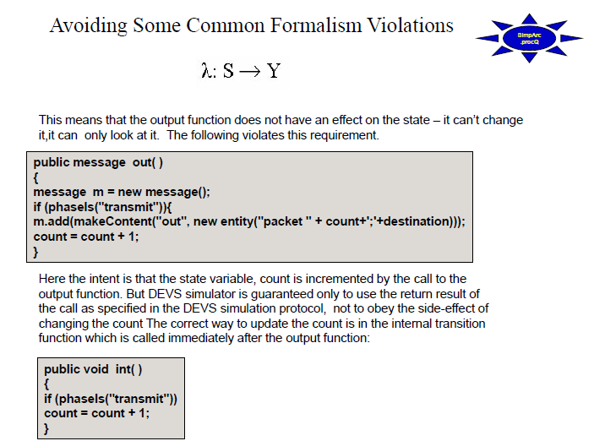

Slide 33
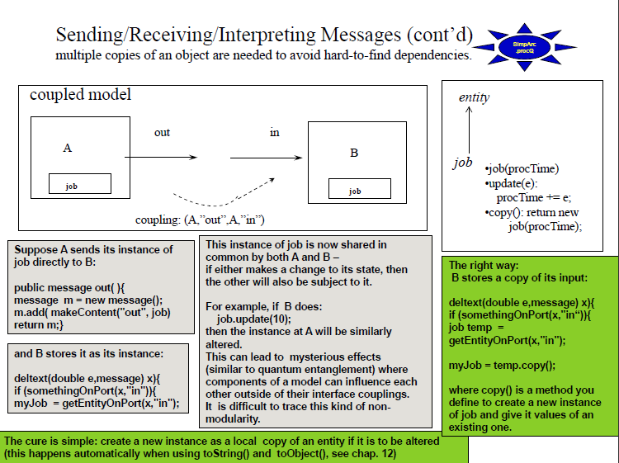

Slide 34
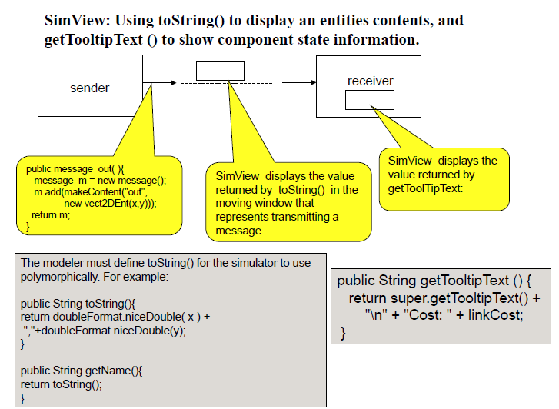

Slide 35
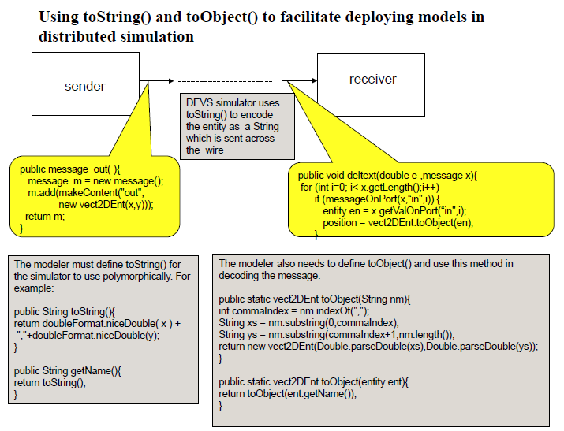

Slide 36
The DEVSJAVA Example: carWashSys
1. To simplify the problem, let’s first assume the system will reject any incoming cars and trucks if it is busy.
2. Test the model: addTestInput( )
3. Test the model: create a car generator and couple it to the carWashCenter
4. Add random numbers in generators
5. Create a truck generator and add to the system
6. Add queue
7. Each car is unique – add vehicleEntity
8. Display message – implement the toString() in vehicleEntity
9. Show model state on SimView -- getTooltipText ()
10. Add transducer
11. Test the model without SimView

